Slide 1
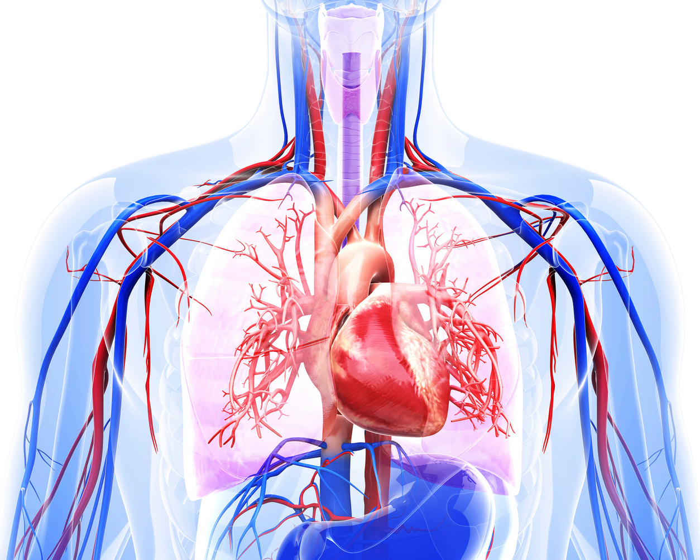

1.1b The Cardiovascular System
thepeclassroom.com

Slide 2
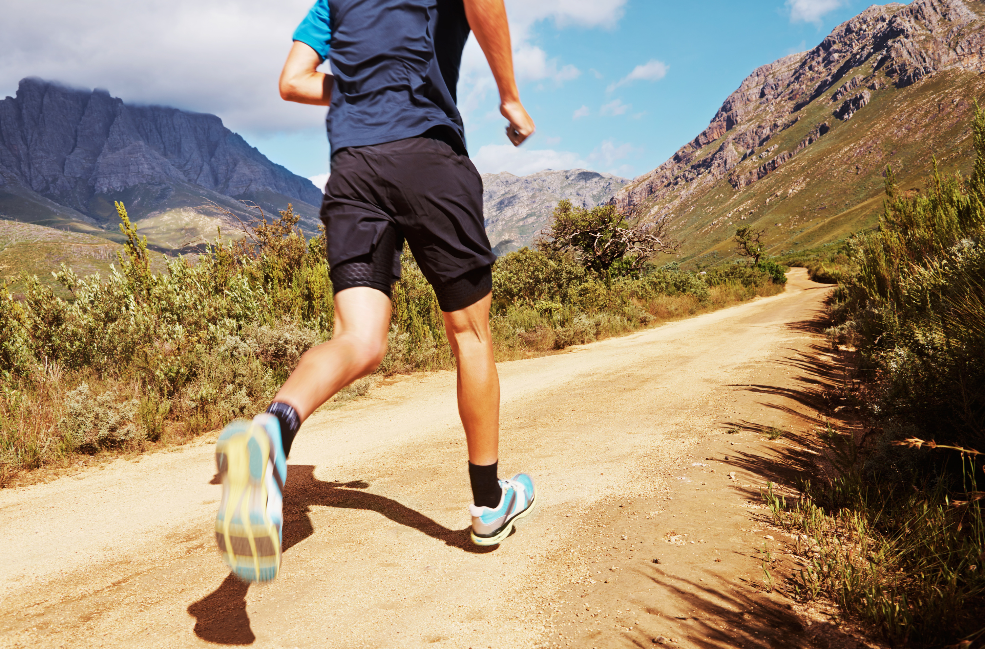
TOPIC AREAS
Cardiovascular system at rest,
Cardiovascular system during exercise of differing intensities and during recovery.

Slide 3
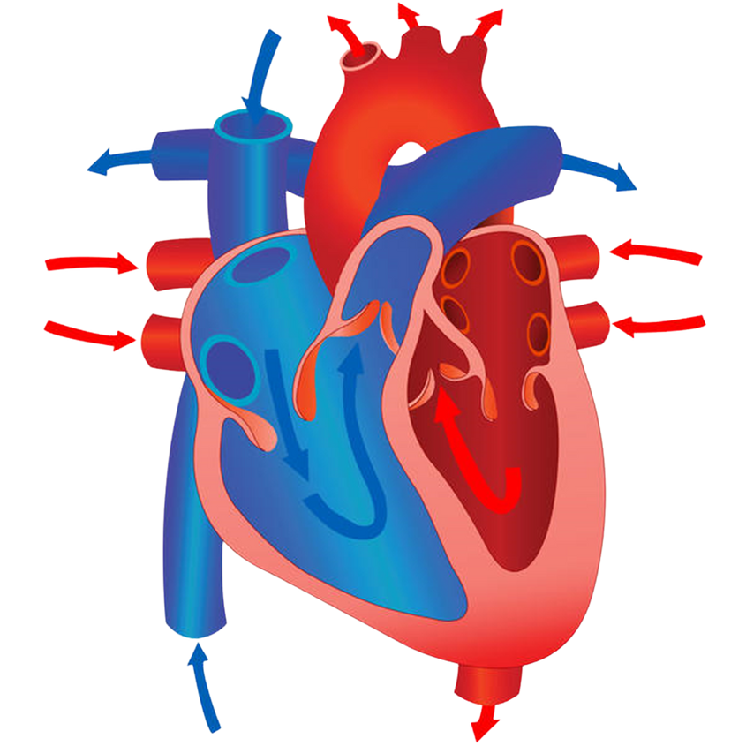
THE HEART
Label the diagram in your booklet with the chambers, arteries, veins and valves of the heart.
Arteries:
Right Pulmonary Artery
Aorta
Left Pulmonary Artery
Chambers:
Right Atrium
Left Atrium
Right Ventricle
Left Ventricle
Veins:
Right Pulmonary Vein
Vena Cava
Left Pulmonary Vein
Valves:
Tricuspid Valve
Bicuspid Valve (x2)
Booklet
Page 2
Septum (cardiac tissue)

Slide 4
THE HEART
Aorta
Vena Cava
Left Pulmonary Artery
Right Pulmonary
Artery
Bicuspid Valve
Right Pulmonary
Vein
Left Pulmonary Vein
Right Atrium
Left Atrium
Tricuspid Valve
Bicuspid Valve
Right Ventricle
Left Ventricle
Booklet
Page 2
Septum

Slide 5


THE HEART
The Pulmonary Circuit carries...
Deoxygenated blood to the lungs via the pulmonary arteries
Oxygenated blood to the heart via the pulmonary veins
The Systemic Circuit carries...
Deoxygenated blood to the heart via the vena cava
Oxygenated blood to the body via aorta.
Booklet
Page 2

Slide 6
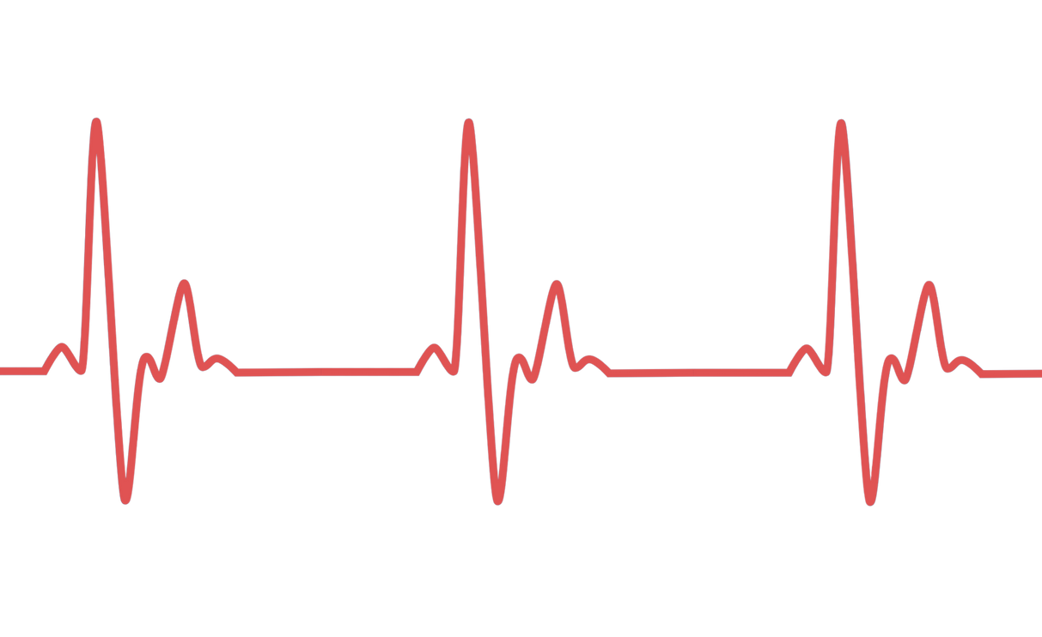
THE CARDIAC CONDUCTION SYSTEM
The cardiac conduction system is a group of cells found in the wall of the heart.
They are responsible for the electrical impulses that cause the artia/ventricles to contract and pump blood towards arteries.
The heart is myogenic, meaning it is capable of generating its own electrical impulses.
Booklet
Page 3

Slide 7
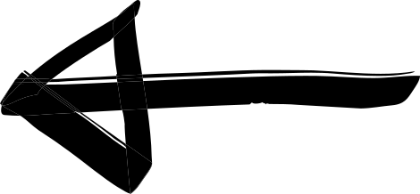
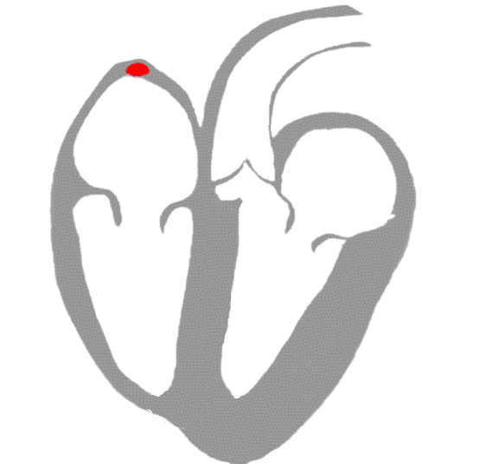
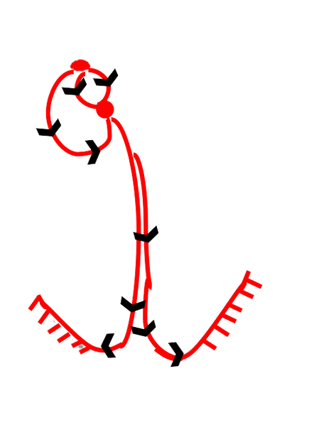
CARDIAC CONDUCTION SYSTEM
Electrical signal begins in the Sinoatrial Node (SAN)
(Ventricular contraction)
The Bundle of His then separates into smaller branches called purkinje fibres. These spread around the ventricles and cause them to contract.
The electrical impulse travels through the atria, causing them to contract and pass blood into the ventricles, before reaching the Atrioventricular Node (AVN)
The electrical impulse then travels down the Bundle of His, which is located in the septum
(Atrial contraction)
A delay of 0.1 seconds then occurs whilst the atria fully contract and empty

Slide 8
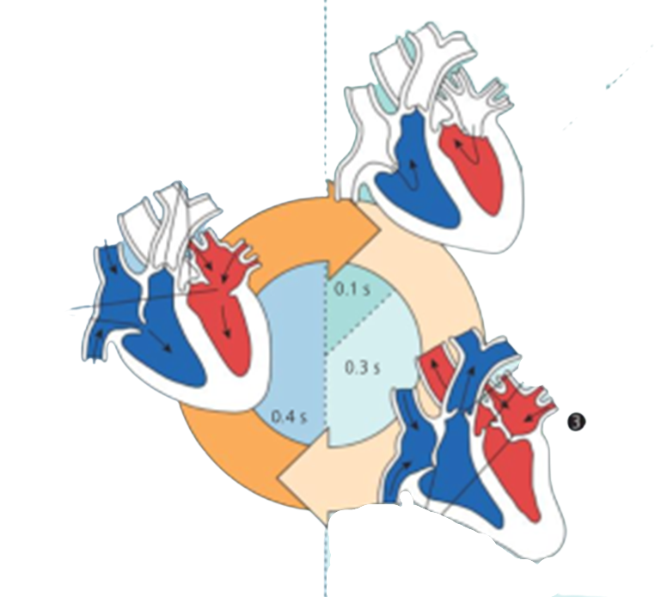
CARDIAC CYCLE
Booklet
Page 4
The cardiac cycle is the cardiac muscle contraction and movement within the chambers:
Cardiac Diastole
2 Atrial Systole
The contraction of atria muscle walls.
As they contract, the remaining blood is forced into the ventricles.
The relaxation of the cardiac muscle.
The increases volume and decreased pressure allows blood to enter the atria.
3. Ventricular Systole
The increased pressure in the atria opens the AV valve, allowing blood to enter the ventricles.
As ventricles contract, pressure increases and AV valves close to prevent backflow into the atria.
SL forced open and blood is ejected into the aorta and pulmonary artery.

Slide 9
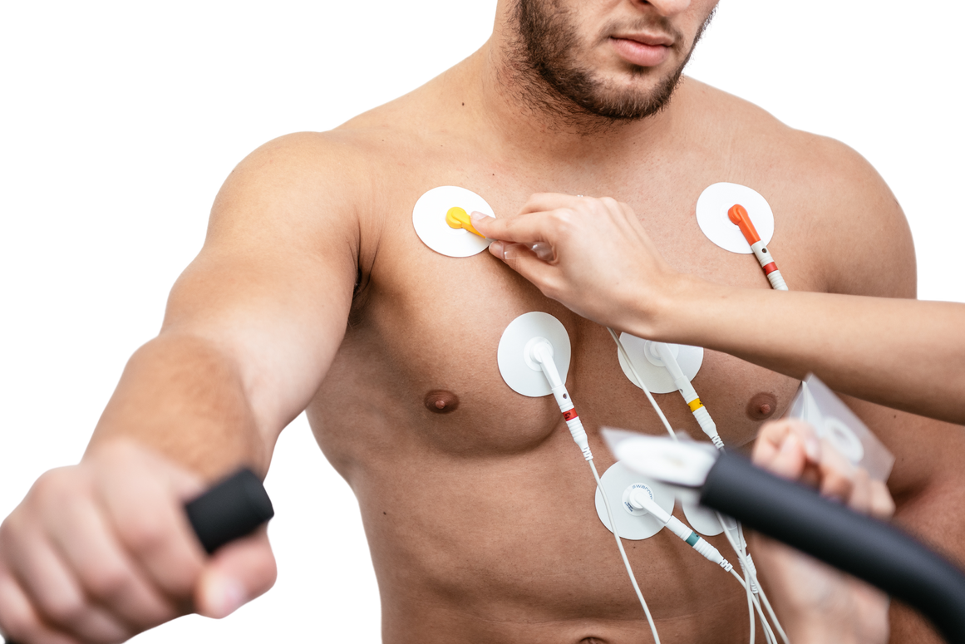
ASSESSING 'FITNESS'
We can measure the performer's stroke volume and use that to calculate their cardiac output.
Heart Rate = The number of cardiac cycles (beats) per minute.
Stroke Volume = The volume of blood pumped out by the heart ventricles in each contraction.
A heart rate lower than 60bpm is considered bradycardia, resulting from cardiac hyperthophy.
Stroke volume depends on two factors;
The 'venous return'
The 'ventricular elasticity and contractility'
Booklet
Page 5

Slide 10
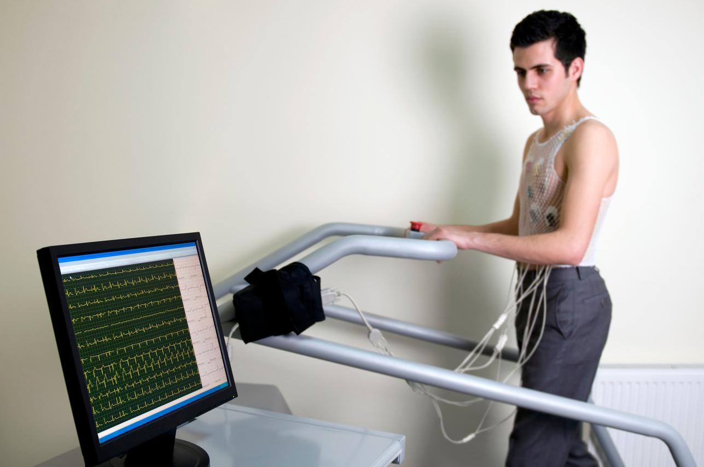
ASSESSING 'FITNESS'
We can measure the performer's stroke volume and use that to calculate their cardiac output.
Heart Rate = The number of cardiac cycles (beats) per minute.
Stroke Volume = The volume of blood pumped out by the heart ventricles in each contraction.
Cardiac Output = The volume of blood (litres) pumped out by the heart ventricles per minute.
(Heart Rate x Stroke Volume)
Discuss with a partner what you'd expect to happen to stroke volume and cardiac output during exercise?

Slide 11
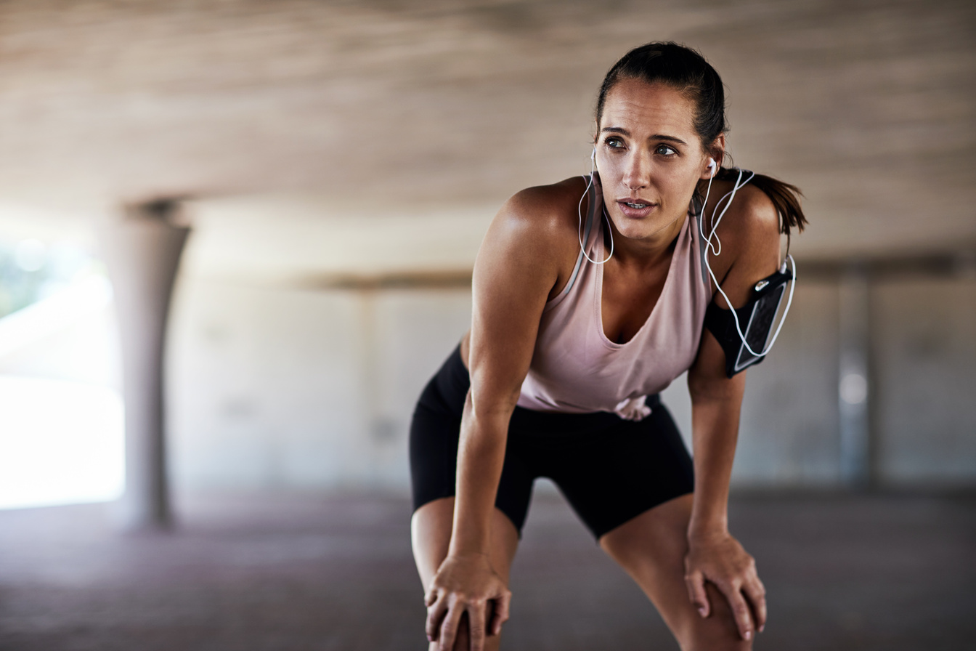

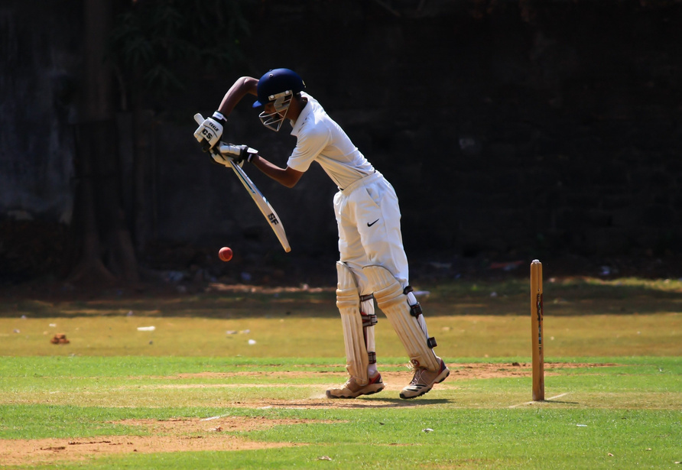
FITNESS
MAXIMAL AND SUBMAXIMAL
Booklet
Page 5
Generally, stroke volume and cardiac outout increase during physical activity. However, there are exceptions relating to the intensity of the activity.
Maximal intensity exercise causes you to exceed 85% of your maximum heart rate.
Submaximal intensity exercise causes your heart rate to increase to up to 85% of your maximum heart rate.

Slide 12
STROKE VOLUME IN SUB-MAXIMAL EXERCISE
The table shows the stroke volume (ml) of a performer exercising at different sub-maximal intensities.
Time | Stroke Volume (ml) | Heart Rate Estimate
1 min (30% max effort) | 80
2 min (40% max effort) | 120
3 min (50% max effort) | 140
4 min (60% max effort) | 160
A persons maximum heart rate is
estimated using the calculation 220-age.
The performer was 18 years old. Estimate their heart rate at each minute. Explain your estimations.
Booklet
Page 6

Slide 13
STROKE VOLUME IN SUB-MAXIMAL EXERCISE
Time | Stroke Volume (ml) | Heart Rate Estimate
1 min (30% max effort) | 80 | 60
2 min (40% max effort) | 120 | 80
3 min (50% max effort) | 140 | 101
4 min (60% max effort) | 160 | 121
An 18 year old's maximum heart rate is 202 (220-18).
So, at 30% max effort, heart rate would be about 30% of 202.
202 x 0.3 = 60.6 so 60 beats per minute.

Slide 14
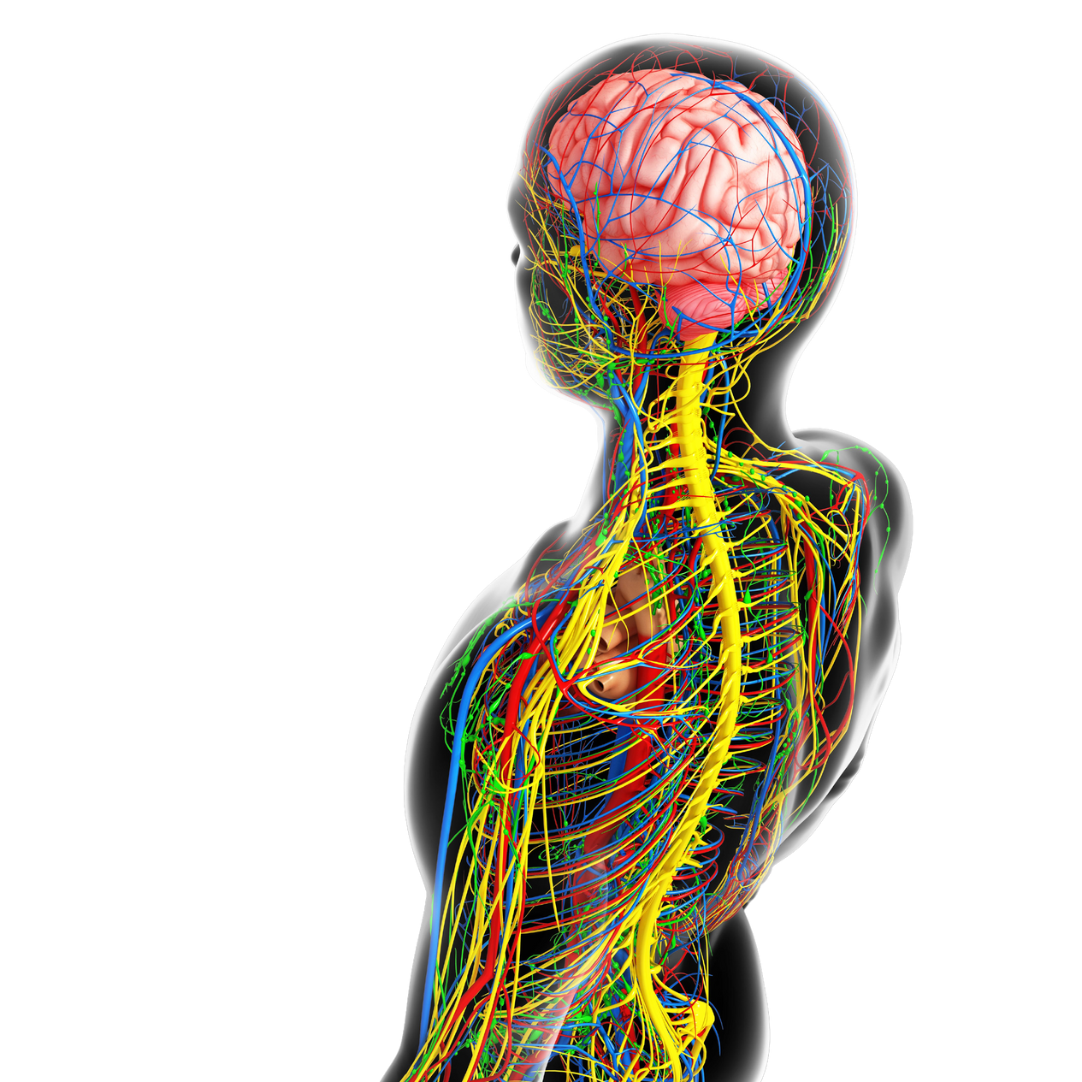
ANCITIPATORY RISE
An anticipatory rise is an increase heart rate that occurs just before taking part in exercise. It is cause by increased activity of the sympathetic nervous system.
The Sympathetic Nervous System
A part of the Autonomic Nervous System
Located in the brain
Activated when a 'fight or flight' response is required, increasing heart rate.
Booklet
Page 6

Slide 15
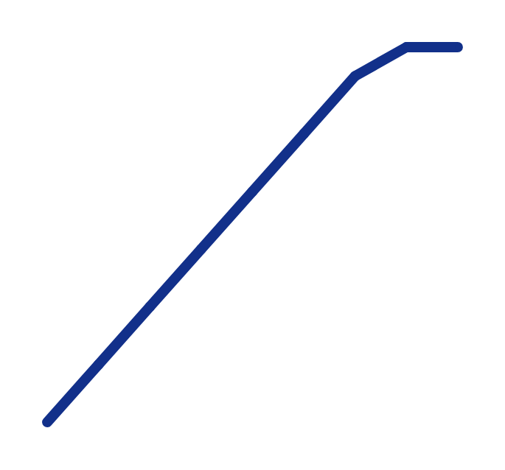
ANCITIPATORY RISE
HRmax
200
During sustained sub-maximal exercise, heart rate plateaus as the supply of oxygen meets the demand.
Heart rate (HR) (beats/min)
Booklet
Page 6
0
100%
Relative exercise intensity

Slide 16
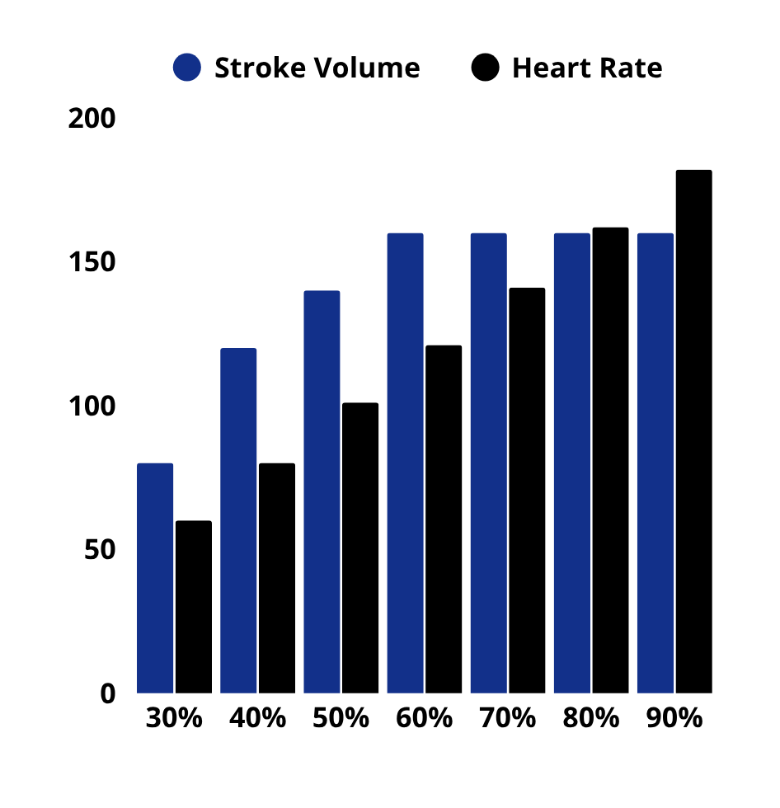
STROKE VOLUME IN MAXIMAL EXERCISE
Stroke volume will only continue to rise up to around 60% maximal effort, even as heart rate continues to rise.
At this point, stroke volume plateaus as the heart rate is too high for ventricles to fill up with blood before the next contraction.
Booklet
Page 7

Slide 17
STROKE VOLUME IN MAXIMAL EXERCISE
Fill in the table to show what would happen to stroke volume at heart rate above 60% maximum effort.
Time | Stroke Volume (ml) | Heart Rate Estimate
1 min (30% max effort) | 80 | 60
2 min (40% max effort) | 120 | 80
3 min (50% max effort) | 140 | 101
4 min (60% max effort) | 160 | 121
5 min (70% max effort)
6 min (80% max effort)
7 min (90% max effort)
Booklet
Page 7

Slide 18
STROKE VOLUME IN MAXIMAL EXERCISE
Time | Stroke Volume (ml) | Heart Rate Estimate
1 min (30% max effort) | 80 | 60
2 min (40% max effort) | 120 | 80
3 min (50% max effort) | 140 | 101
4 min (60% max effort) | 160 | 121
5 min (70% max effort) | 160 | 141
6 min (80% max effort) | 160 | 162
7 min (90% max effort) | 160 | 182
If stroke volume does not increase at maximal exercise, how do your working muscles continue to get the oxygen they require?
Booklet
Page 7

Slide 19
STROKE VOLUME IN MAXIMAL EXERCISE
As heart rate continues to increase, the amount of oxygen being supplied per minute (cardiac output) to working muscles continues to increase.
Booklet
Page 7

Slide 20
CARDIAC OUTPUT
Cardiac Output = Heart Rate x Stroke Volume
IMPORTANT!
Stroke volume is usually measured in ml. However, cardiac output it measured in litres/min.
Therefore, remember to either DIVIDE stroke volume by 1000 before calculating or divide your calucation by 1000 to report cardiac output correctly.
Booklet
Page 7

Slide 21
CARDIAC OUTPUT
Add cardiac output to the table.
Time | Stroke Volume (ml) | Heart Rate Estimate | Cardiac Output (litres/min)
1 min (30% max effort) | 80 | 60
2 min (40% max effort) | 120 | 80
3 min (50% max effort) | 140 | 101
4 min (60% max effort) | 160 | 121
5 min (70% max effort) | 160 | 141
6 min (80% max effort) | 160 | 162
7 min (90% max effort) | 160 | 182

Slide 22
CARDIAC OUTPUT
Time | Stroke Volume (ml) | Heart Rate Estimate | Cardiac Output (litres/min)
1 min (30% max effort) | 80 | 60 | 4.8
2 min (40% max effort) | 120 | 80 | 9.6
3 min (50% max effort) | 140 | 101 | 14.1
4 min (60% max effort) | 160 | 121 | 19.4
5 min (70% max effort) | 160 | 141 | 22.6
6 min (80% max effort) | 160 | 162 | 25.9
7 min (90% max effort) | 160 | 182 | 29.1
Using the table, explain what happens to Cardiac Output when exercising at submaximal and maximal levels.

Slide 23
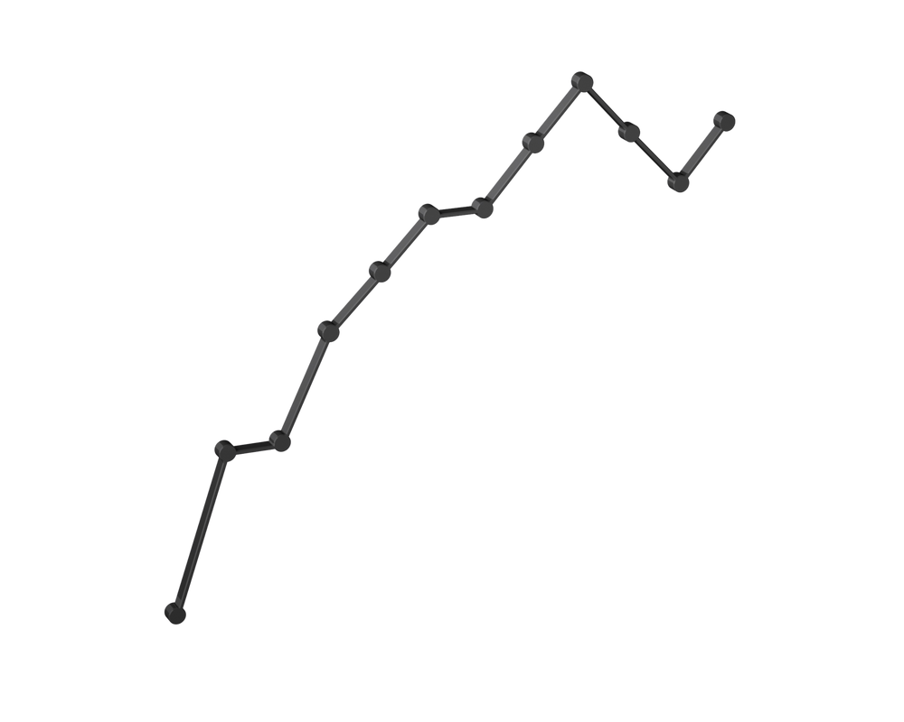
CARDIAC OUTPUT
Use graph paper to plot two line graphs, showing the results from i) table 2, and ii) the results from table 3.
Booklet
Page 8

Slide 24
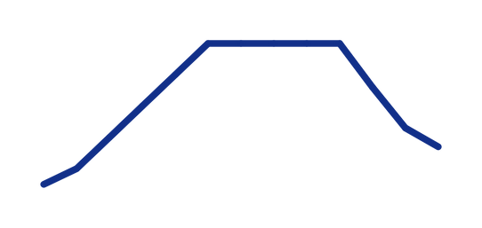
RECOVERY
Once exercise has ended, there is a gradual decrease in heart rate.
During recovery, the body needs to maintain blood/oxygen supplies and the removal of waste.
Therefore, stroke volume is maintained in order to maintain blood supply.
Rapid increase
Rapid decrease
HR (bpm)
Anticipatory rise
Steady
state
Exercise
Recovery
0
Pre-exercise
Cardiac output decreases rapidly at first, then more slowly back to resting levels.
Booklet
Page 8

Slide 25
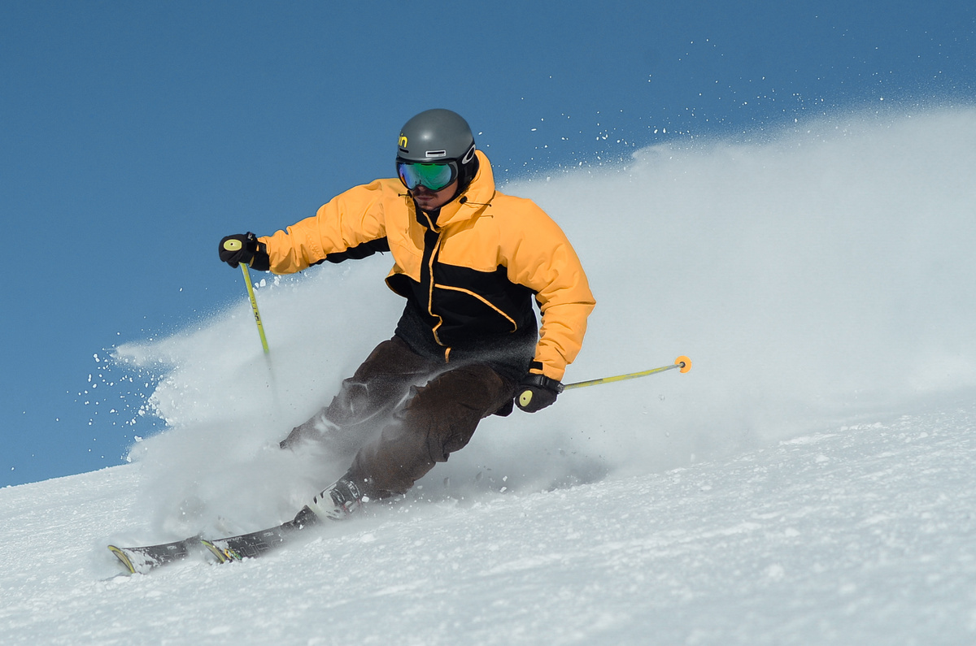
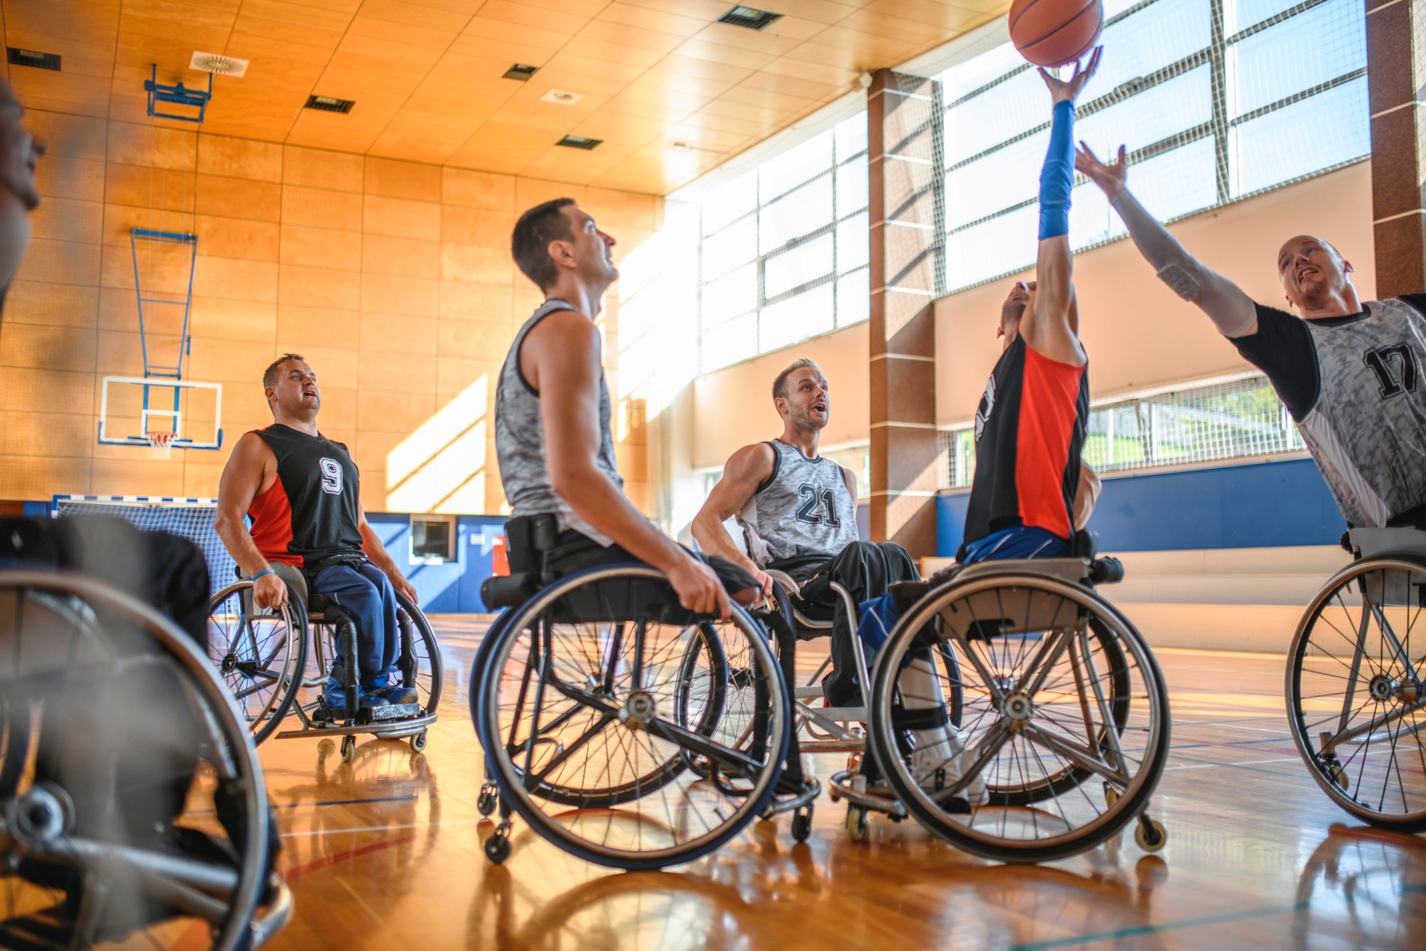
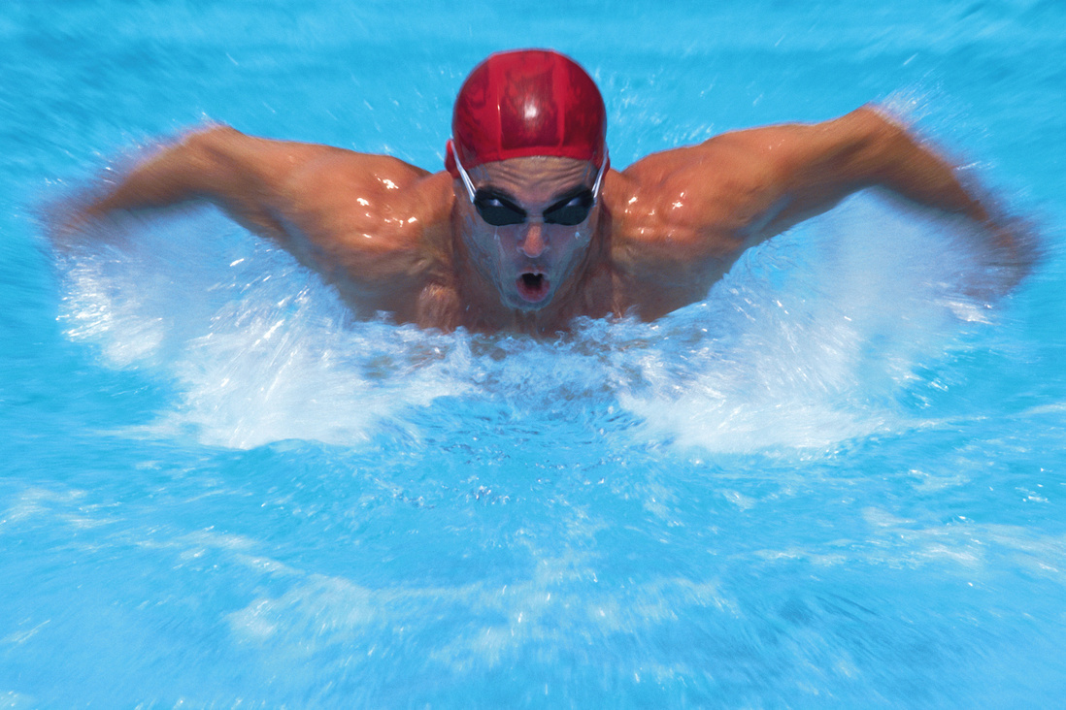
REDISTRIBUTION OF BLOOD FLOW
During exercise, blood must be distributed to the areas of the body that require increased oxygen supplies.
In order to do this, blood flow is redistributed through a mechanism called vascular shunting.
How would the following performers benefit from the vascular shunt mechanism?
Booklet
Page 9
Consider which muscle groups require more oxygen.

Slide 26
REDISTRIBUTION OF BLOOD FLOW
Vascular shunting results in increased oxygen delivery to the:
Quadriceps
Hamstrings
Biceps
Triceps
Deltoids
Pectorals
Arm muscles
Leg muscles

Slide 27
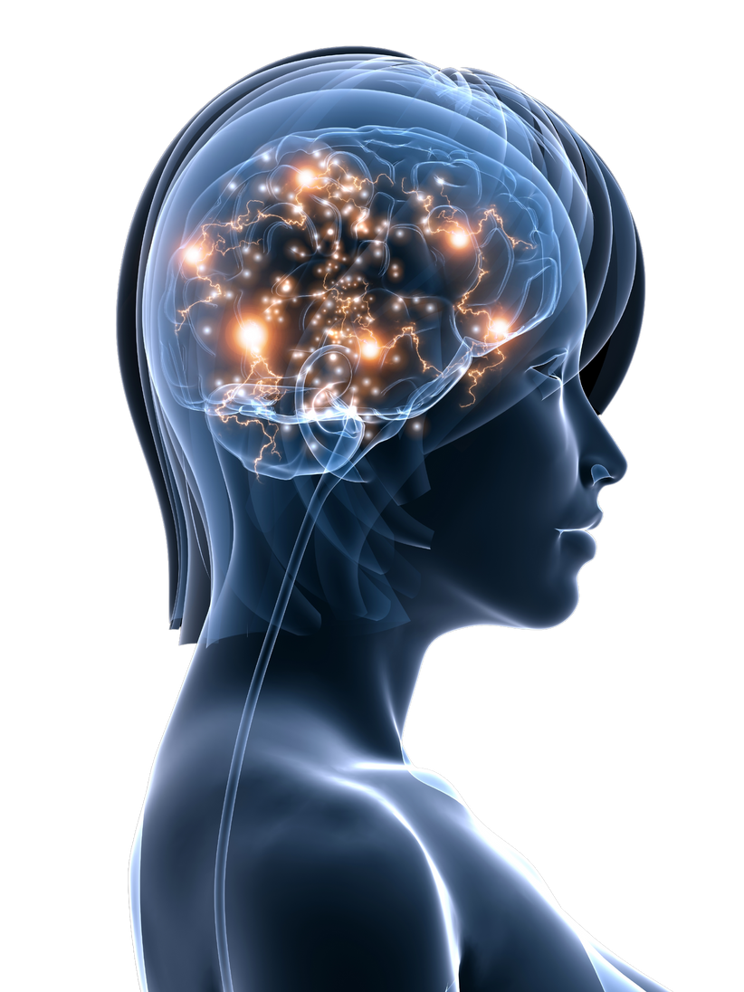
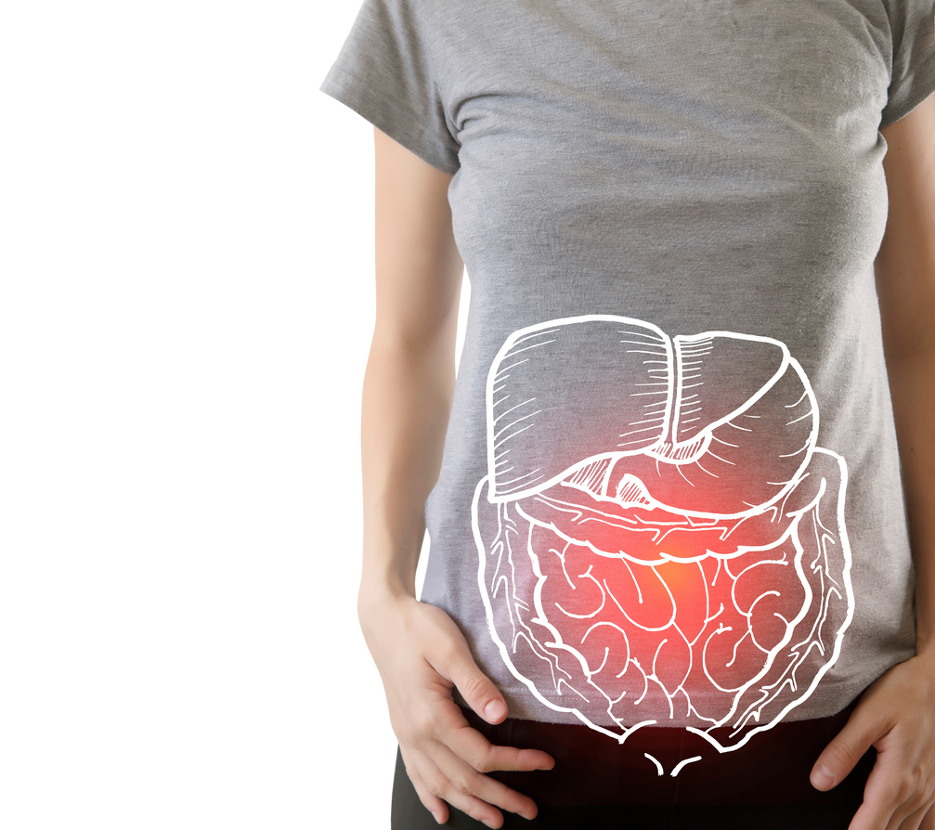
REDISTRIBUTION OF BLOOD FLOW
The brain requires the same amount of oxygen at rest and during exercise.
However, the digestive system will require increased oxygen supplies after eating for digestion.
Eating just before exercising can cause a conflict between the demands of muscles and the digestive system, causing cramps and stomach pain.
Booklet
Page 9

Slide 28
VASODILATION AND VASOCONSTRITION
Vasoconstriction and vasodilation are the mechanisms used by blood vessels to dictate blood flow to different areas of the body.
VasoDILATion - blood vessels DILATE (get bigger)
Allows MORE blood for the active muscles
VasoCONSTRICTion - blood vessels CONSTRICT (get smaller)
Takes blood AWAY from inactive areas and organs

Slide 29
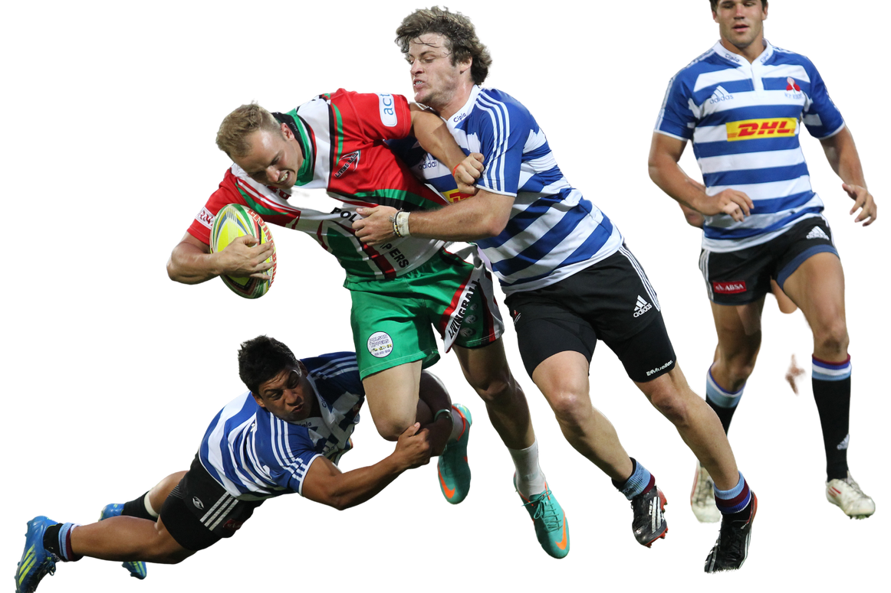
VASODILATION
Vasodilatedartery
Normal artery
During a rugby match, vasodilation will occur in arteries delivering oxygenated blood to the performers leg.
This allows more oxygen to be delivered to active muscles, allowing more aerobic respiration to take place to produce more energy.
Booklet
Page 10

Slide 30
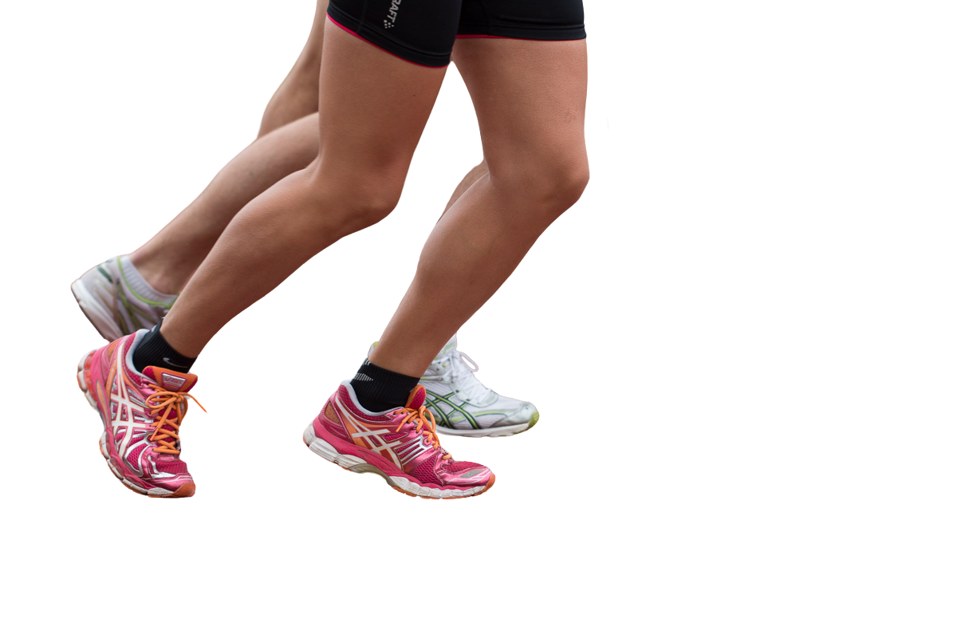
VASOCONSTRICTION
Normal artery
Vasoconstricted artery
During exercise, arteries delivering blood to areas such as the digestive system and the liver are constricted.
This diverts a larger proportion of the performers blood supply to their muscles.
Booklet
Page 10

Slide 31

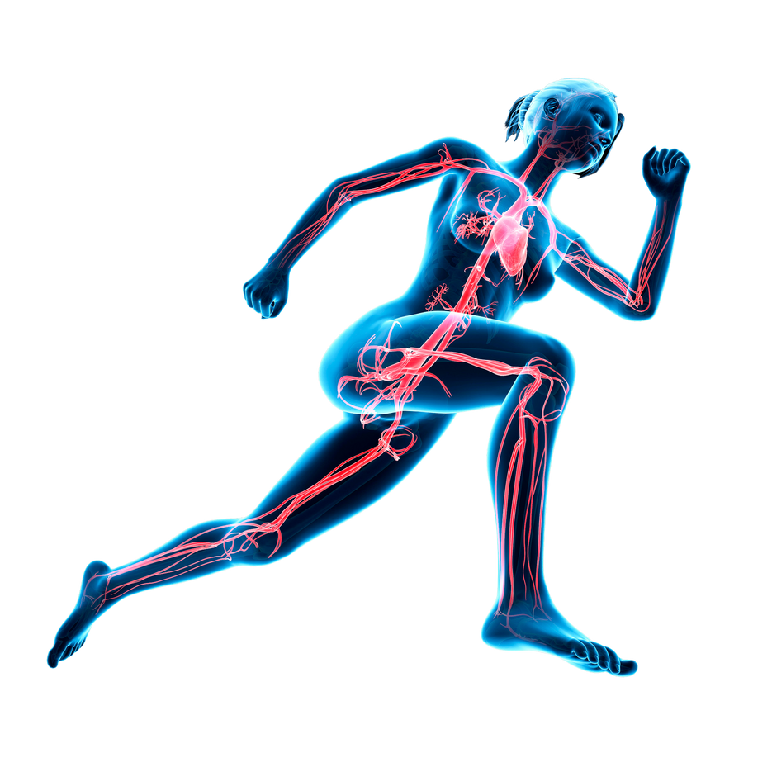
PROCESS OF VASCULAR SHUNTING
Increase in CO2 and Lactic Acid detected by the Chemoreceptors
Chemoreceptors stimulate the Vasomotor
The Vasomotor signals for a redistribution of blood flow
Vasodilation and Vasoconstriction occur and the pre-capillary sphincters adjust blood flow into the capillaries.

Slide 32
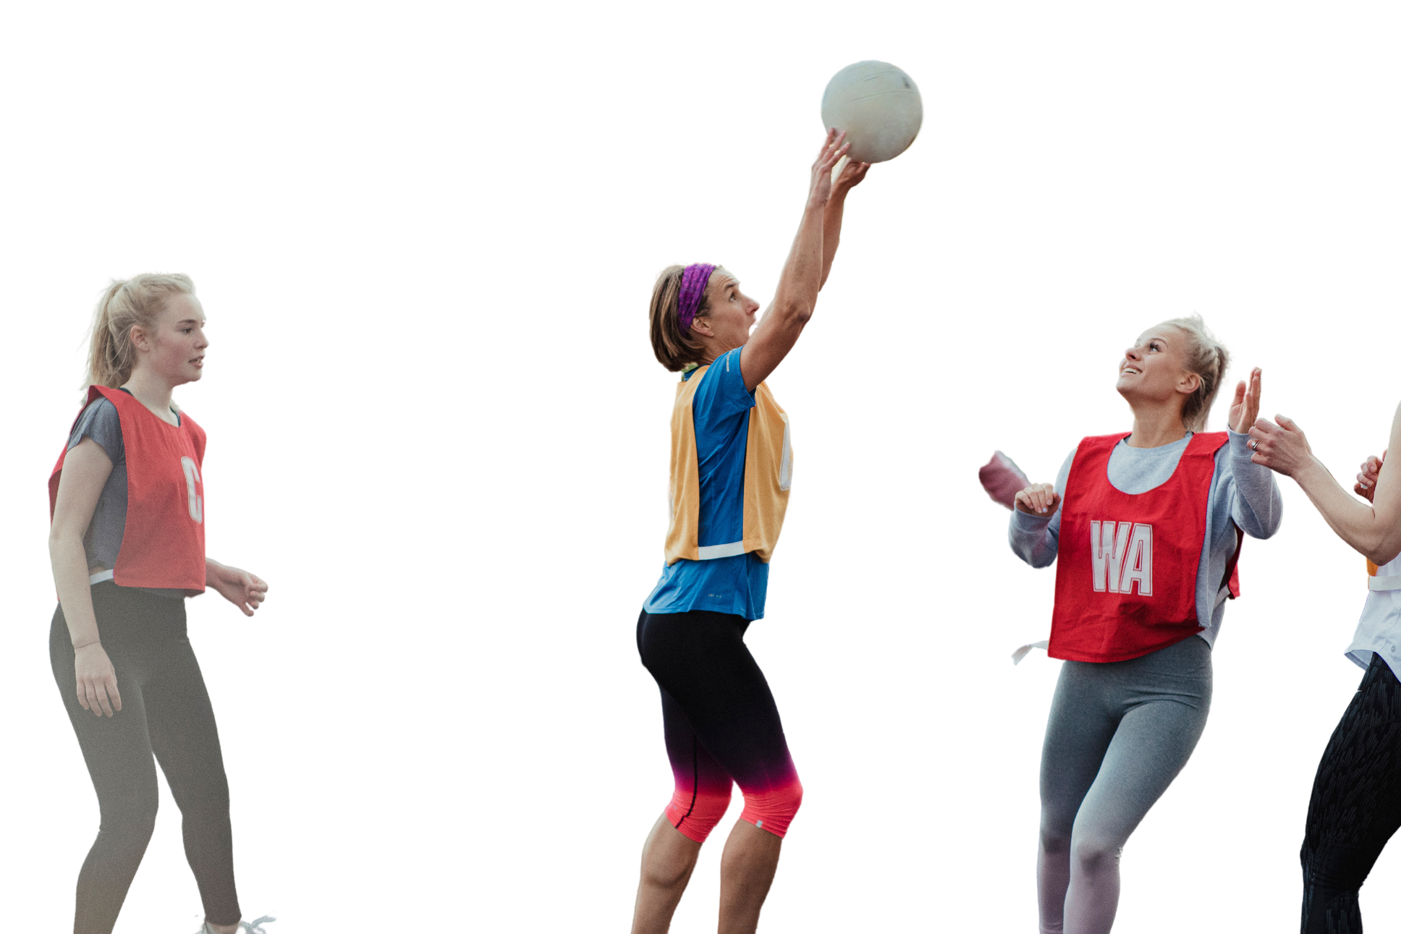
PROCESS OF VASCULAR SHUNTING
How does vascular shunting occur in order to benefit a netball players during a match?

Slide 33
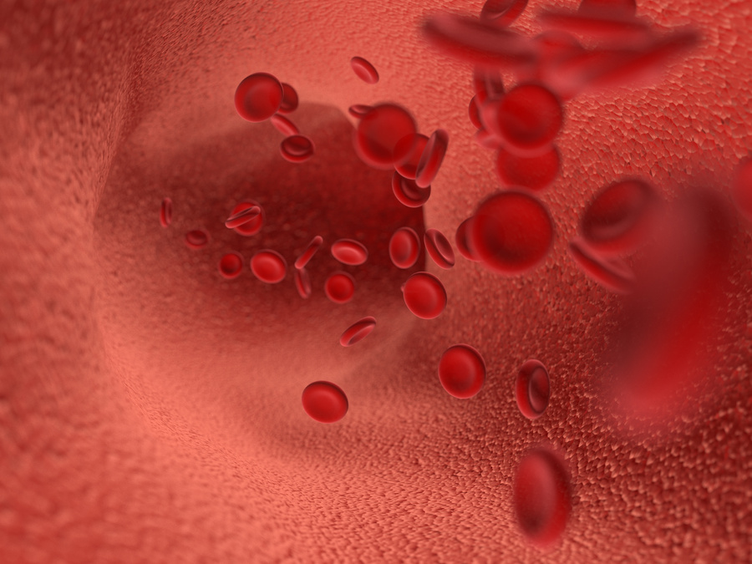
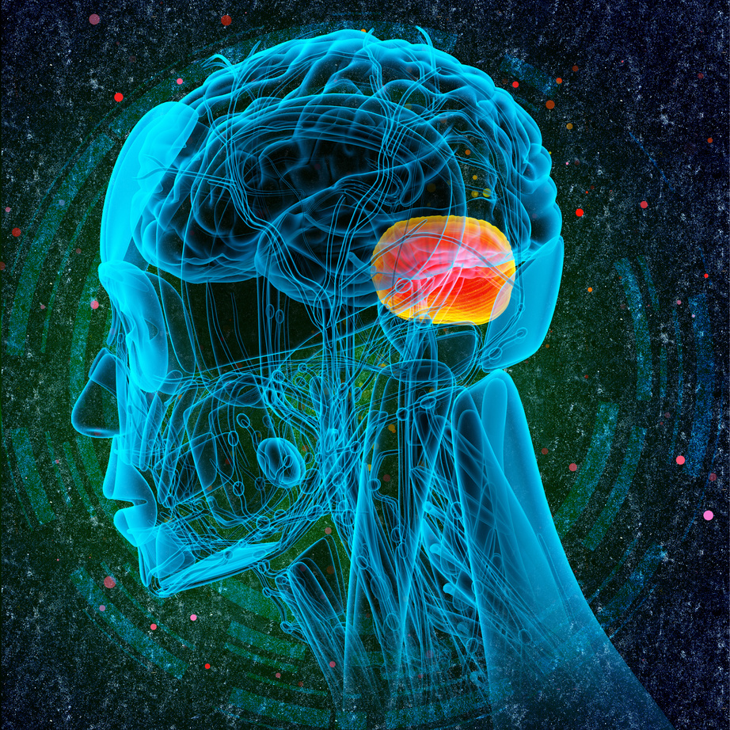
PROCESS OF VASCULAR SHUNTING
Chemoreceptors detect a change in blood acidity/CO2 levels. They are located in the wall of arteries.
The Vasomotor is located in the Medulla Oblongata in the brain and is responsible for the regulation of heart rate, blood pressure and the redistribution of blood flow.
Booklet
Page 11

Slide 34
SYMPATHETIC V PARASYMPATHETIC SYSTEMS
During exercise, the heart rate of an individual needs to change to meet certain demands.
The Cardiac Control Centre (CCC) in the medulla oblongata in the brain receives information from sensory nerves and sends information to motor nerves.
Heart rate can be regulated by:
Neural Controls
Intrinsic Controls
Hormonal Controls
Booklet
Page 12

Slide 35


SYMPATHETIC V PARASYMPATHETIC SYSTEMS
The activation of the sympathetic or parasympathetic nervous systems result in different changes in heart rate...
Sympathetic system increases the number of cardiac impulses, increasing heart rate (e.g. during exercise).
Parasympathetic system decreases the number of cardiac impulses, decreasing heart rate
(e.g. at rest).
Both are controlled by the medulla oblongata in the brain.
Booklet
Page 12

Slide 36
CHEMORECEPTORS
Fill in the blanks
During exercise the chemoreceptors detect an increase in carbon dioxide. Nerve impulses
are therefore sent to the medulla oblongata in the brain and the sympathetic nervous
system is activated and impulses are sent to the SA node in order for contractions to
increase. This will lead to an increase in heart rate and the supply of oxygen for the body.

Slide 37
BARORECEPTORS
Fill in the blanks
The baroreceptors detect an increase or decrease in blood pressure by detecting the stretching of the arterial wall. An increase in arterial pressure will result in the baroreceptors sending a message to the medulla oblongata in the brain. The parasympathetic system will then be activated and impulses are sent to the SA node for contractions to decrease. However during exercise the baroreceptor set point increases, so that heart rate does not slow down.

Slide 38
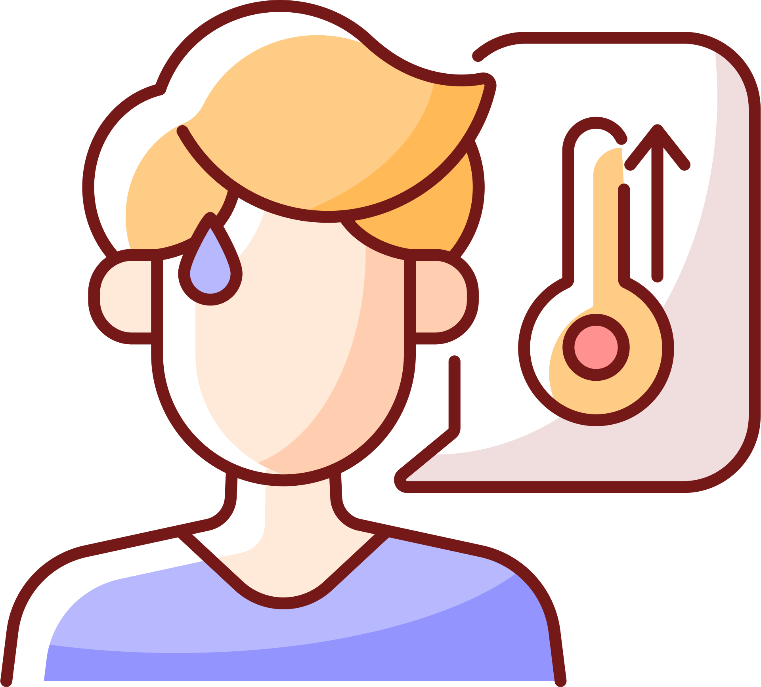
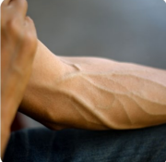
INTRINSIC CONTROL
Temperature changes will affect the viscosity (thickness) of the blood therefore the speed of nerve impulse transition.
Venous return changes affect the stretch in the ventricle walls, force of contraction and stroke volume.
Booklet
Page 13

Slide 39
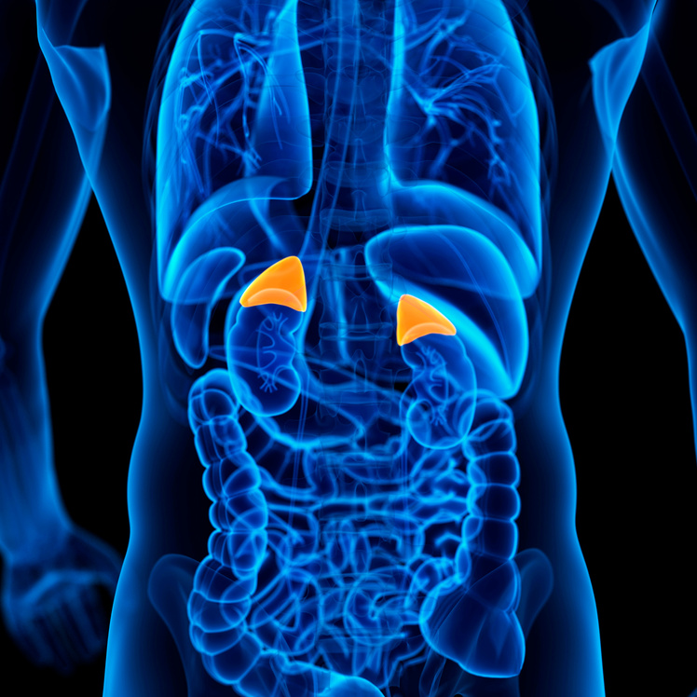

HORMONAL CONTROL
The sympathetic nervous system causes the release of adrenaline and noradrenaline from the adrenal glands.
Their release increases the force of ventricular contraction and speed of electrical activity
The parasympathetic nervous system releases acetylcholine which decreases heart rate.
Booklet
Page 13

Slide 40
VENOUS RETURN
Venous return is the flow of blood back to the heart, via the veins and specifically the vena cava.
During exercise, venous return increases. As a return, more blood will get ejected from the heart into the arteries as well (stroke volume).
The blood in the veins is at a much lower pressure than in the arteries, particularly in the vena cava. Why do you think this is?
Booklet
Page 13

Slide 41
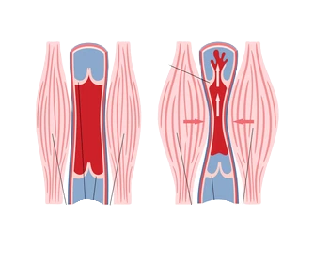
VENOUS RETURN MECHANISMS
1. The Skeletal Muscle Pump – Muscles contracting and relaxing are constantly changing shape. This results in muscles pressing on nearby veins. This causes a pumping action, which pushes blood back towards the heart.
Booklet
Page 14

Slide 42
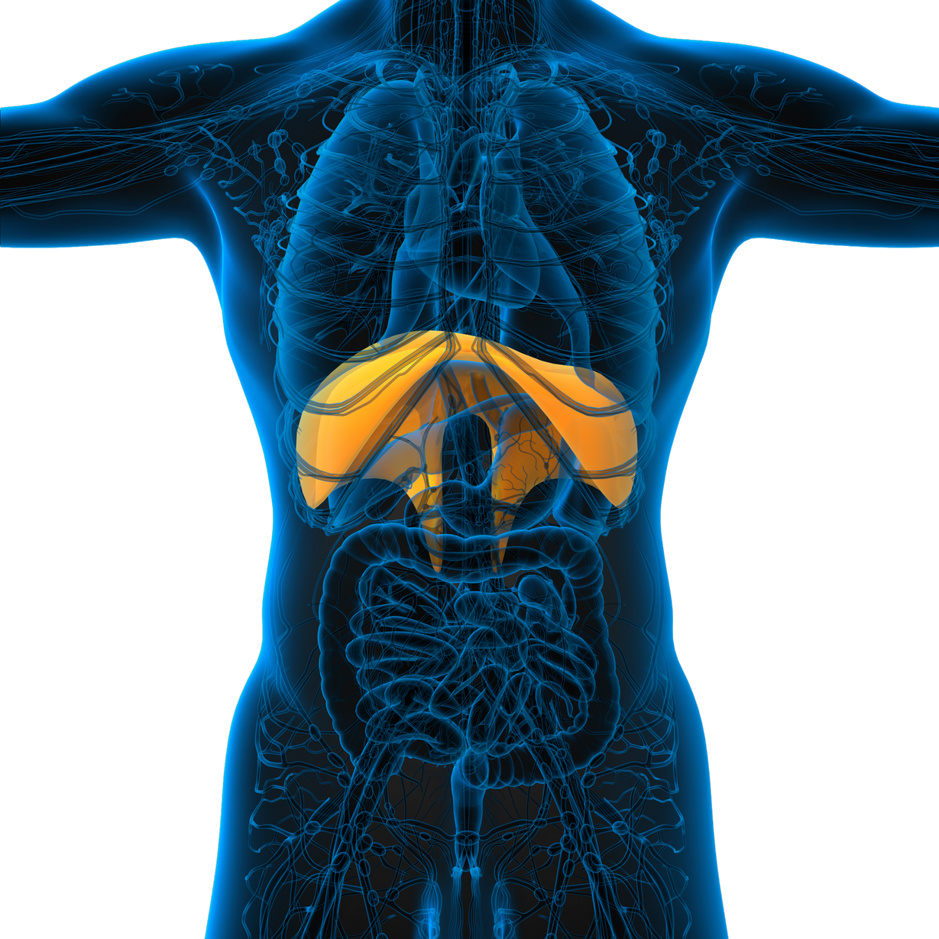
VENOUS RETURN MECHANISMS
2. The Respiratory Pump - Breathing in and out causes contractions in many muscles, as well as the diaphragm. This causes a constant change in the pressure of the thoracic (chest) cavity, compressing the veins and causing venous return.
Booklet
Page 14

Slide 43
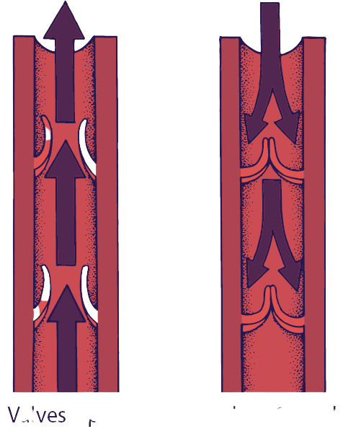
VENOUS RETURN MECHANISMS
3. Pocket Valves - Veins are full of pocket valves. As blood passes through these valves, they close in order to prevent the backflow of blood.
Booklet
Page 14

Slide 44

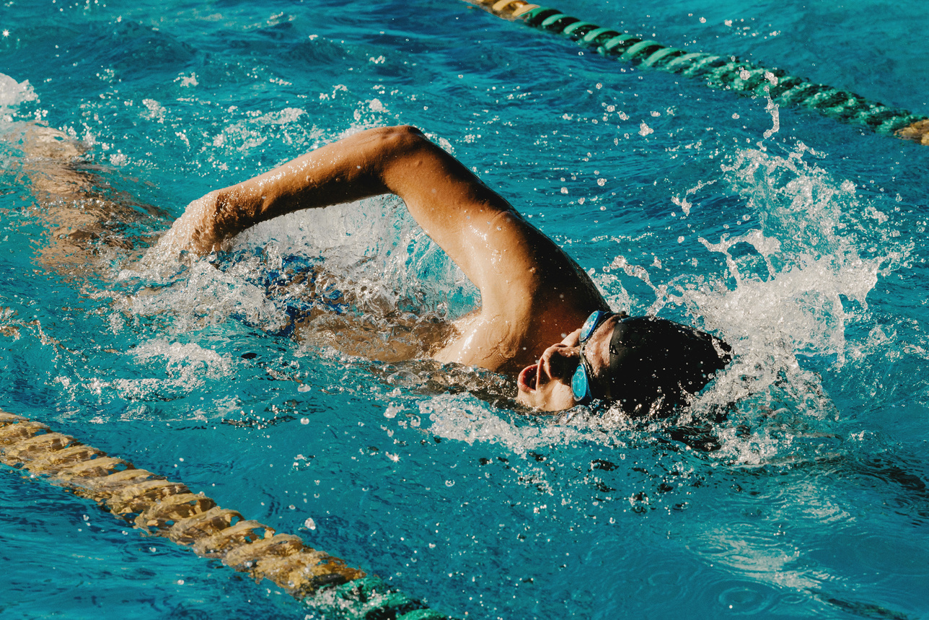
VENOUS RETURN
Venous return is also aided by 'smooth muscle', 'gravity', and the 'suction pump' of the heart.
Do some of your own research to find out about these factors.
How would swimming effect the venous return mechanisms?
Booklet
Page 14+15
Apply information about mechanisms to your answer

Slide 45
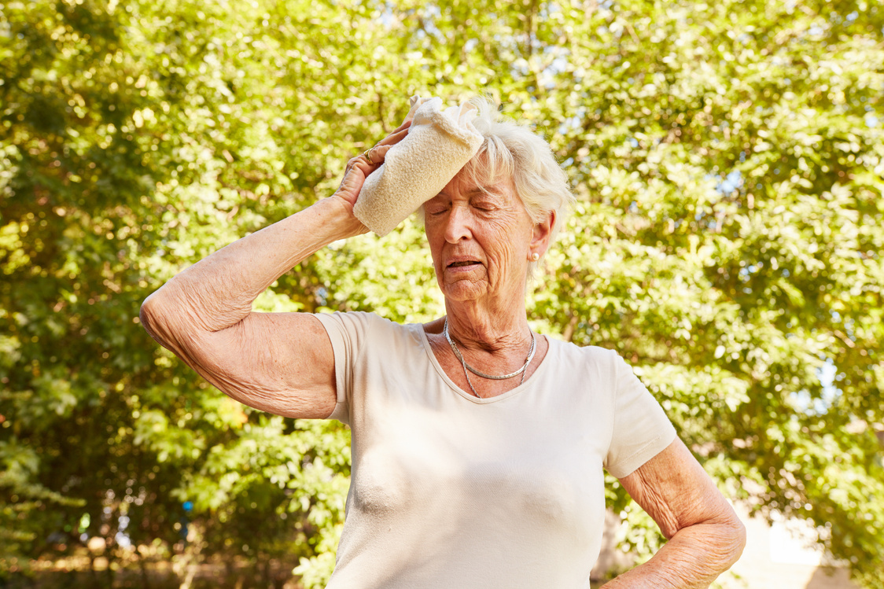
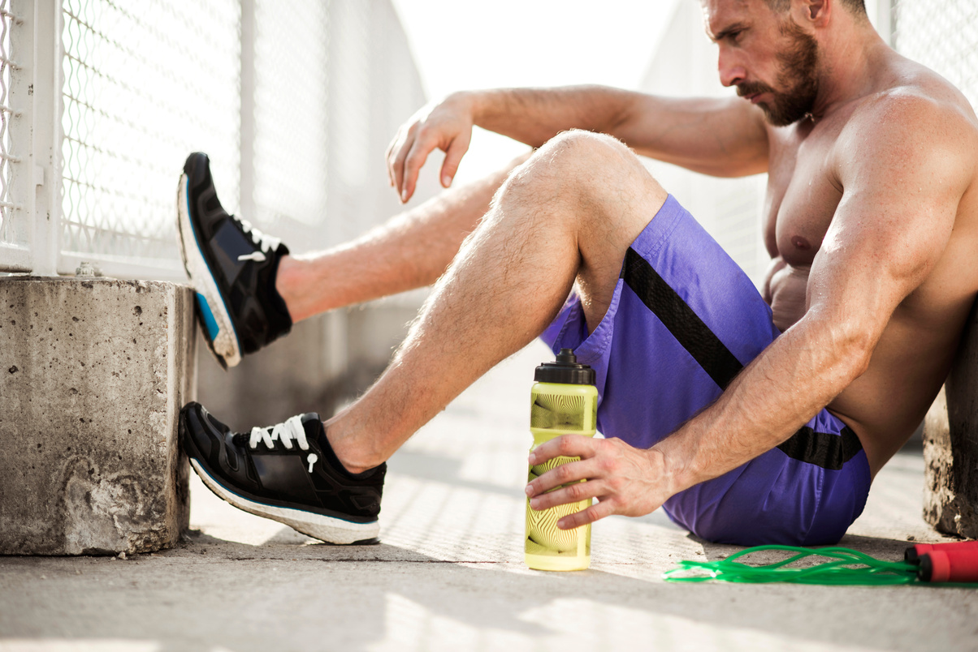
VENOUS RETURN
As exercise is coming to an end, cardiac output remains high.
But, sometimes not enough blood is returned back to the heart in comparison to that being ejected, causing feelings of dizziness.
Also, blood pooling can occur, aka ‘heavy legs’. Therefore, an active recovery is needed to prevent this, which includes low-intensity exercise to maintain muscle and respiratory pump.

Slide 46
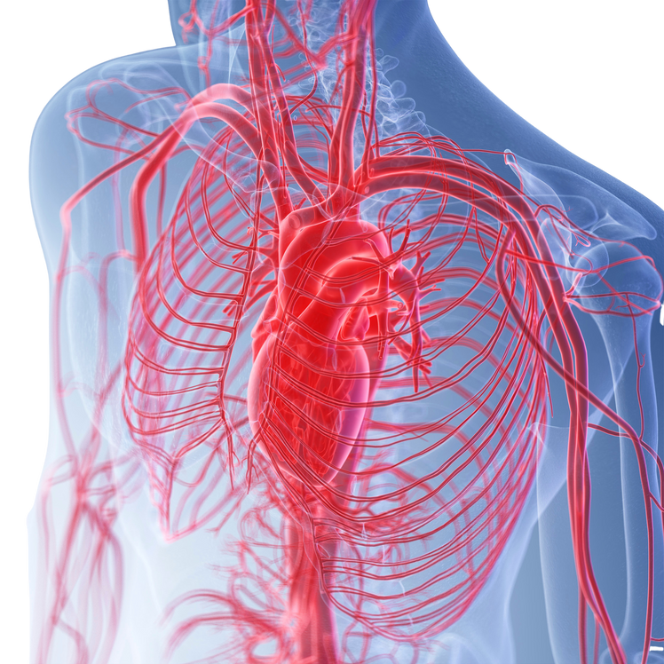
STARLING'S LAW
There is an increase in venous return
Starling's Law states that stroke volume increases in response to an increase in venous return.
Therefore greater diastolic filling of the heart occurs
This causes the cardiac muscle to be stretched
Resulting in a more powerful contraction and increased ejection fraction (stroke volume)
Booklet
Page 29

Slide 47
SAMPLE EXAM QUESTIONS
At the start of an endurance cycling event, a cyclist will experience a redistribution of cardiac output. Explain how and why the vascular shunt mechanism redistributes blood in a cyclist as they begin cycling at the start of the event. (5 marks)
2.a. Calculate the cardiac output when the heart rate is 180bpm. Show your working. (2 marks)
b. Explain the changes to stroke volume during sub maximal exercise. (3 marks)
3. When a performer is running, blood is redirected to the working muscles. Explain how this redistribution of blood is achieved. (3 marks)

