Slide 1
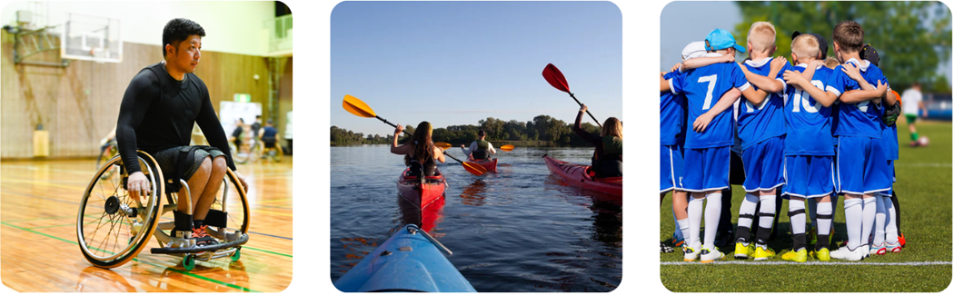

Component 3A: Explore the Importance of Fitness for Sports Performance
thepeclassroom.com

Slide 2
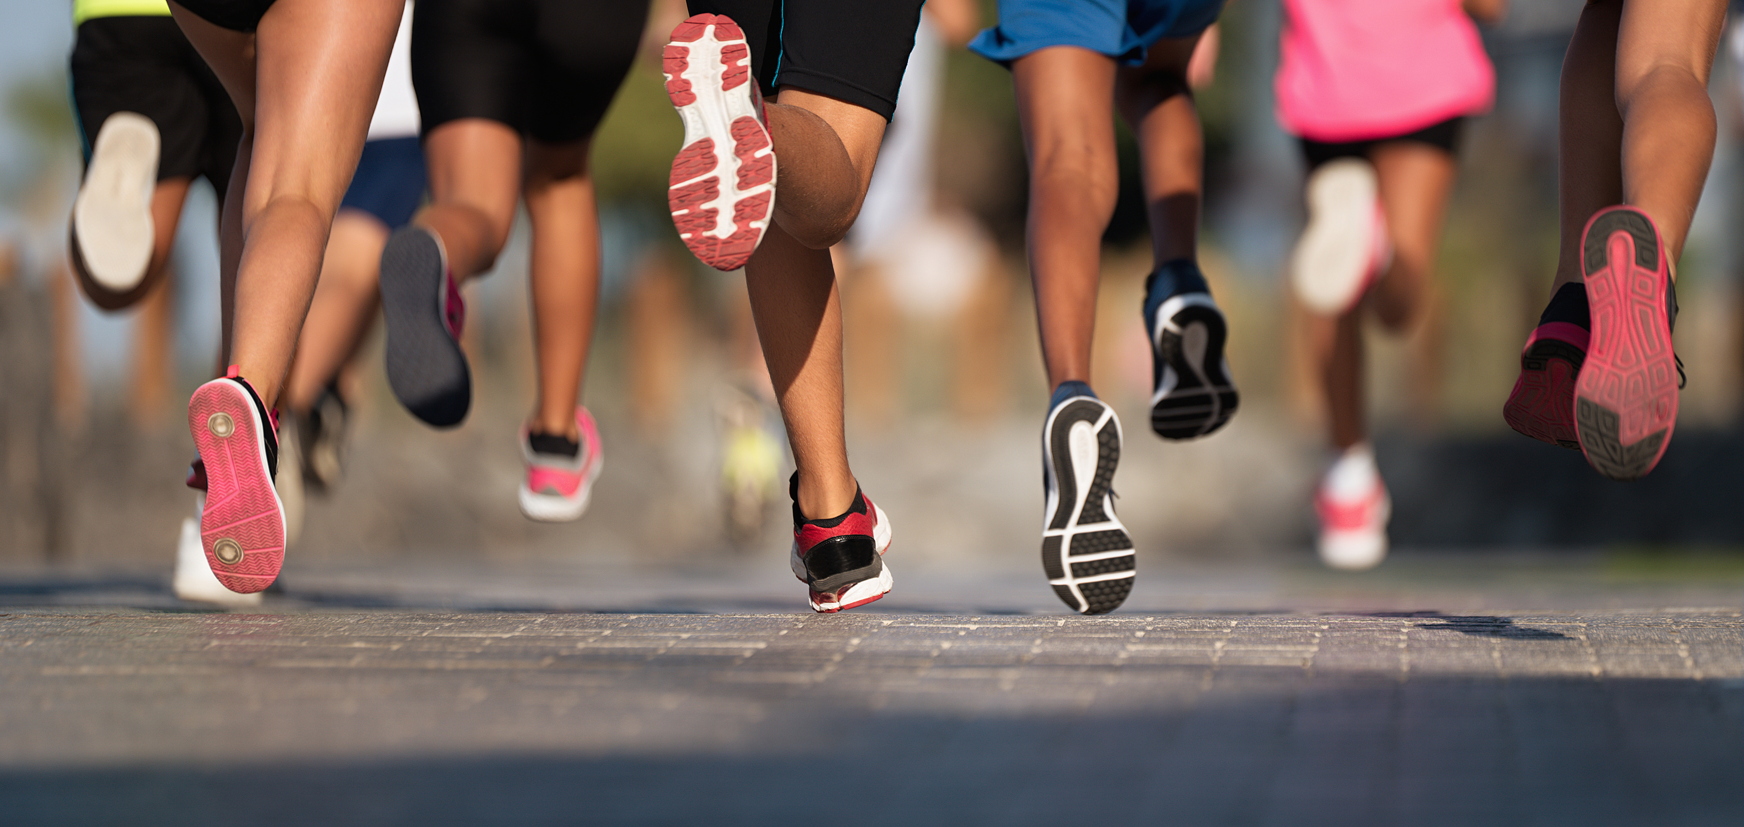
Learning Outcomes
A1: The importance of fitness for successful participation in sport
A2: Fitness training principles
A3: Exercise intensity and how it can be determined

Slide 3

COMPONENTS OF FITNESS
Each sport requires different levels of fitness. There are 10 different components of fitness.
1:
Aerobic
Endurance
4:
Speed
7:
Power
10:
Balance
2:
Muscular
Endurance
5:
8:
Agility
11:
Coordination
Flexibility
3:
Muscular
Strength
Body Composition
9:
Reaction
Time
6:
Booklet
Page 2

Slide 4
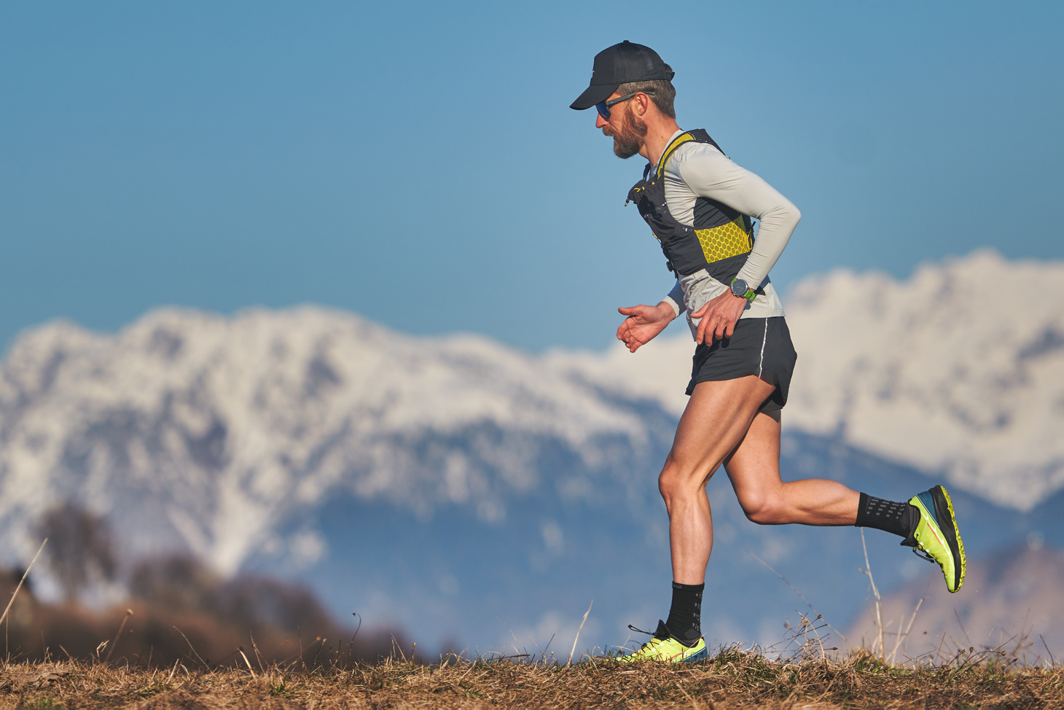
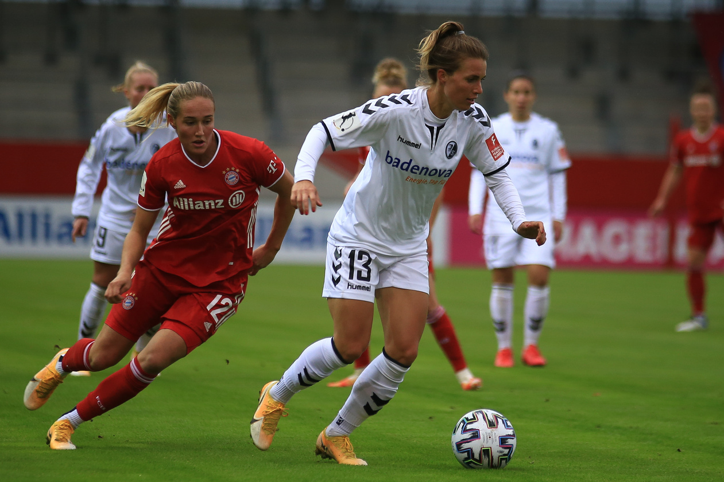
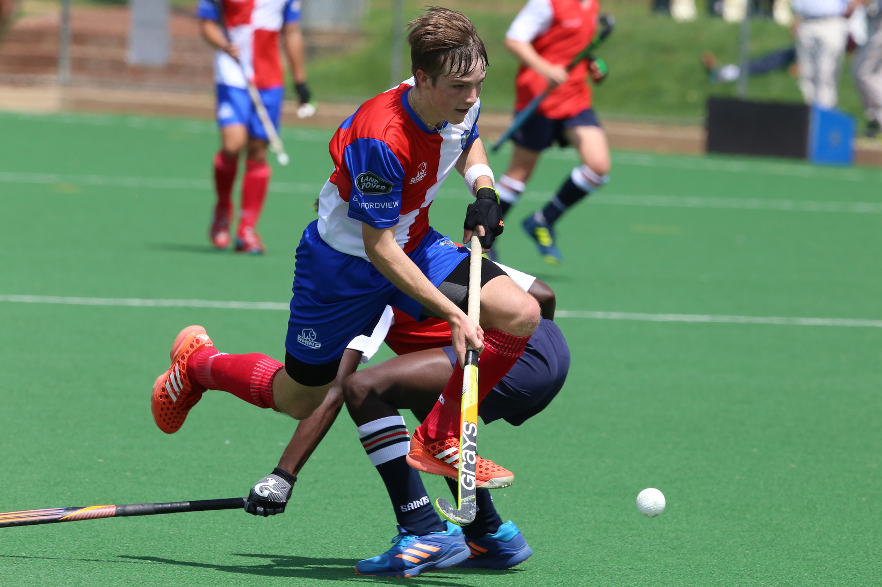
AEROBIC ENDURANCE
Used for: Sports lasting more than 30 minutes
Examples include long-distance running, football and hockey.
Booklet
Page 2

Slide 5
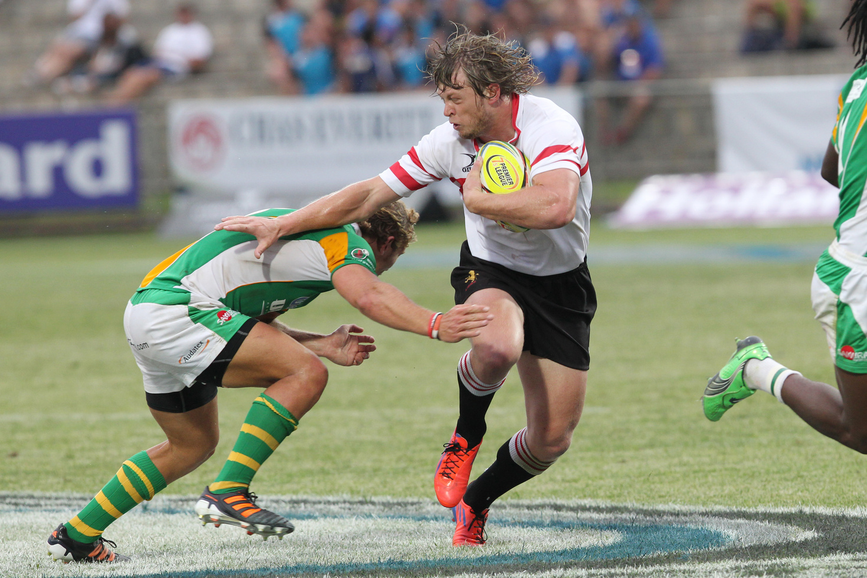
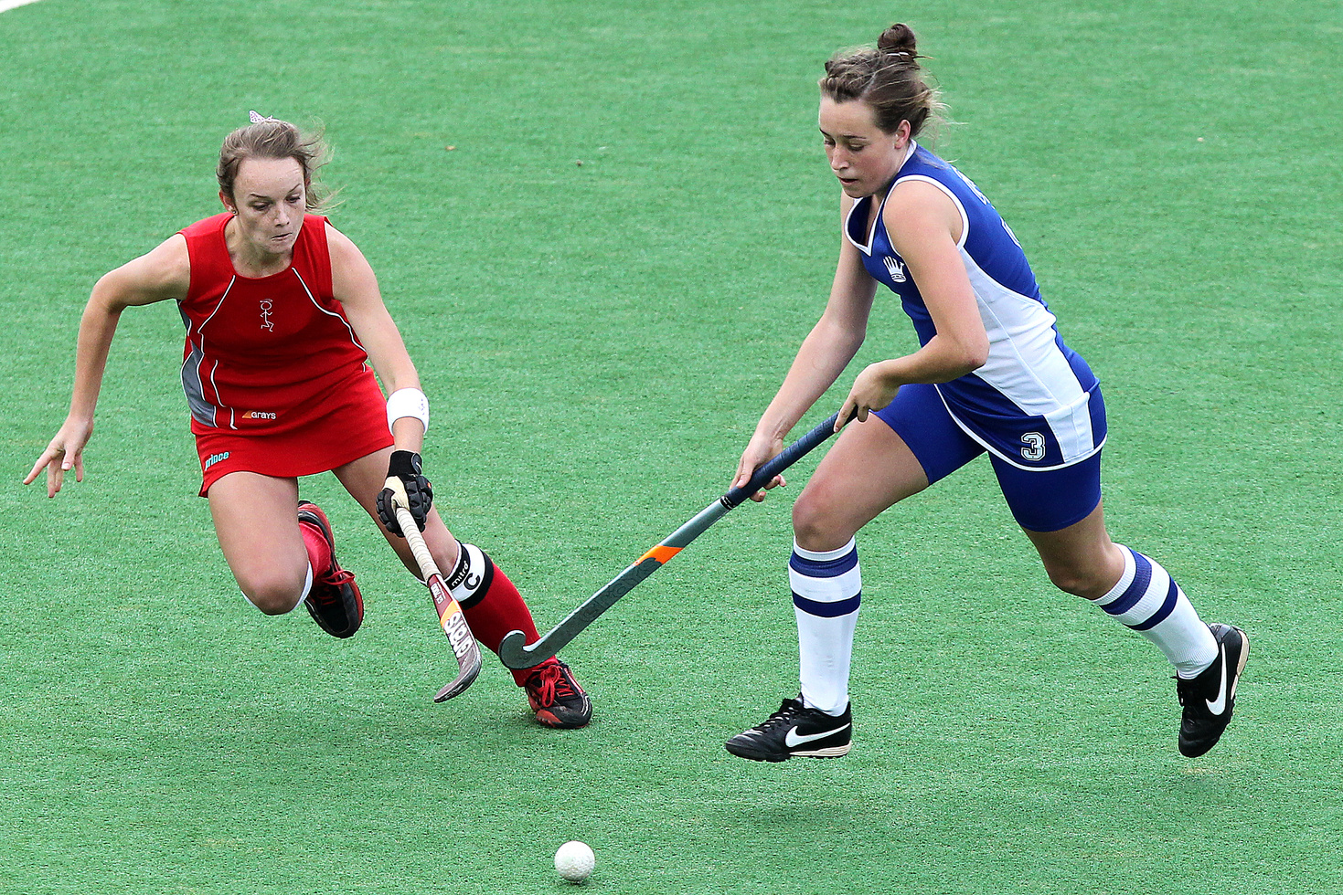

MUSCULAR ENDURANCE
Used for: sports lasting more than 30 minutes
Examples include rugby, hockey and weightlifting
Booklet
Page 2

Slide 6
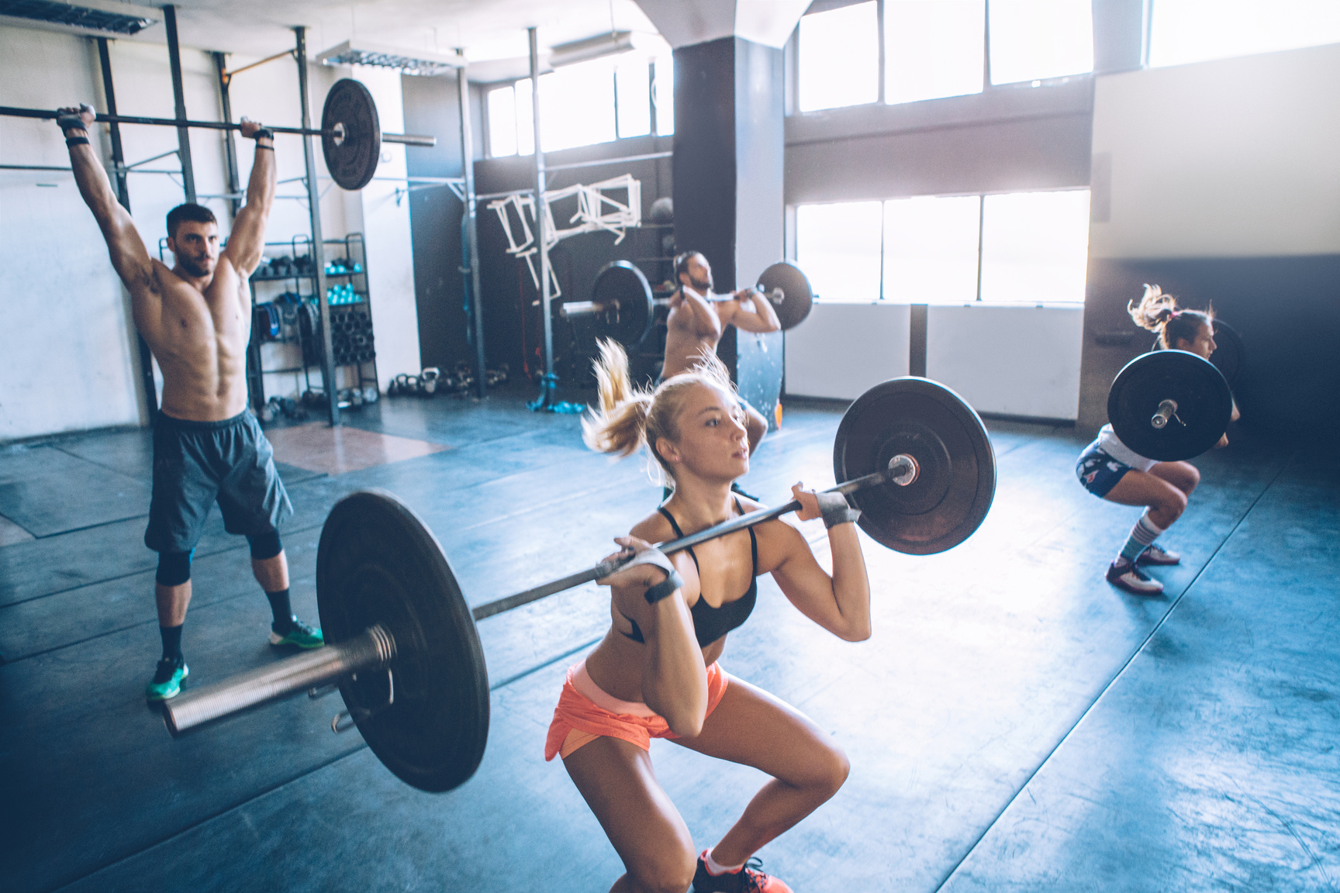
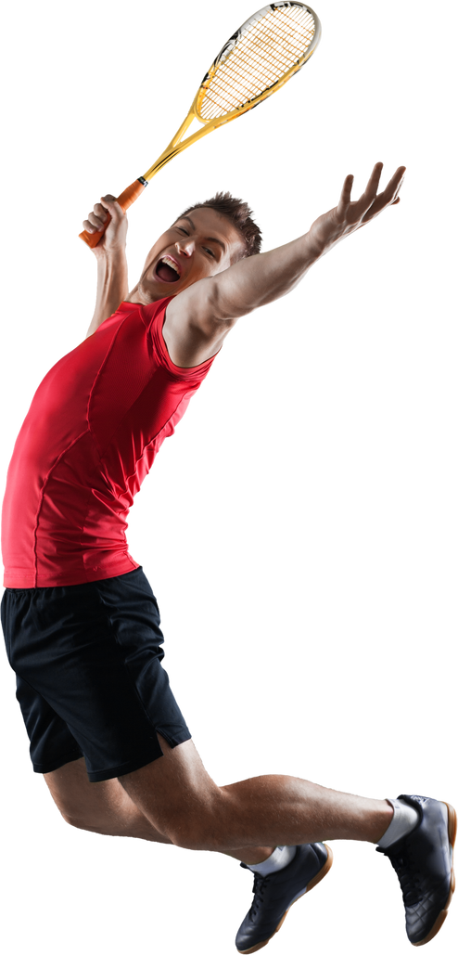
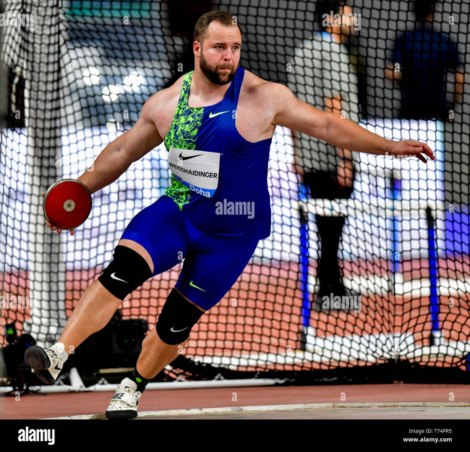
MUSCULAR STRENGTH
Used for: activities requiring force
Booklet
Page 2
Examples include discuss throwing, weightlifting and tennis shots

Slide 7
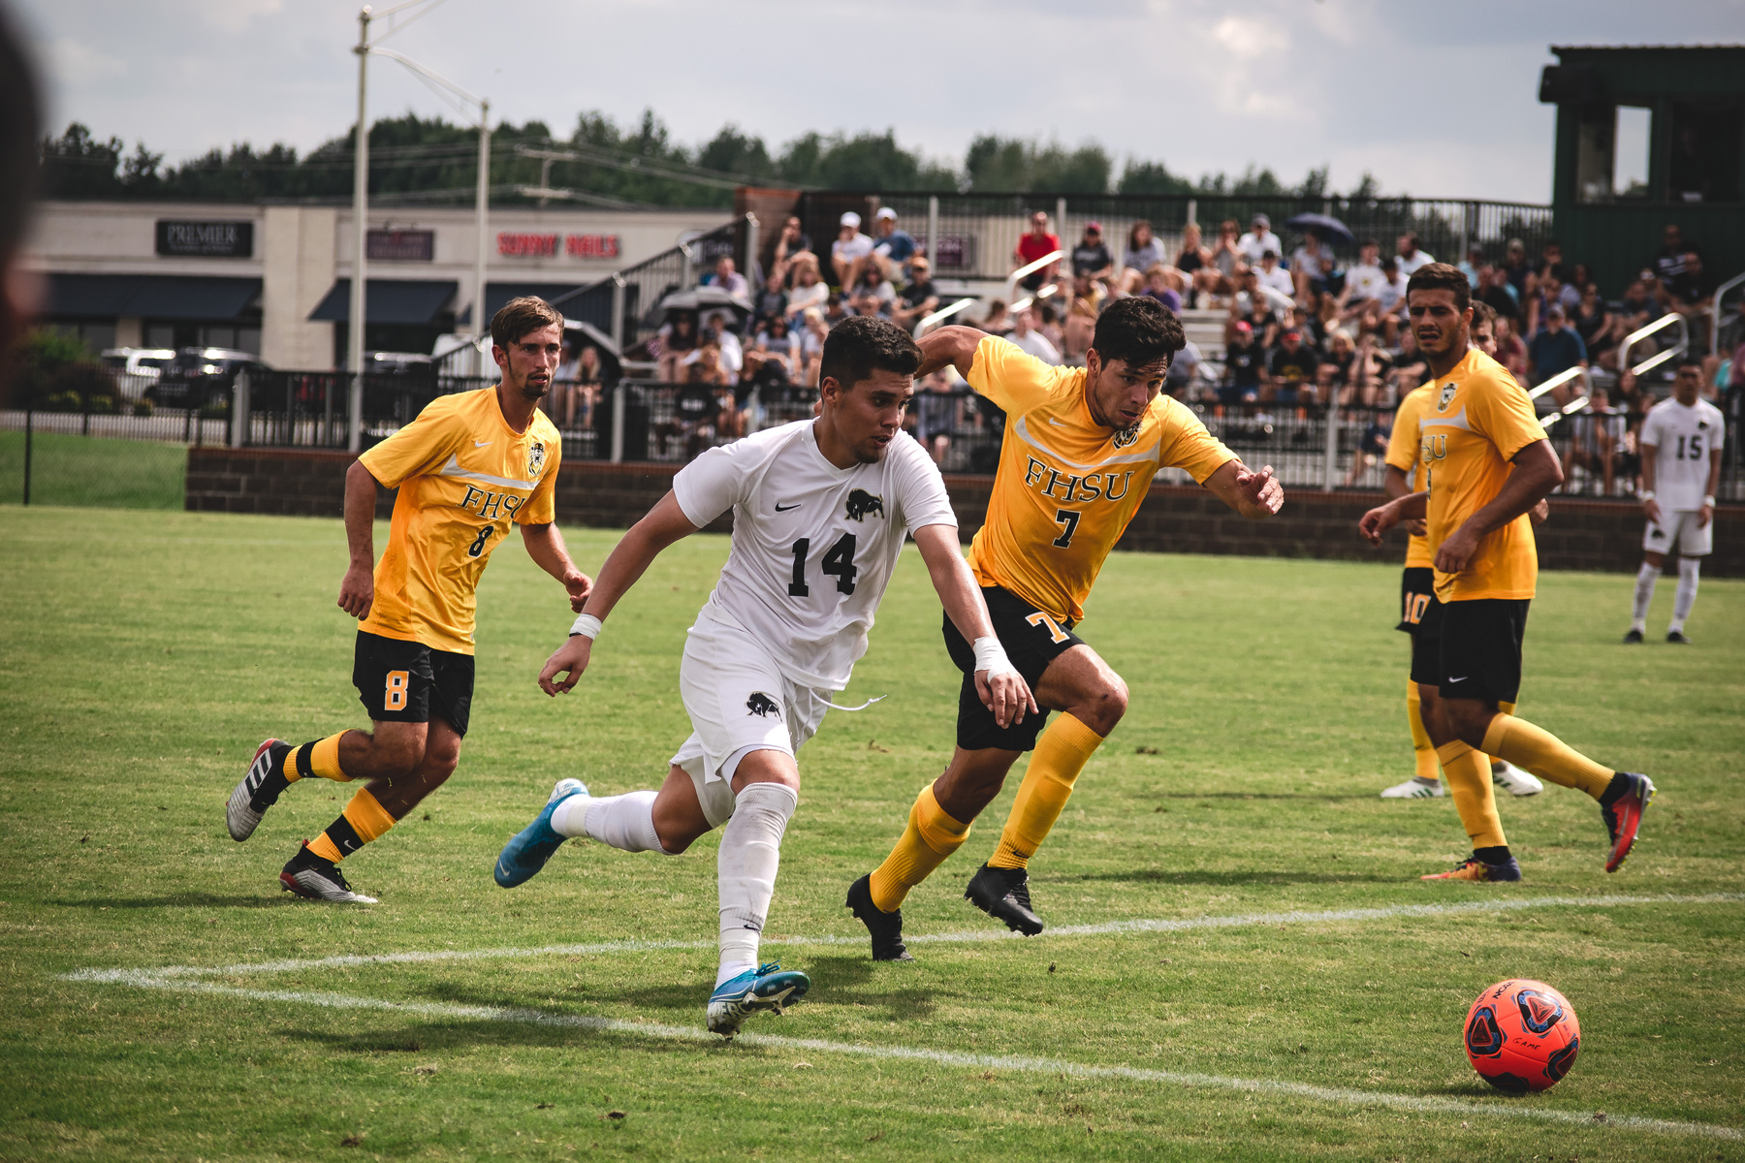
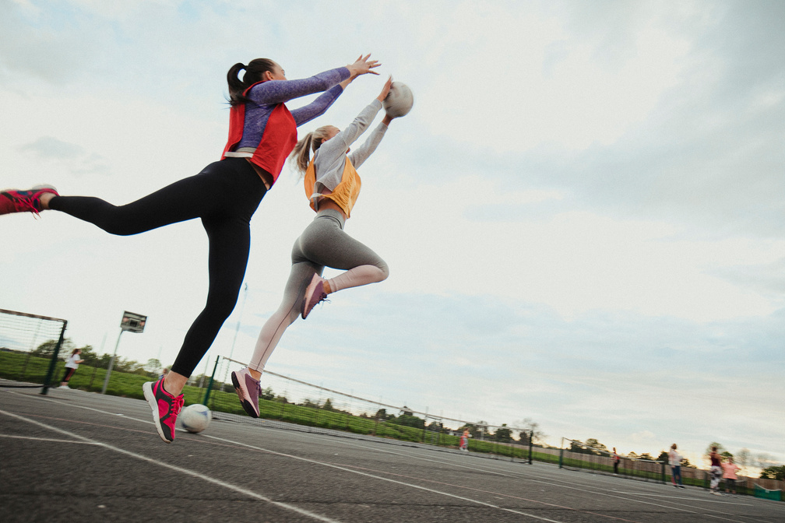
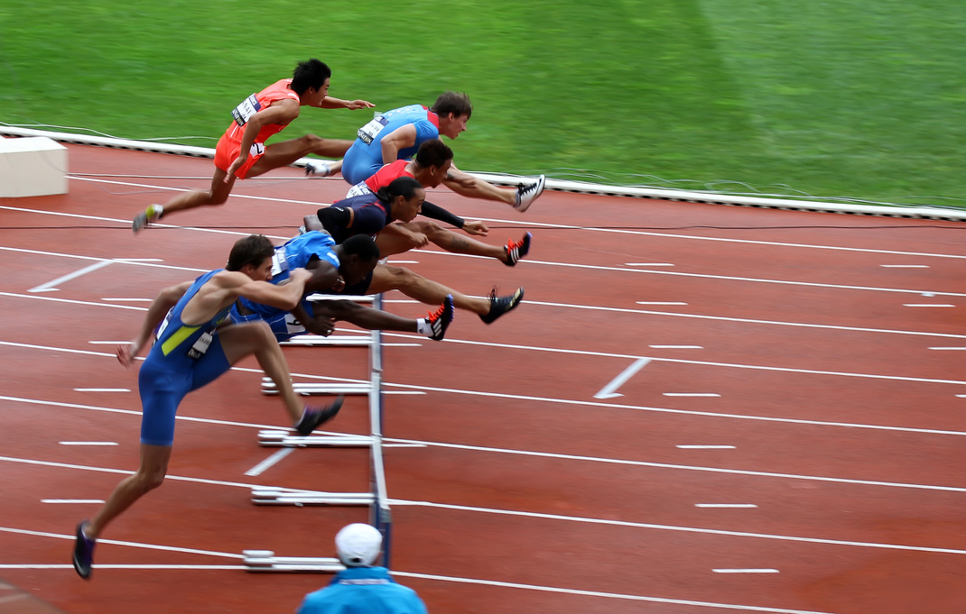
SPEED
Used for: activities requiring fast movement
Examples include sprinting, football and netball
Booklet
Page 2

Slide 8
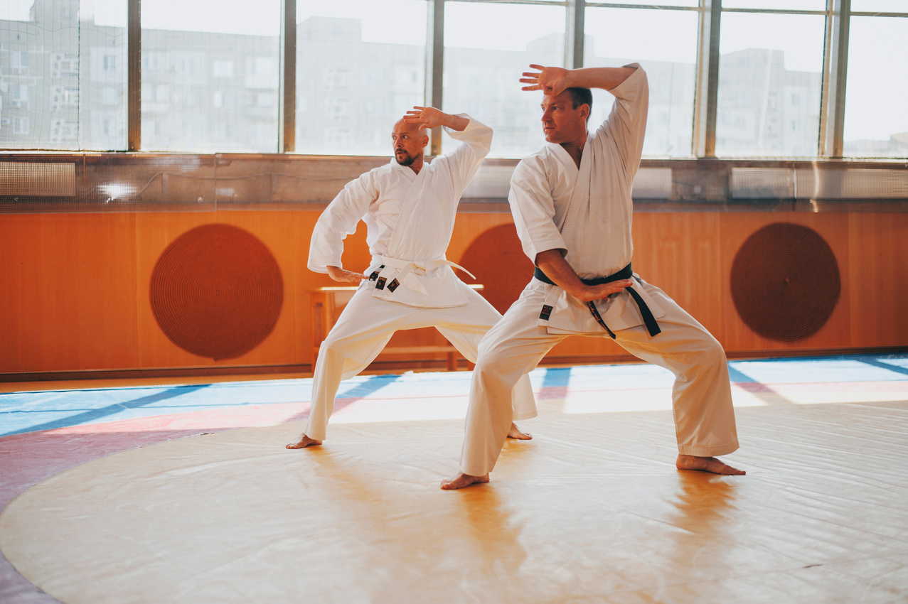
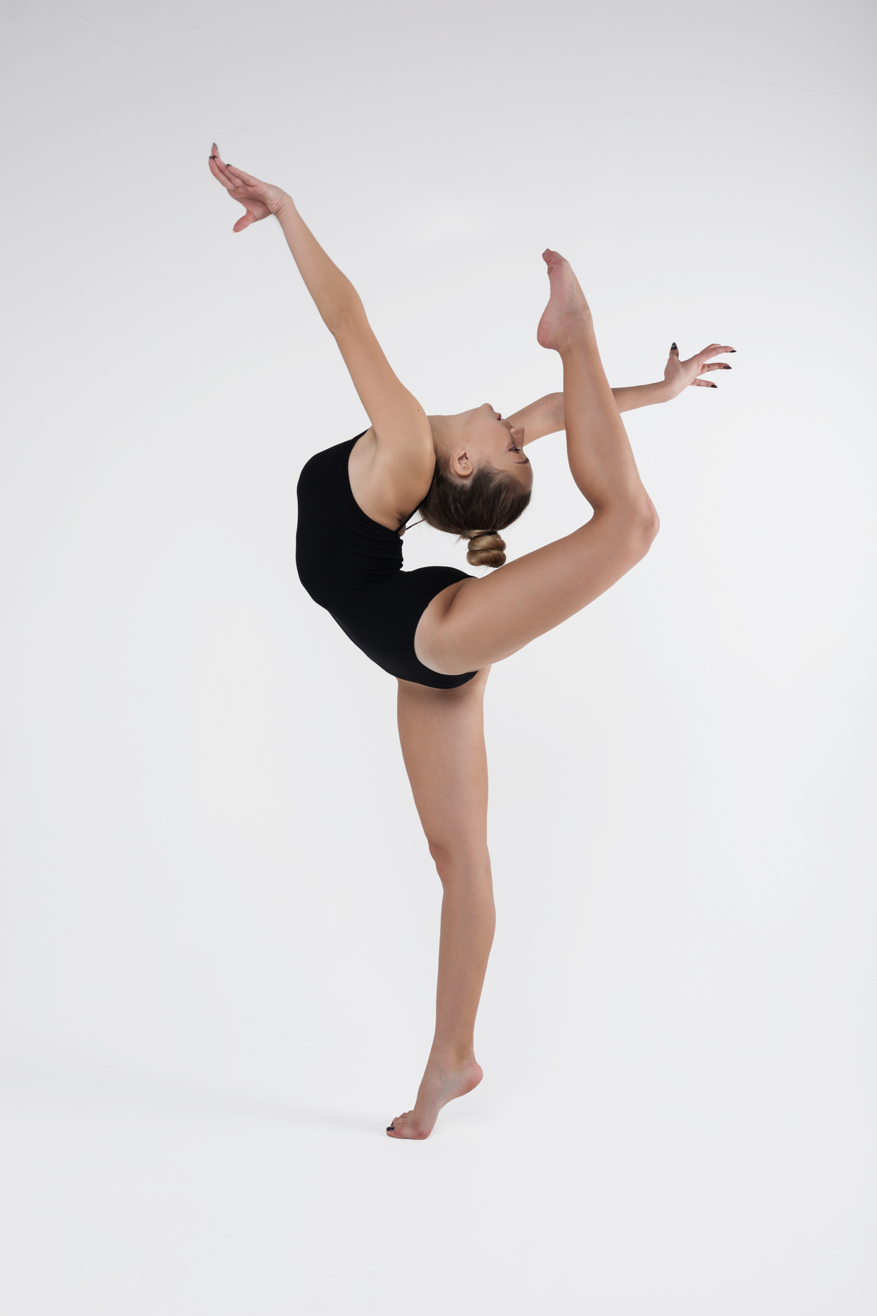
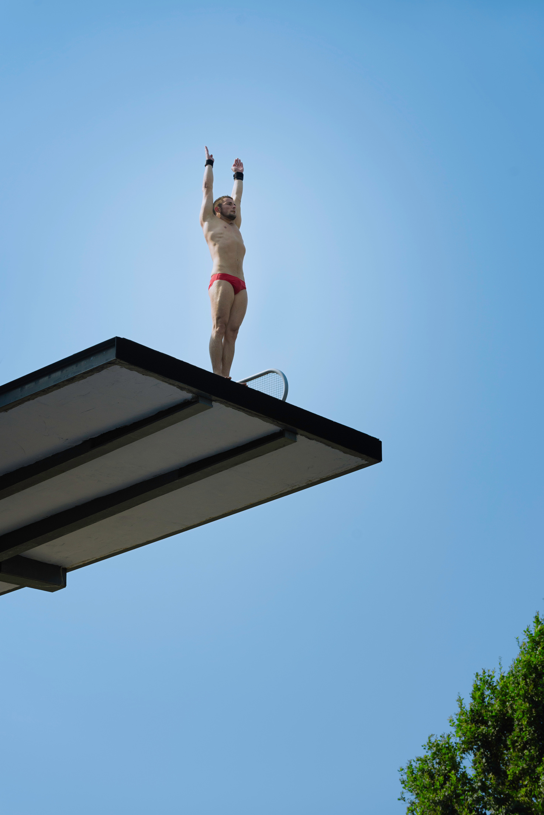
FLEXIBILITY
Used for: activities requiring a wide range of movement around a joint
Booklet
Page 2
Examples include martial arts, gymnastics and diving

Slide 9

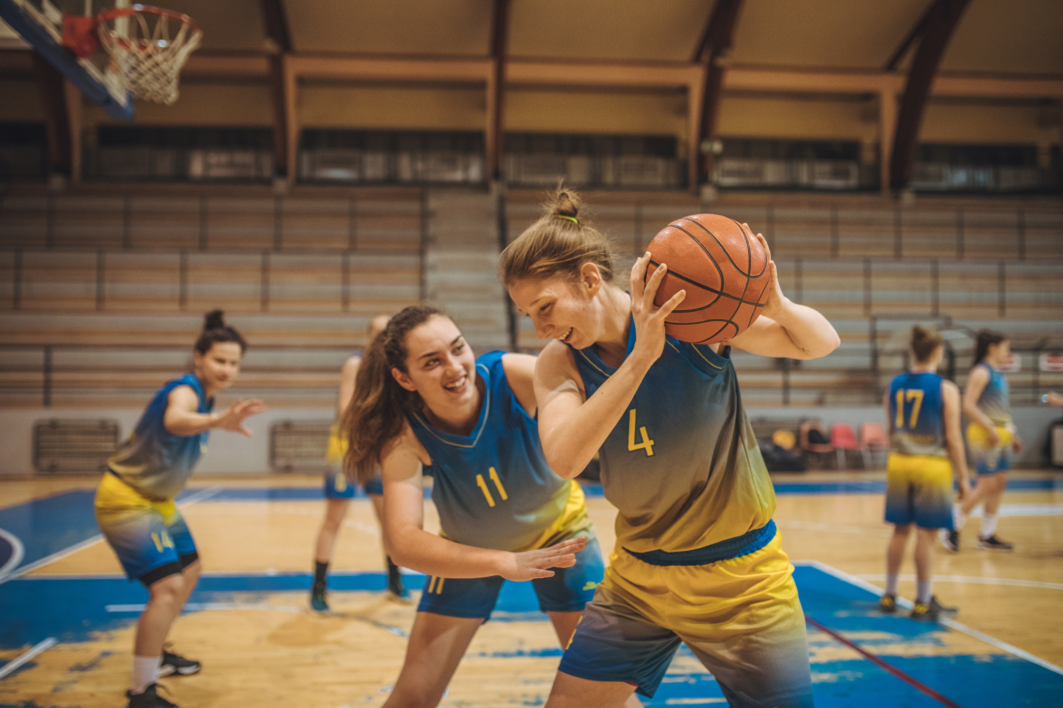
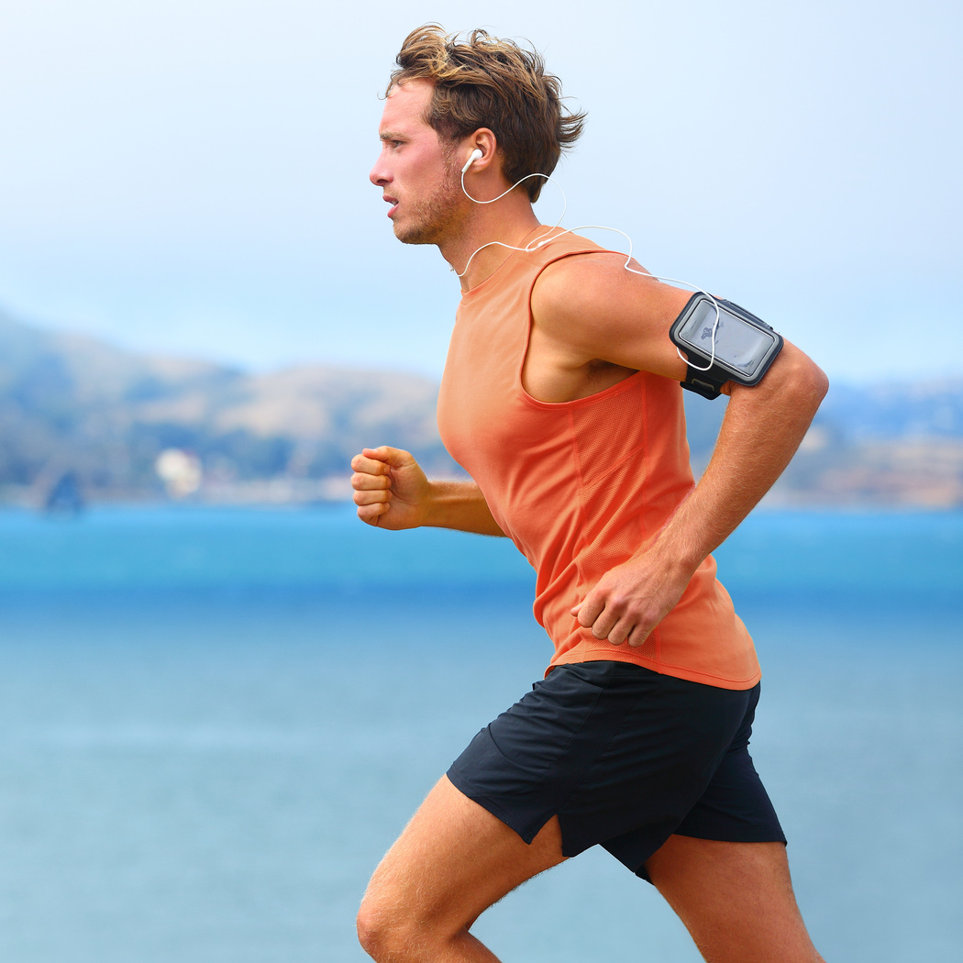
BODY COMPOSITION
The percentage of body weight that is muscle, fat or bone
Different sports will require different body composition for optimal performance. For example the body composition of a weightlifter will differ greatly to a marathon runner.
Booklet
Page 2

Slide 10
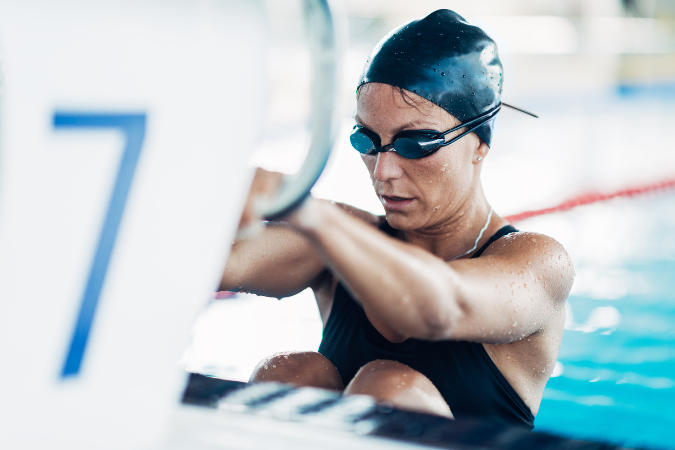
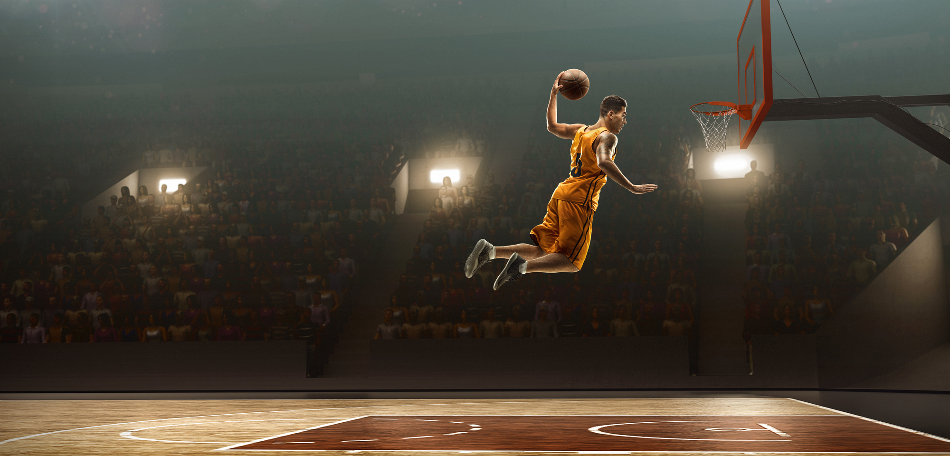

POWER
Used for: activities requiring explosive movement
Examples include basketball, swimming and weightlifting
Booklet
Page 2

Slide 11
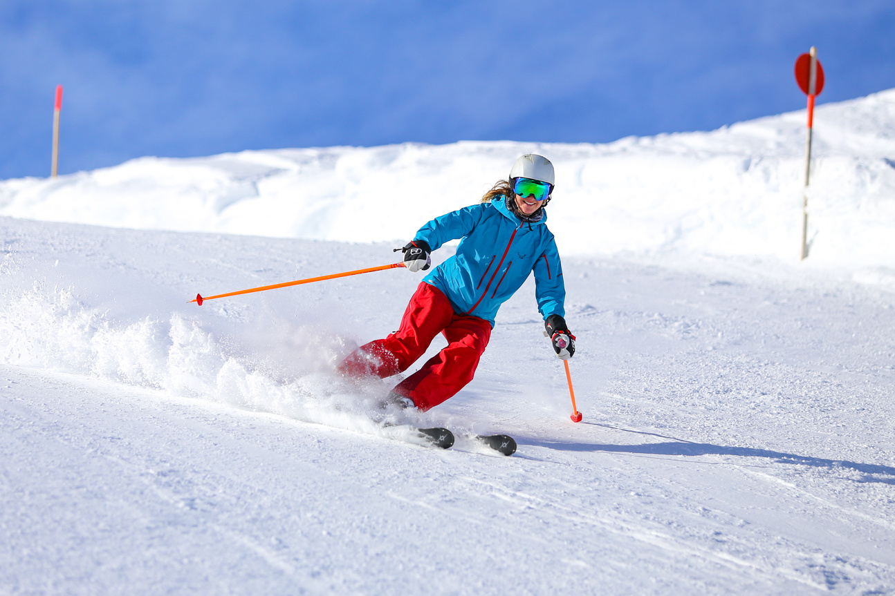
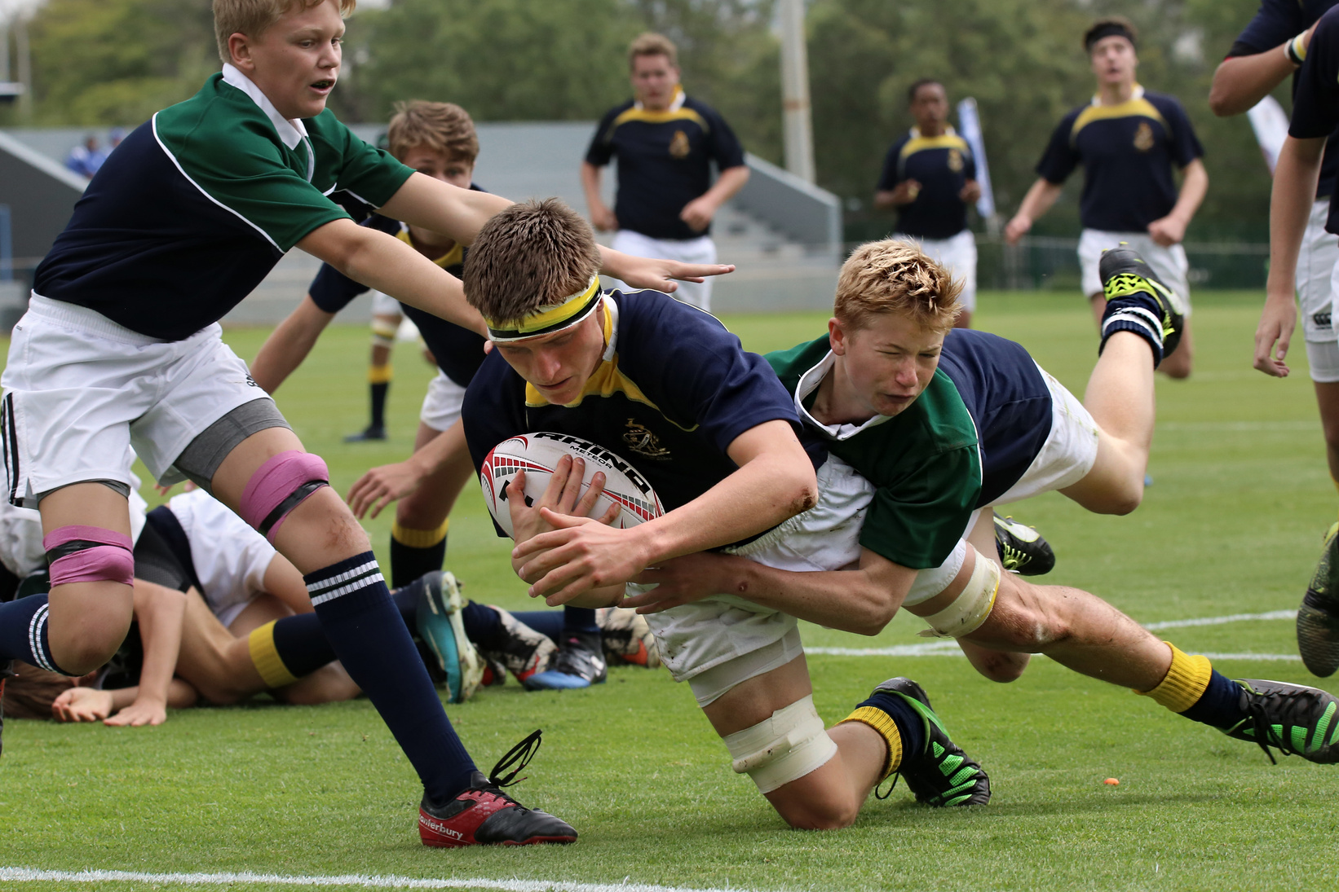
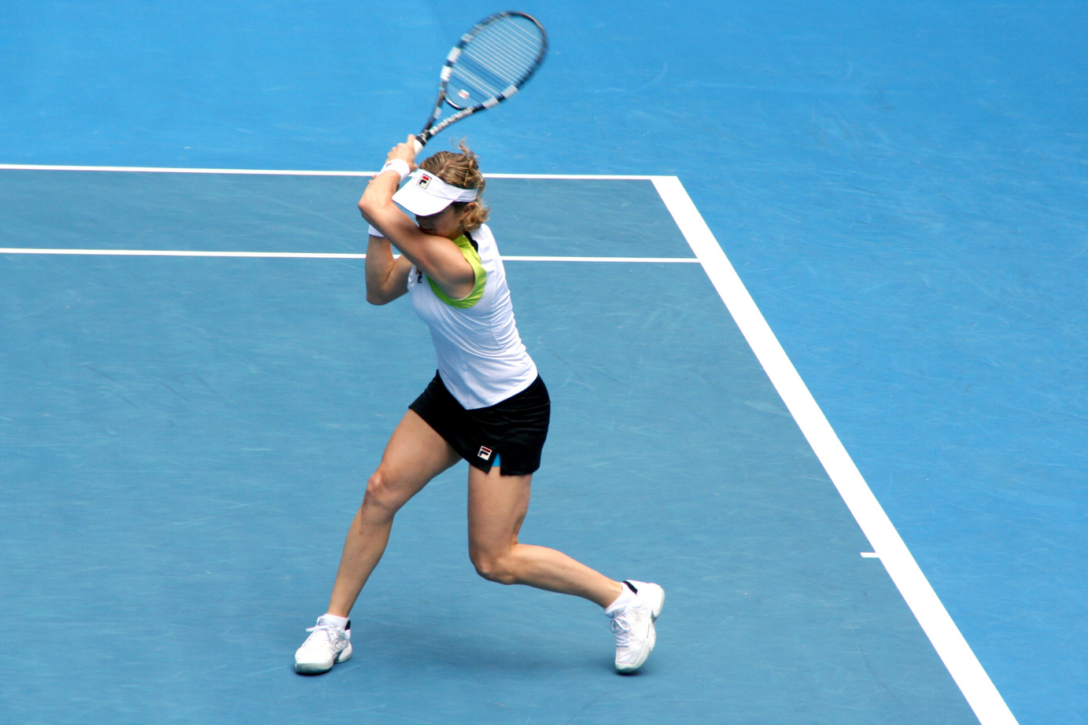
AGILITY
Used for: activities requiring quick changes of direction.
Booklet
Page 2
Examples include skiing, rugby & tennis

Slide 12
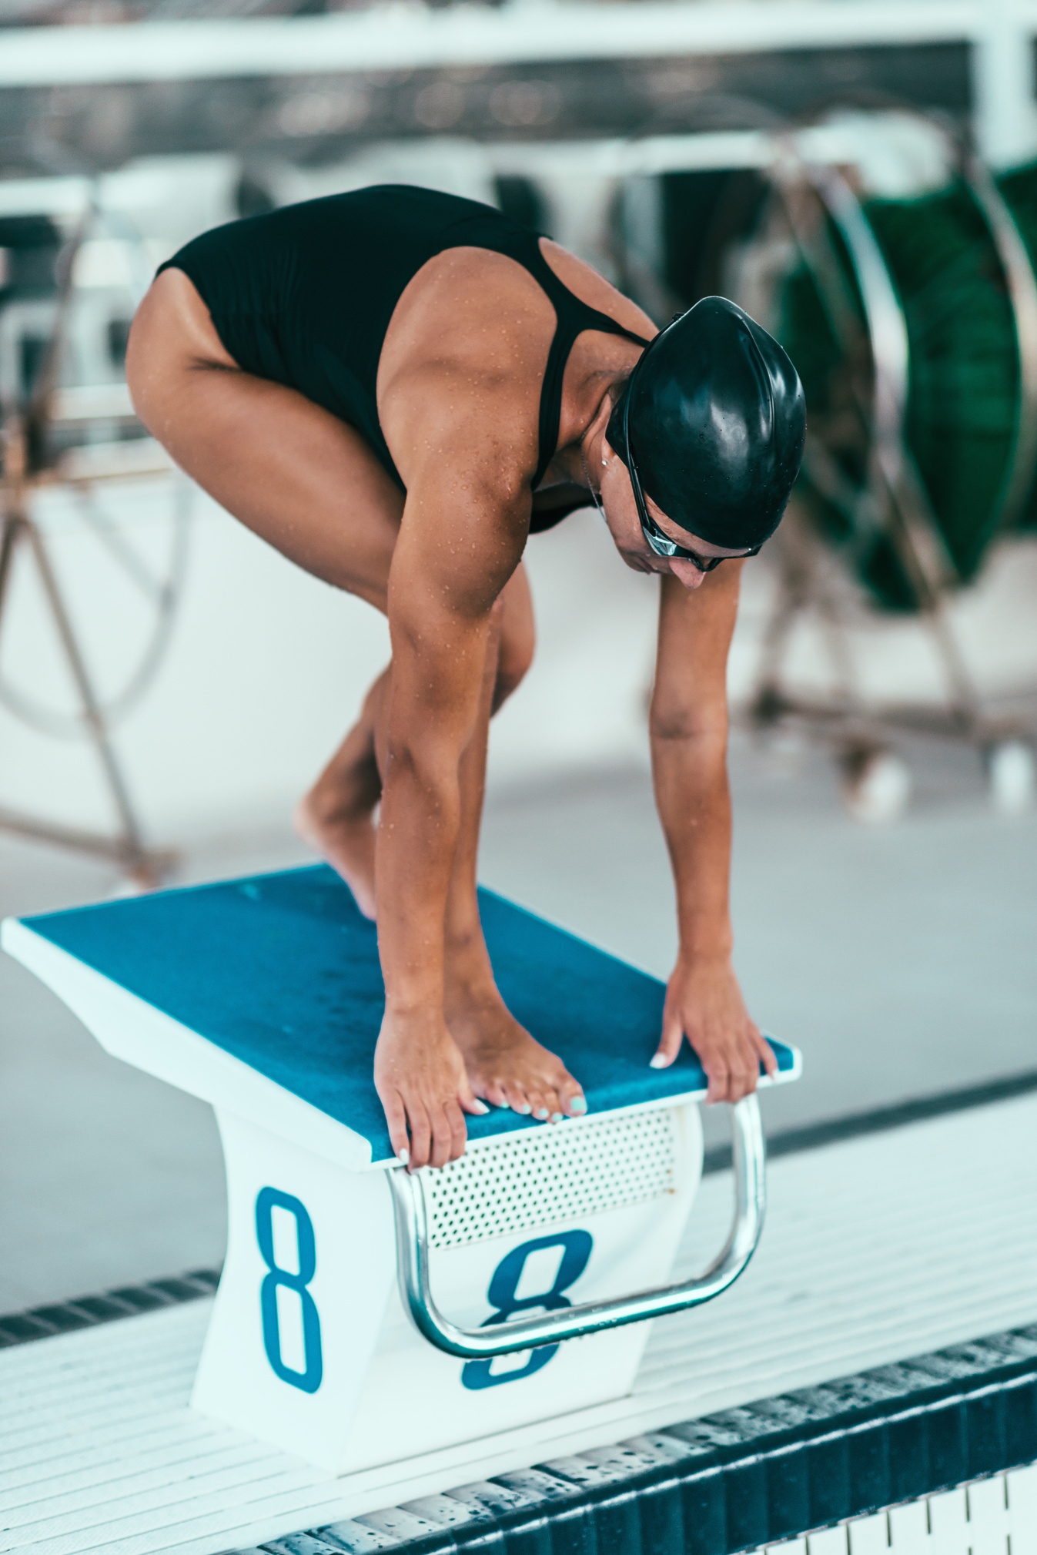

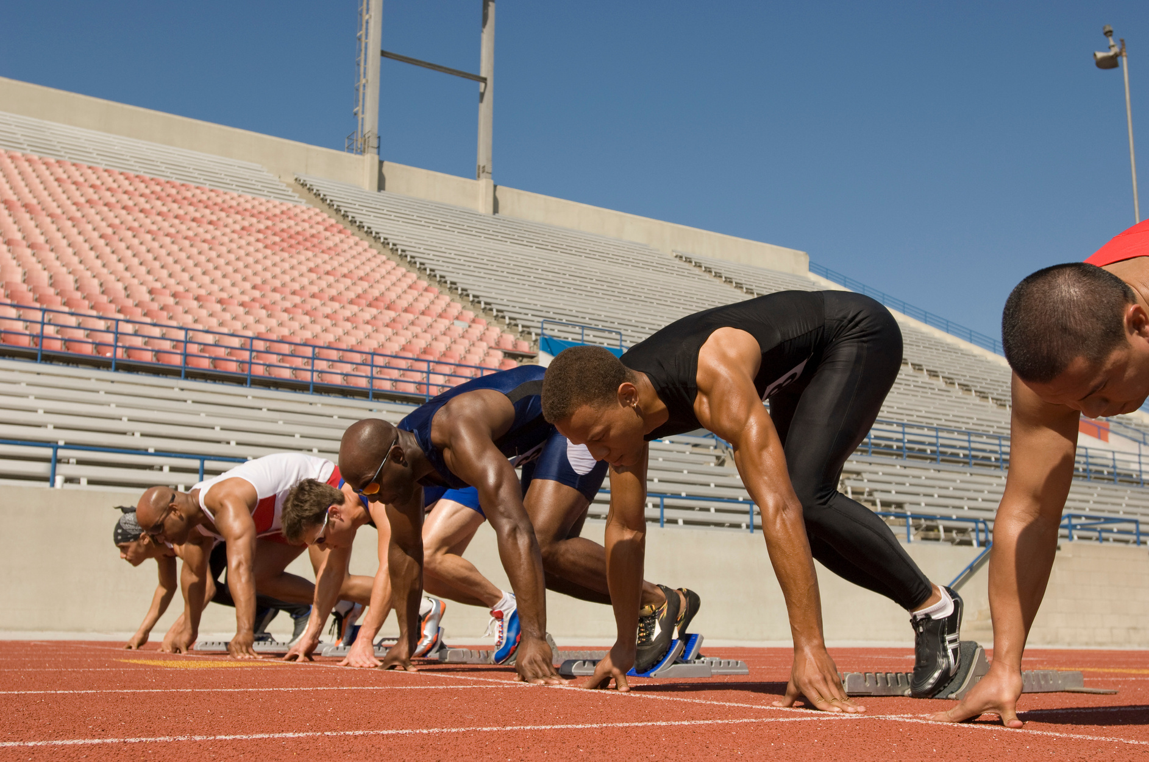
REACTION TIME
Used for: activities that need a quick decision or response to stimulus.
Booklet
Page 2
Examples include football (goalkeeping), swimming and sprinting

Slide 13
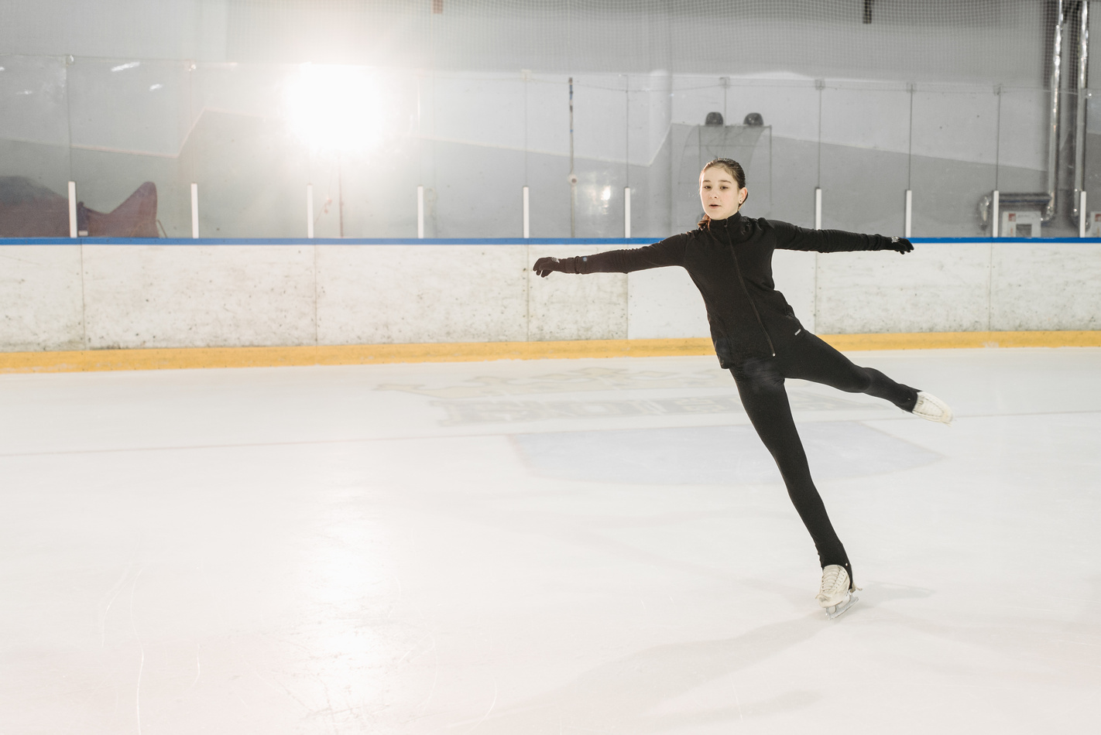

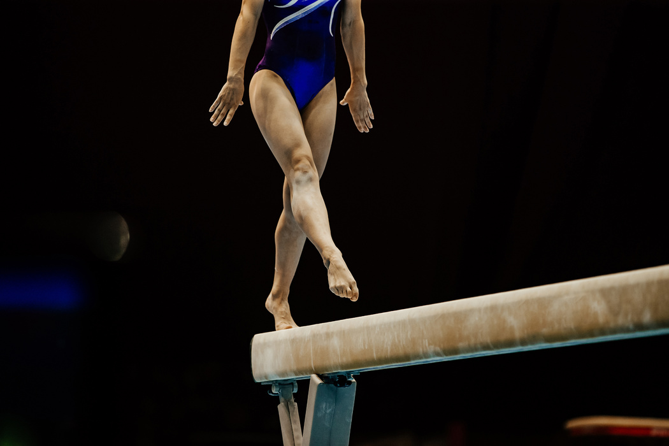
BALANCE
Used for: activities requiring the control of distribution of weight.
Booklet
Page 2
Examples include ice skating, cycling and gymnastics

Slide 14
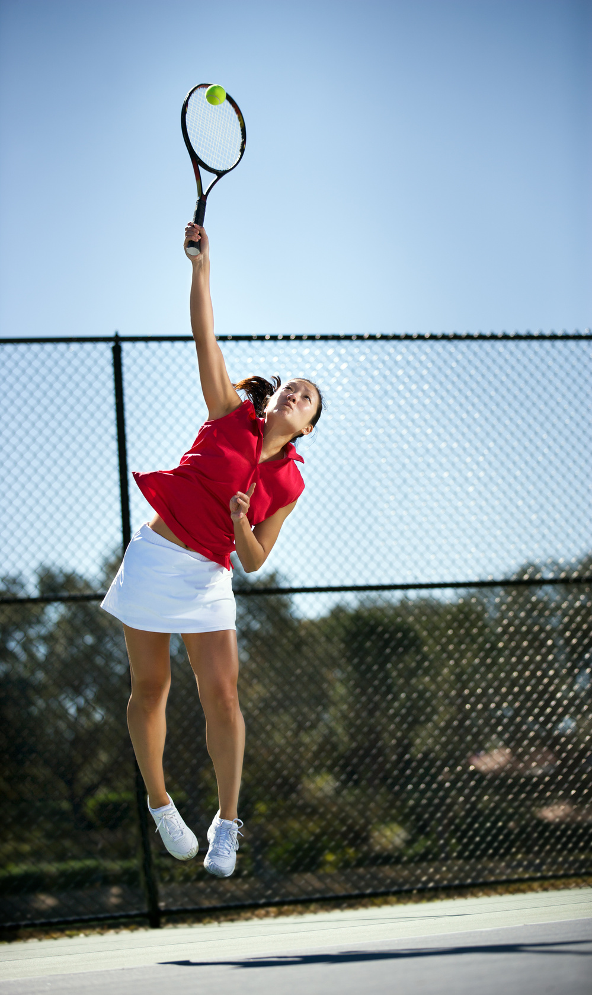
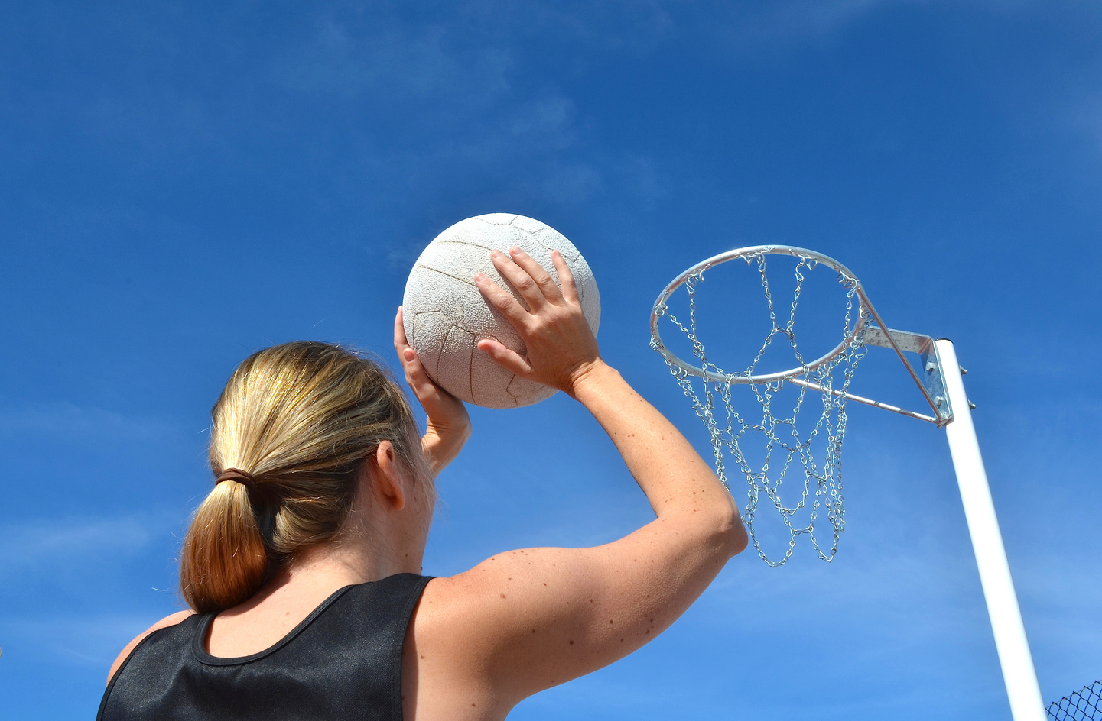
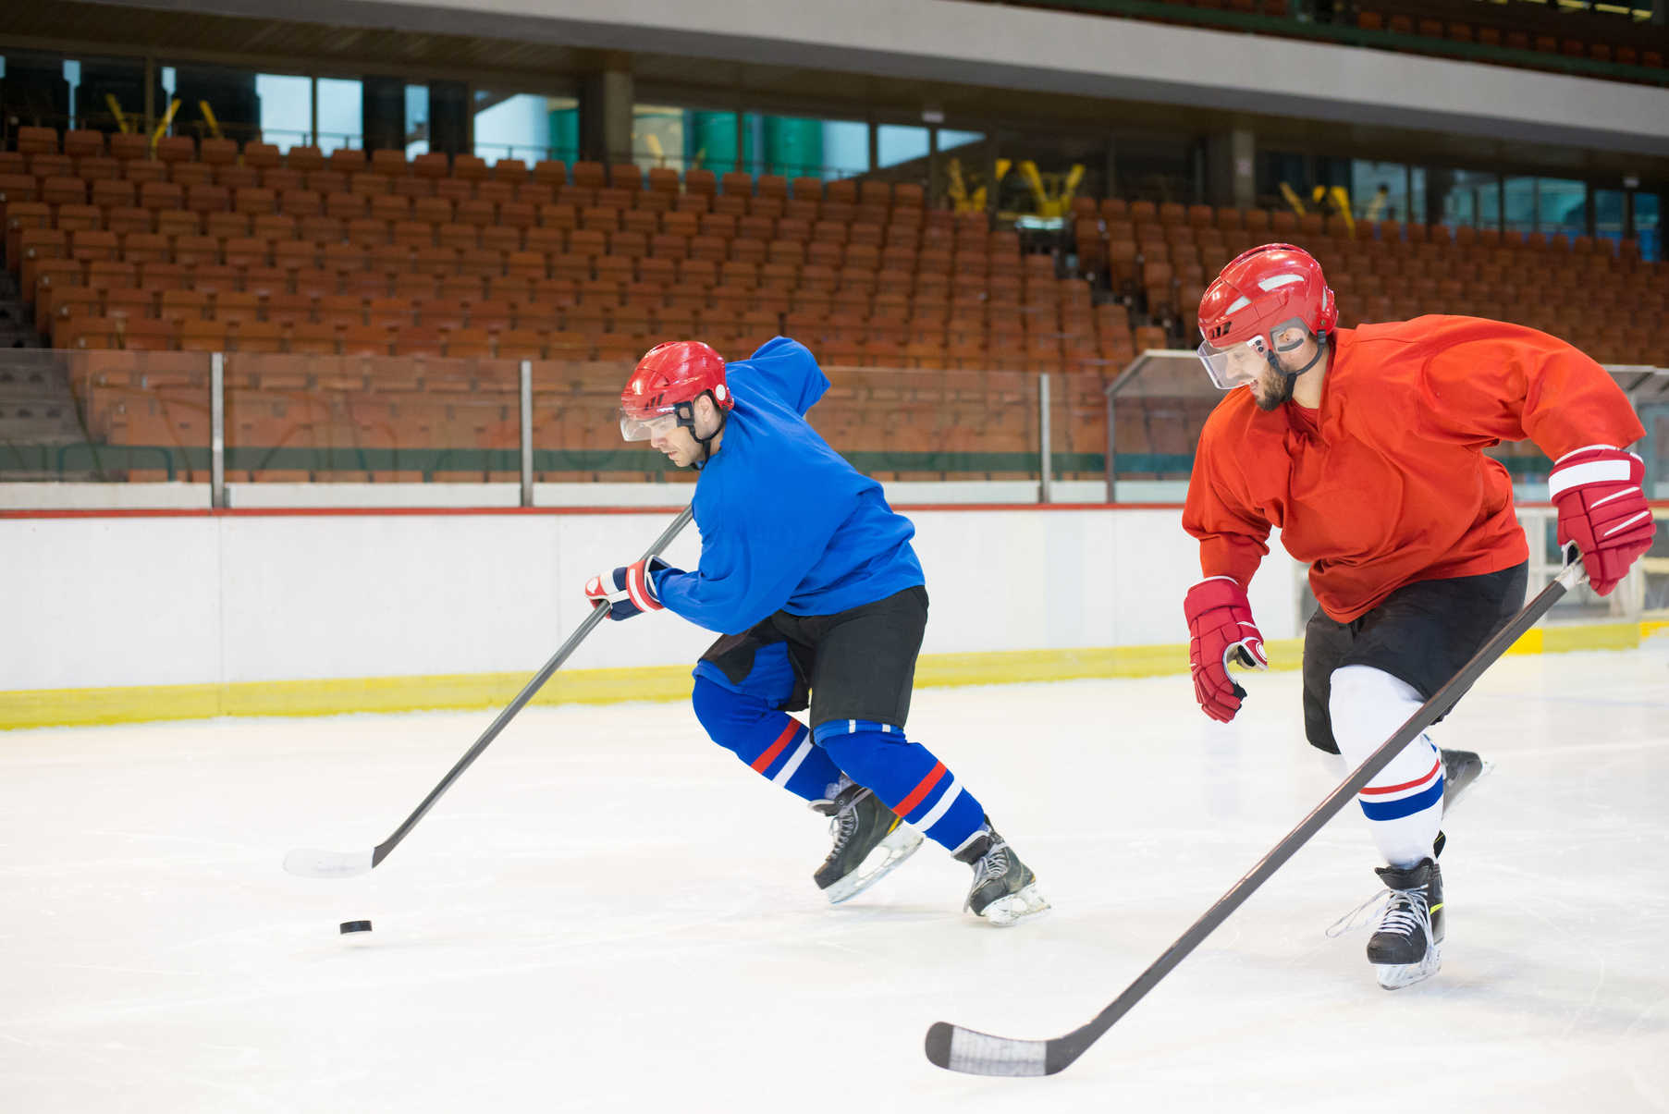
COORDINATION
Used for: activities requiring movement of two or more body parts at the same time.
Booklet
Page 2
Examples include tennis, netball and ice hockey

Slide 15
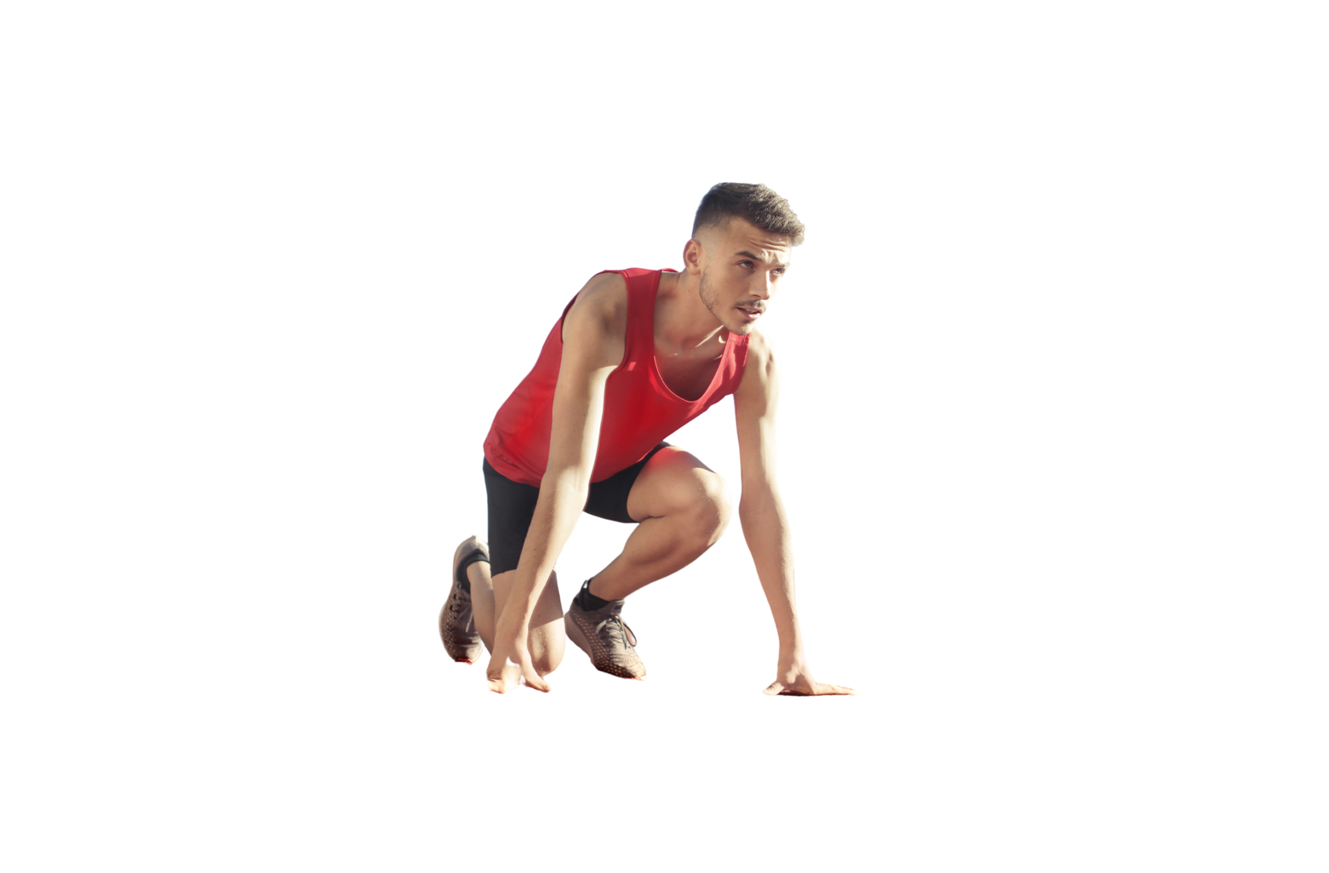

4 Basic Principles of Training
Frequency
How often training takes place
Intensity
How 'hard' training is
Time
How long training lasts
Type
What type of training is used to improve a specific component of fitness
How would a weightlifter incorporate these basic principles in their training?
Booklet
Page 3

Slide 16

Additional Principles of Training
Progressive Overload
Specificity
Gradually increasing the amount of overload during training in order to improve fitness but without injury
Matching training to the requirements of an activity - different sports require athletes to excel in different components of fitness.
Individual Differences
Adaptation
The needs of an individual could alter due to their fitness level, weight, gender or previous injuries.
This is about how your body changes due to increased training loads.
Booklet
Page 5-7

Slide 17
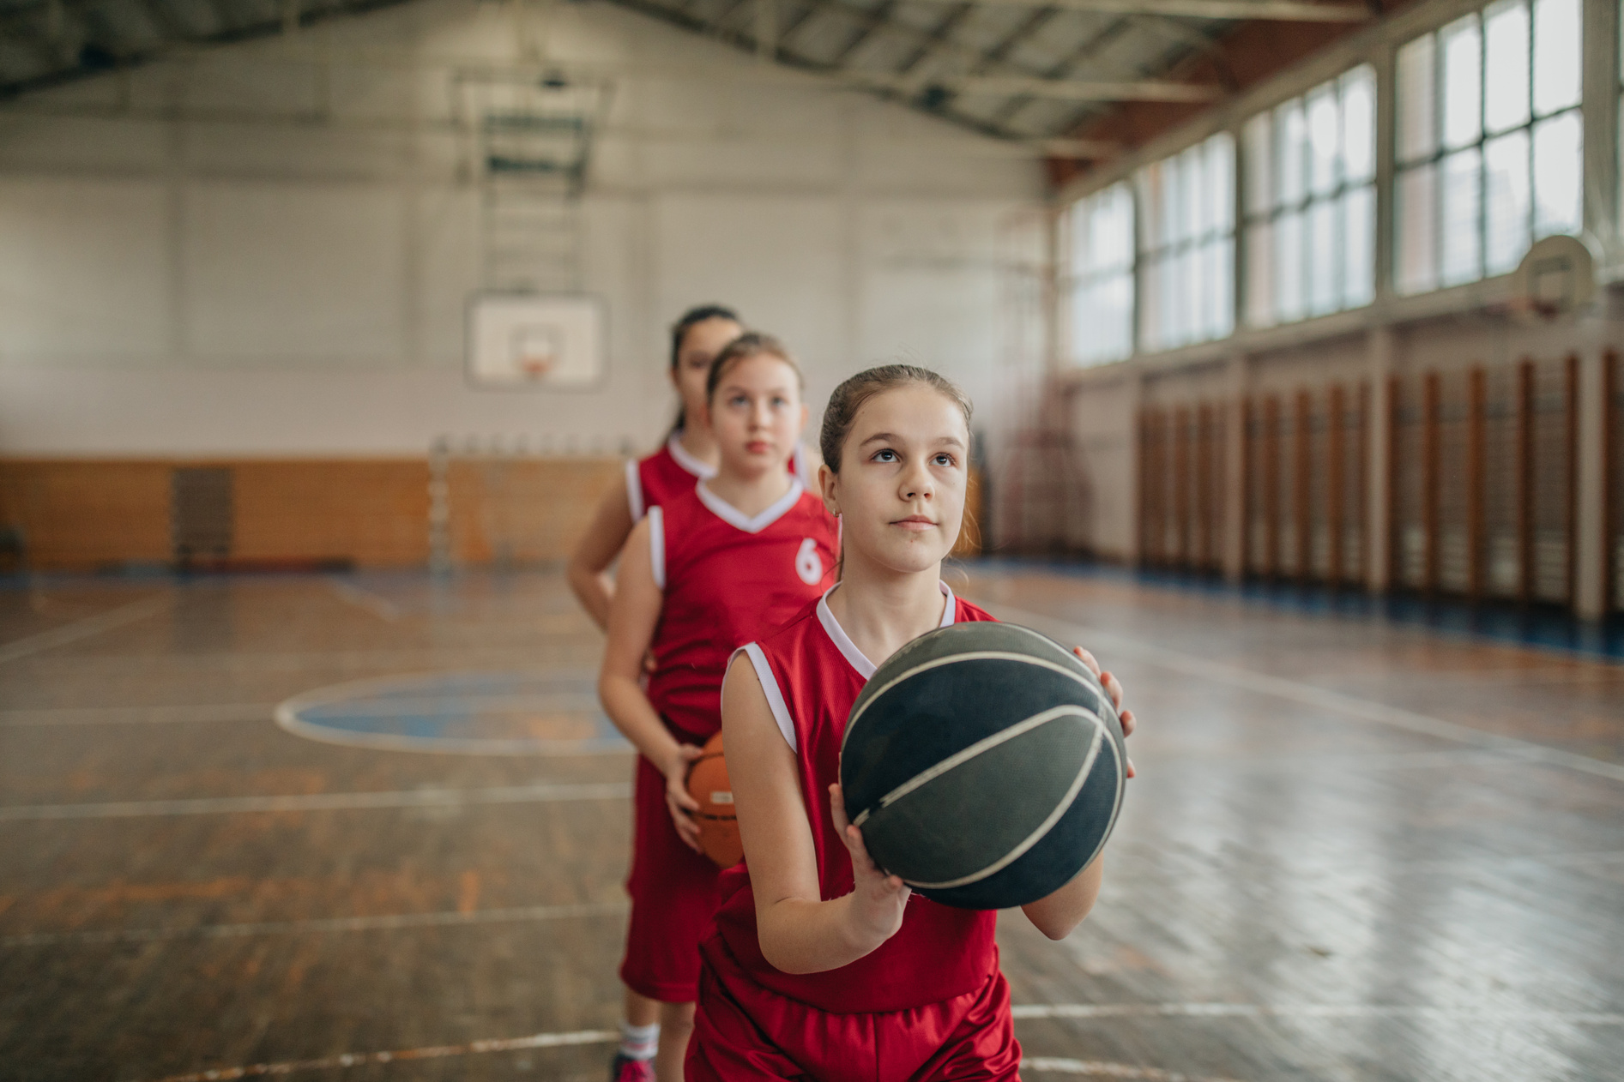
Additional Principles of Training
Reversibility
Variation
This means gradually losing fitness and occurs to anybody who stops training.
You can avoid boredom and maintain motivation to train by altering the types of training.
Rest & Recovery
How would you overcome or maintain these principles?
This is very important during an exercise programme and without rest, progressive overload is unlikely to occur.
Booklet
Page 7-8

Slide 18



Exercise Intensity
You can measure exercise intensity by measuring heart rate (HR).
You can do this by feeling your Pulse (either at your carotid/wrist) for 30 seconds and multiply it by 2.
Booklet
Page 8

Slide 19

Target Zones & Training Thresholds
Training thresholds are set to make sure that people train at an effective but safe level.
The calculation of your target zones is known as The Karvonen Formula.
The Karvonen Formula:
Firstly work out your maximum heart rate with the formula:
220 – age (in years)
Your aerobic zone is 60-80% of your maximum HR
Your anaerobic zone is 80-90% of your maximum HR
Booklet
Page 9

Slide 20
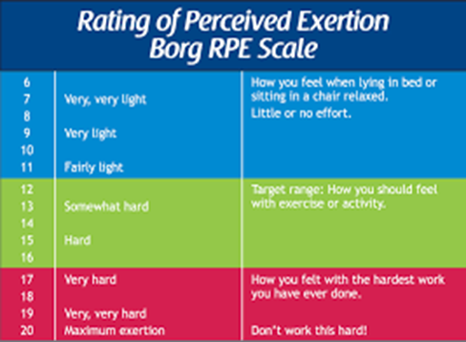
The Borg Rating of Perceived Exertion Scale:
This rating is a way of measuring physical activity intensity level.
Perceived exertion is how hard you feel like your body is working.
Rating of Perceived Exertion Borg RPE Scale
6
7
8
9
10
11
12
13
14
15
16
17
18
19
20
RPE can be used to estimate heart rate (HR), using the equation:
RPE x 10 = HR
How you feel when lying in bed or sitting in a chair relaxed.
Little or no effort.
Very, very light
Very light
Fairly light
Target range: how you should feel with exercise or activity
Somewhat hard
Hard
Booklet
Page 10-11
Very hard
How you felt with the hardest work you have ever done
Very, very hard
Maximum exertion
Dont work this hard!

Slide 21
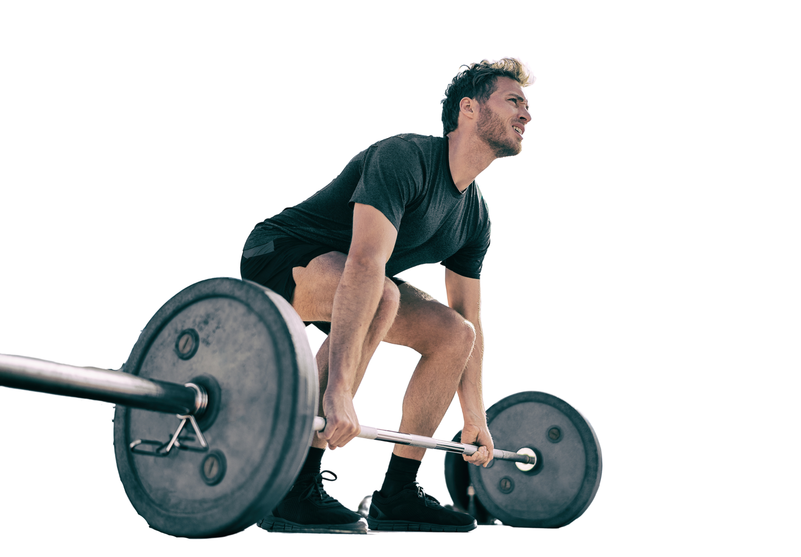
Repetition Maximums
1 Rep Max. (RM) = the heaviest amount you can lift in one repetition.
15 Rep Max. (RM) = the heaviest amount you can lift and repeat 15 times.
1 RM is for strength
15 RM is for muscular endurance
Booklet
Page 11

Slide 22



Technology to Measure Exercise Intensity
Heart Rate Monitors
Smart Watches
To measure exercise intensity you can use:
Apps
Booklet
Page 12

Slide 23

thepeclassroom.com

