Slide 1
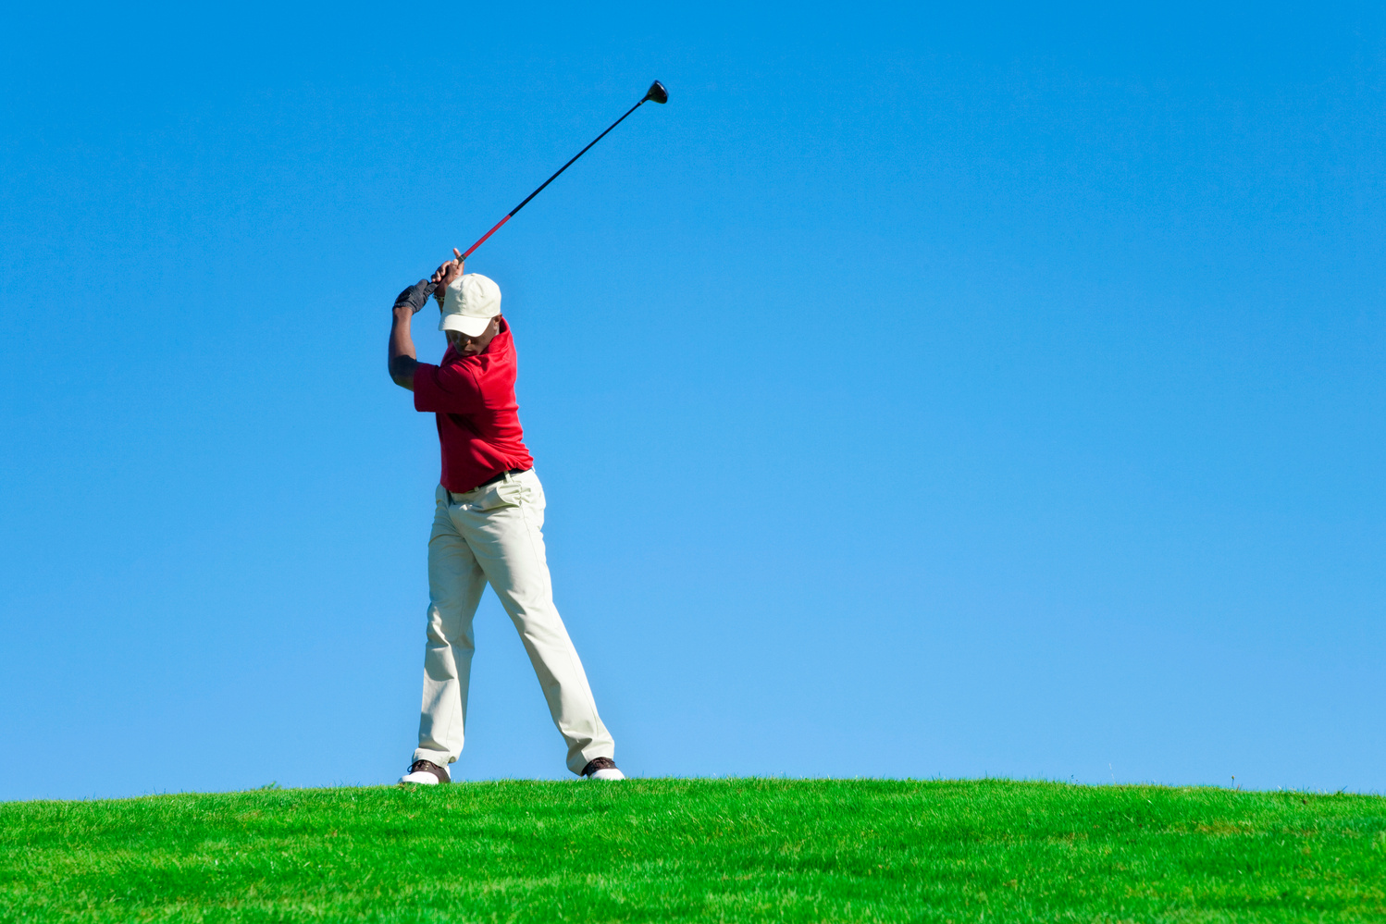

Biomechanical Principles
45*
F= M x A
thepeclassroom.com

Slide 2
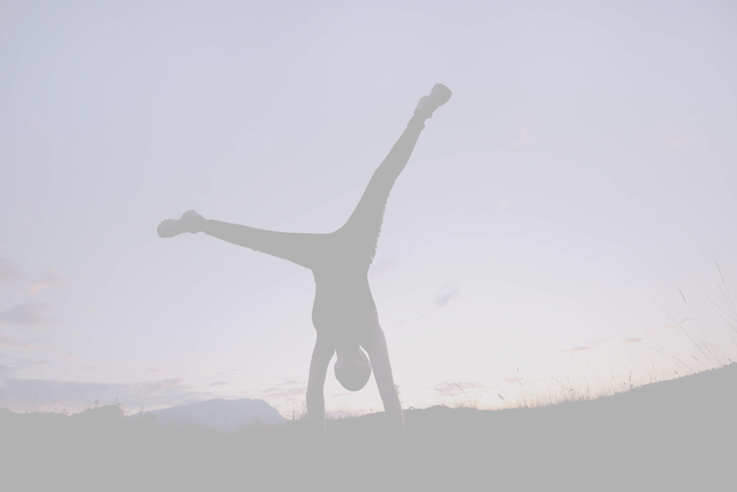
TOPIC AREAS
  Newton's three laws of linear motion applied to sporting movements,
  Definitions, equations and units of scalars,
  Centre of mass,
  Factors affecting stability,
  Classes of levers, their use in the body during physical activity and their mechanical advantages and disadvantages.

Slide 3
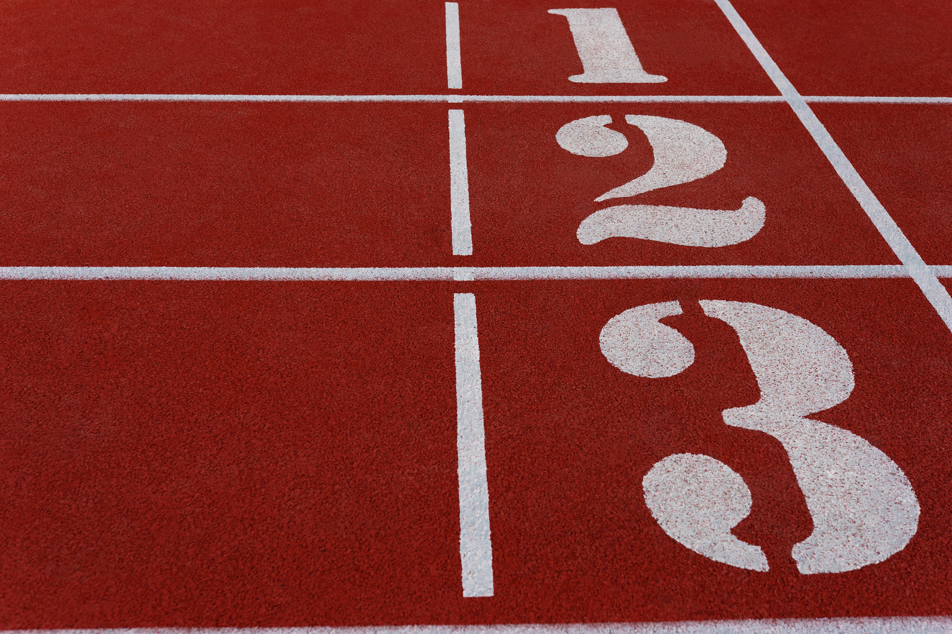

NEWTON'S THREE LAWS OF MOTION
2.1 LEVER SYSTEMS
Newton's Three Laws of Motion
The Law of Inertia
The Law of Acceleration
The Law of Action/Reaction

Slide 4
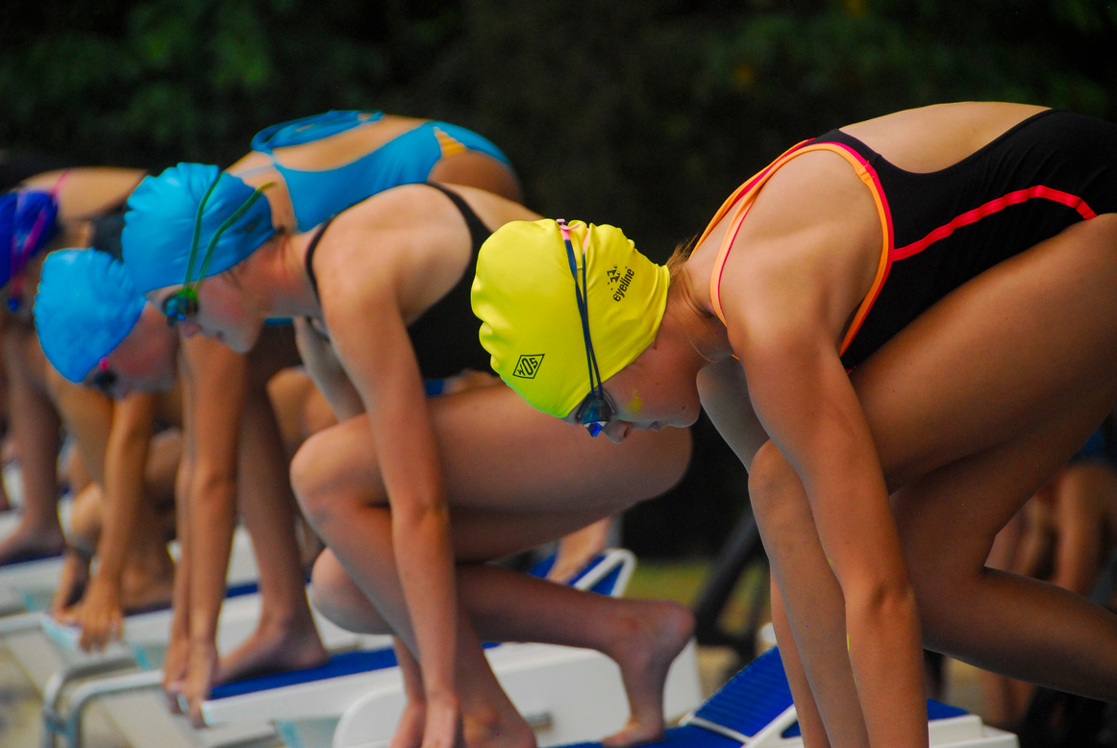
FIRST LAW- THE LAW OF INERTIA
‘Unless acted upon by an external force, an object at rest remains at rest, or if in motion, it continues to move in a straight line with constant speed.’
Example: An object at rest
A swimmer (the object) stood on the blocks before a race is stationary (at rest). They will remain stationary until there is an act of force.
Booklet
Page 3
In this example what provides the external force for motion?

Slide 5



FIRST LAW- THE LAW OF INERTIA
When diving through the air:
When in the water:
Swimmer
Water
resistance
Forward motion from legs kicking
The swimmer begins at a constant pace.
The resistance of the water slows them down.
Booklet
Page 3

Slide 6
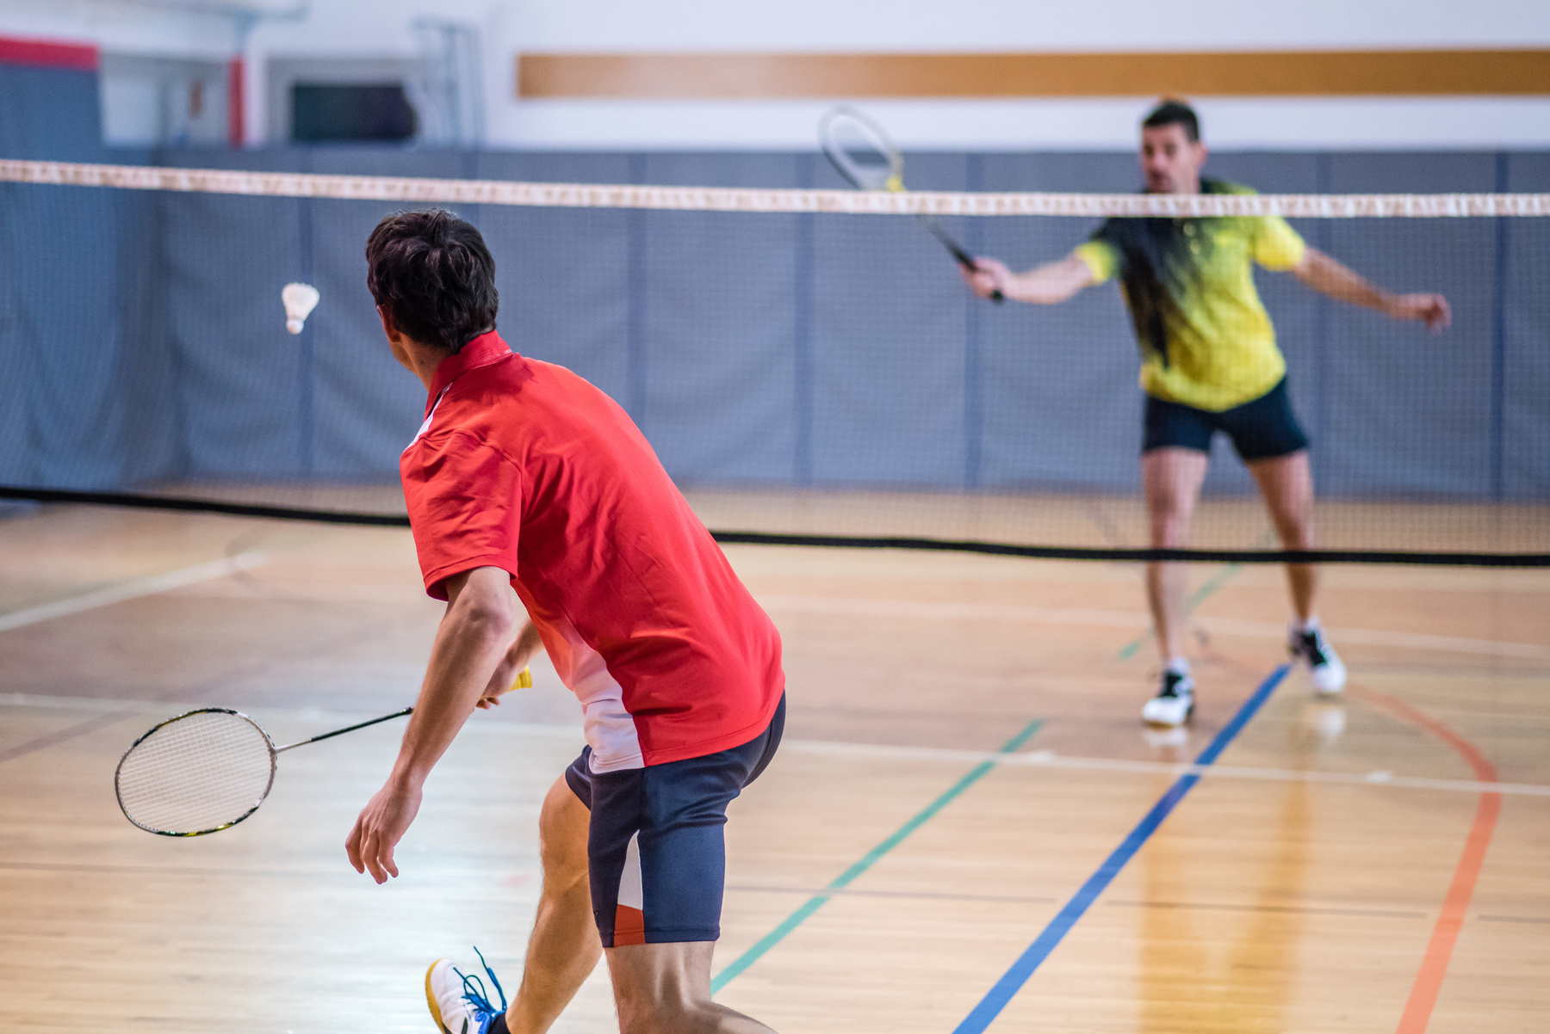
FIRST LAW- THE LAW OF INERTIA
Example: An object in motion
In badminton, Newton’s First Law explains how a shuttlecock travels through the air following a smash shot...
1 | The external force from the arm holding the racket acts on the shuttlecock.
2 | The shuttlecock will accelerate and then remain at a constant speed.
3 | The force which changes this is air resistance, which will act against the shuttlecock and slow it down.
4 | The force of air resistance will eventually bring the shuttlecock to a stop.

Slide 7

THE LAW OF INERTIA- RECAP
Use the words below to fill in the gaps to describe Newton's First Law of Motion
curved rest changing
constant straight
external added inertia
‘_______ is the force required to change the state of motion. Unless acted upon by an _______ force, an object at ______ remains at rest, or if in motion, it continues to move in a ________ line with _______ speed.’

Slide 8
THE LAW OF INERTIA- RECAP
Use the words below to fill in the gaps to describe Newton's First Law of Motion
curved rest changing
constant straight
external added inertia
‘Inertia is the force required to change the state of motion. Unless acted upon by an external force, an object at rest remains at rest, or if in motion, it continues to move in a straight line with constant speed.’

Slide 9
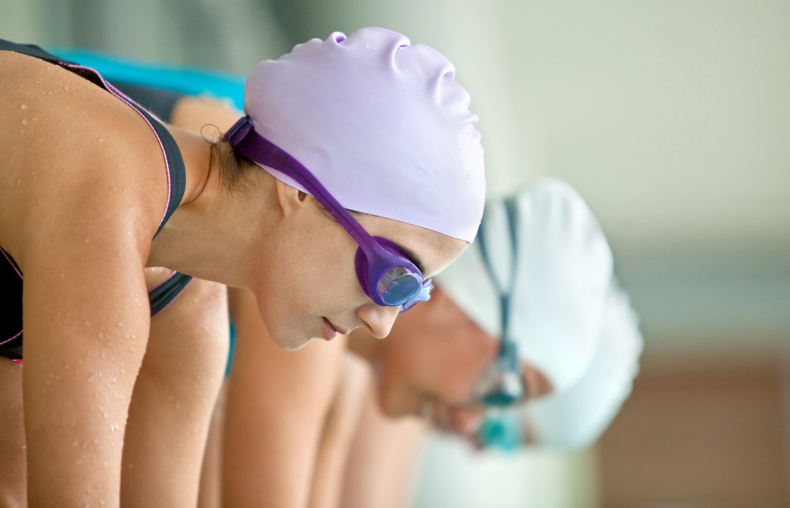

SECOND LAW- THE LAW OF ACCELERATION
Newton's Second Law of Motion States:
‘A force upon an object causes it to accelerate according to the formula: Force = Mass x Acceleration’.
Considering the same swimmer on the blocks, their mass remains constant. This means that the degree of acceleration is determined by the size of the force produced by exertion of their muscles.
Booklet
Page 4
Can you use Newton’s Second Law of Motion to explain how a 100m sprinter starts a race?

Slide 10
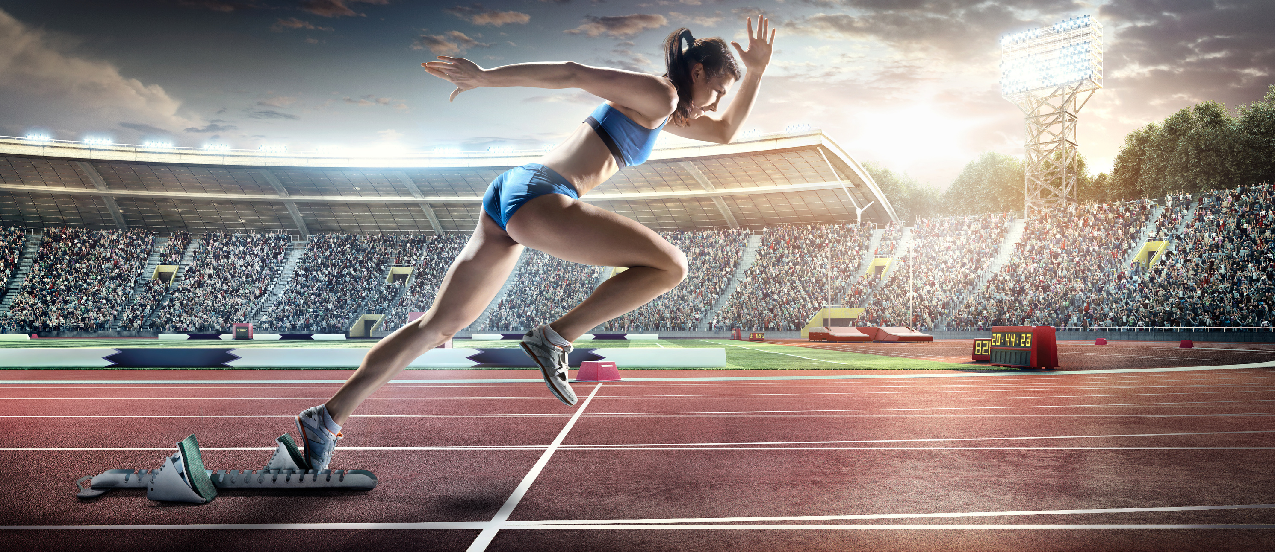
SECOND LAW- THE LAW OF ACCELERATION
Force,
Newtons
F
Use the formula triangle to calculate what force (in newtons) will be applied when a sprinter weighing 80 kg accelerates out of the blocks at 8.5 m/s
M
A
Mass, Kg
Acceleration,
m/s/s
Booklet
Page 4

Slide 11
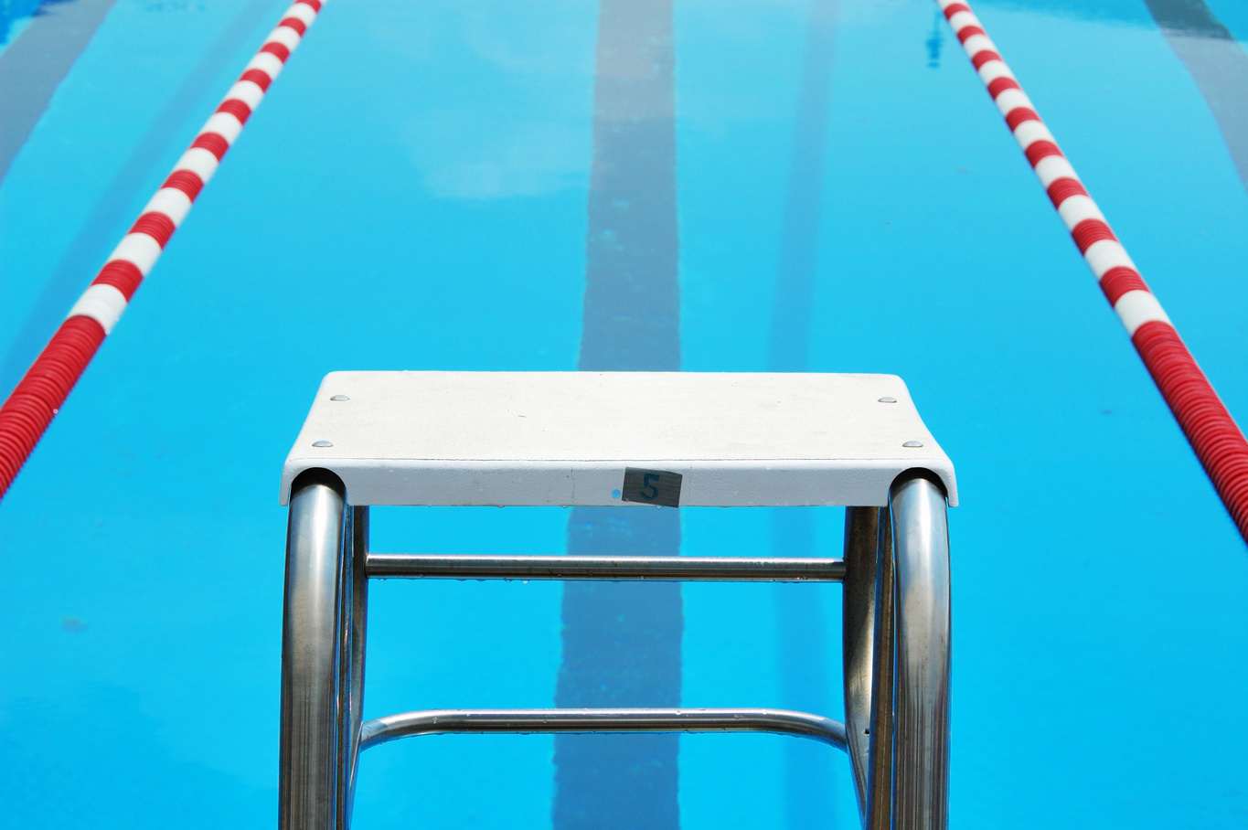
THIRD LAW- THE LAW OF ACTION/REACTION
Newton's Third Law of Motion States:
‘for every action (force) there is an equal and opposite reaction’
Once again consider the swimmer standing on the blocks.
To generate force for their initial movement they push back very hard into the block.
The block also pushes back a force against the swimmer 'equal' in size, and 'opposite' in direction.
This allows the swimmer to dive into the water.

Slide 12
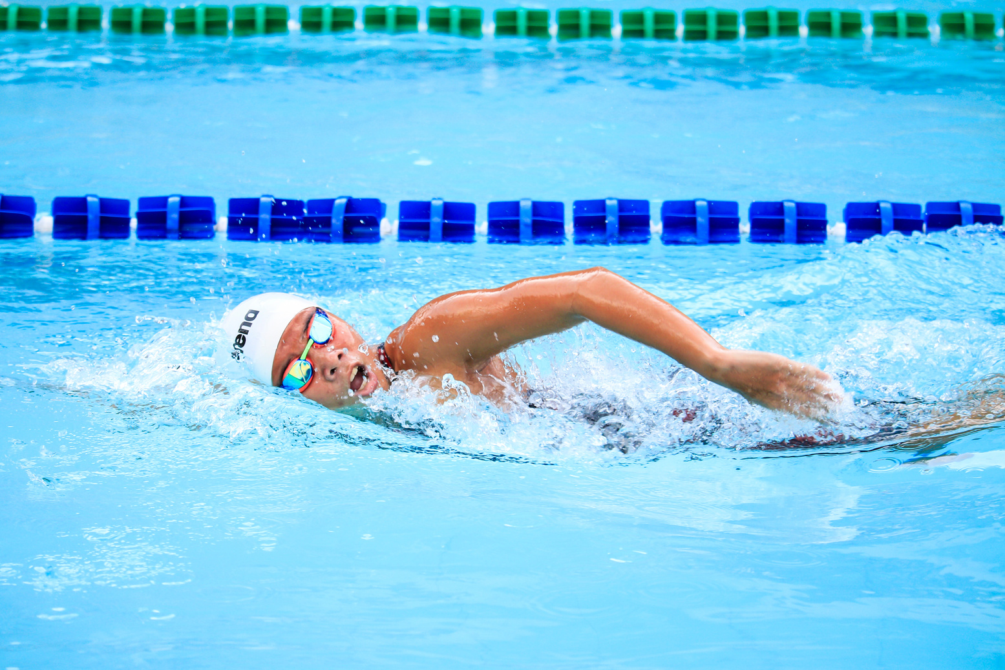
THIRD LAW- THE LAW OF ACTION/REACTION
Now the athlete is in the water they begin to swim. Newton's Third Law still applies:
Action- Drawing back their hand in the water
Reaction- The water pushing against the swimmer
Result- Swimmer is pushed forwards
Using Newton’s Third law of Motion, discuss how:
a) A 100m sprinter generates acceleration from the start line
b) A tennis player produces a powerful forehand shot
Booklet
Page 5

Slide 13
SCALARS & EQUATIONS
Distance,
m
D
A scalar quantity describes a measurement in size or magnitude without taking into account direction.
S
T
You must be able to work out the scalars speed, distance and time which is easily done using this formula triangle
Speed, m/s
Time, s
Booklet
Page 6

Slide 14
SCALARS & EQUATIONS
The key to the units is always given in the question. Fill in the missing units in the table.
You must keep the units the same throughout your workings out.
For example:
A formula one driver has travelled at a speed of 150 miles per hour for 25 minutes. What distance have they covered?
Distance | Time | Speed
________ | Seconds | Metres per second
Kilometres | Hours | _________
Miles | Minutes | __________
HINT: To keep the units the same you must convert 25 minutes to hours. (25/60 = 0.416 hours)
Booklet
Page 7

Slide 15

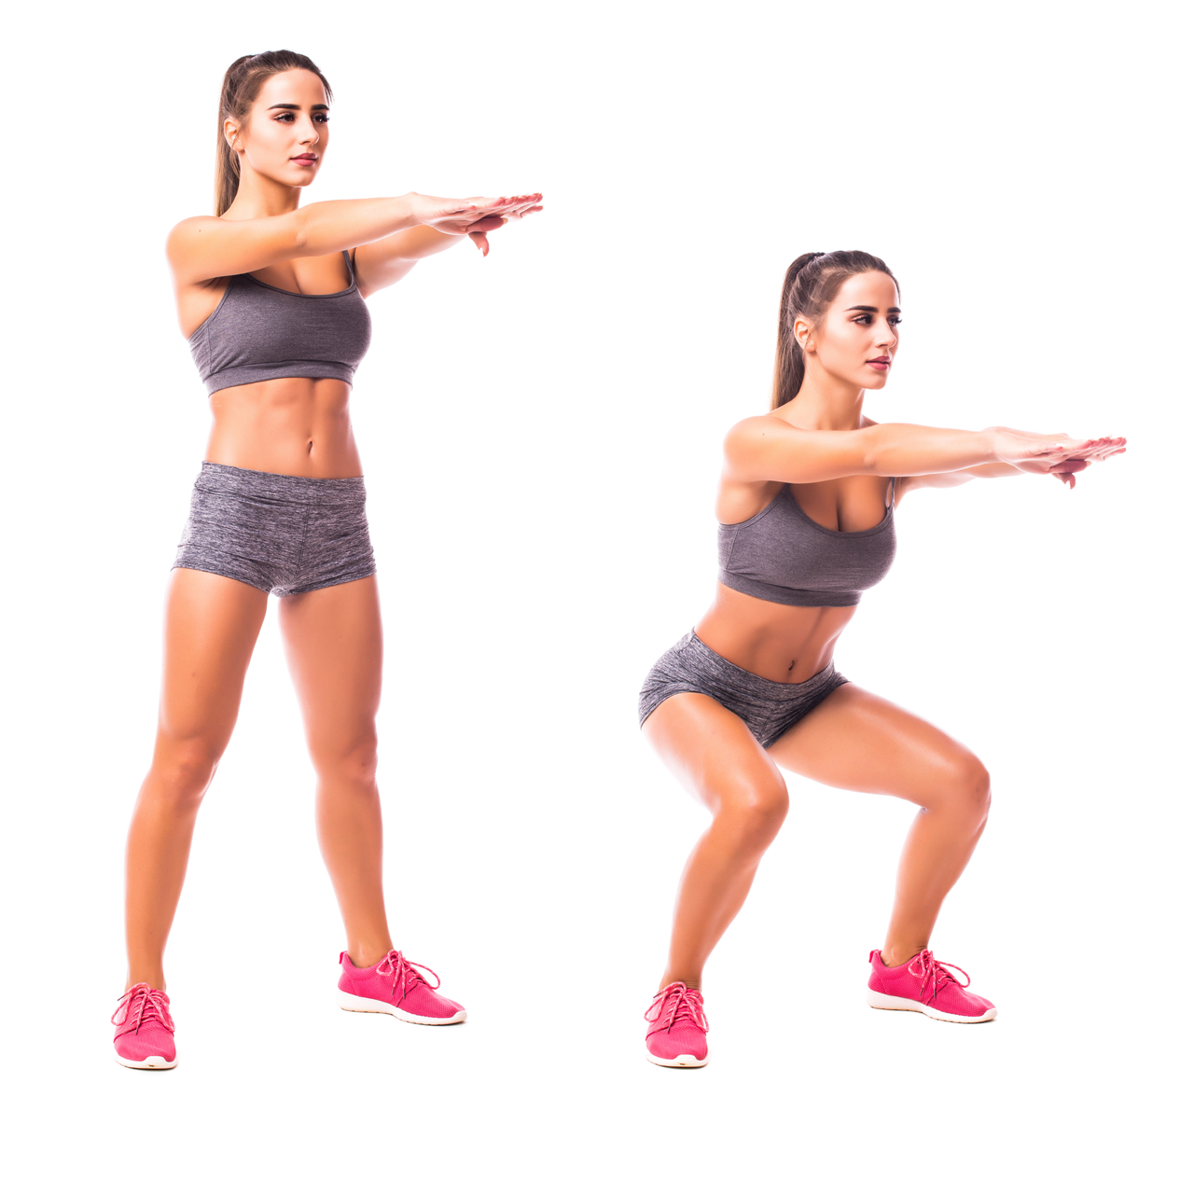
CENTRE OF MASS (COM)
The COM of an object is where its mass is considered to be concentrated.
It can be defined as ‘the point of balance’.
A person's COM differs depending on their height, weight, muscle mass and body shape.
Our centre of mass also changes when we alter our position which happens frequently in sport.
Key: Red Dot = COM
Note how the athlete's COM changes as they change positions

Slide 16
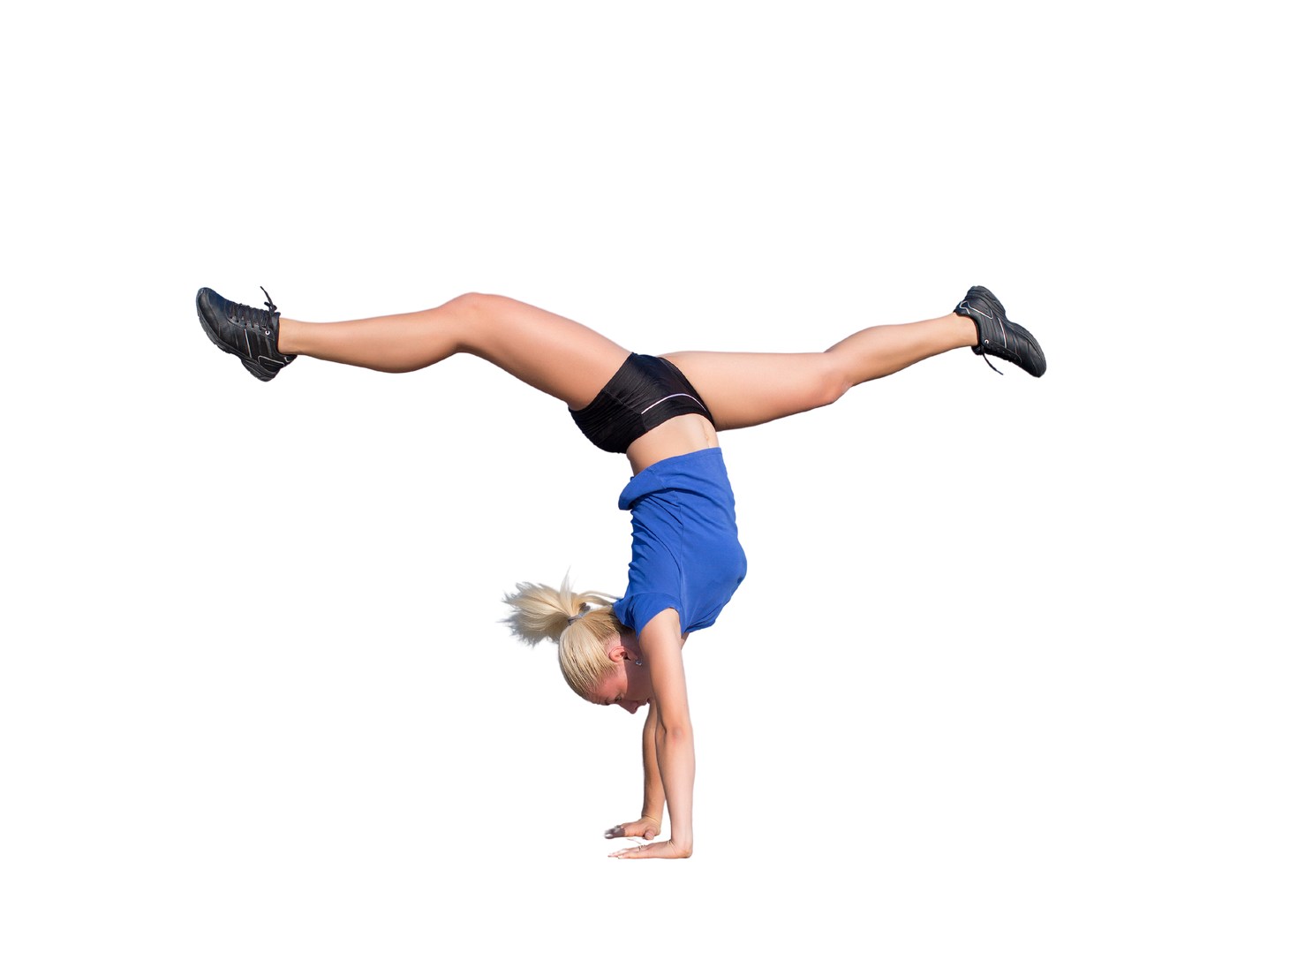
STABILITY
  The Height of the COM
Lowering the centre of mass will increase stability
2. Area of Base of Support The more contact points a performer has, the more stable they will become
The four factors that affect stability
3. Position of the Line of Gravity
This should be central over the base of support
4. Mass of the Performer
The greater the mass, the more stable a performer will become

Slide 17



STABILITY
Put these objects in order from least stable to most stable and discuss why you've chosen them
15 kg
10 kg
30 kg
Key:
= Line of
Gravity
= COM

Slide 18
STABILITY
Put these objects in order from least stable to most stable and discuss why you've chosen them
Least Stable
Most Stable
10 kg
15 kg
30 kg
Low mass
Small contact point
Line of gravity lies outside the base of support
Highest mass
Highest base area
Line of gravity lies centrally in the base of support

Slide 19
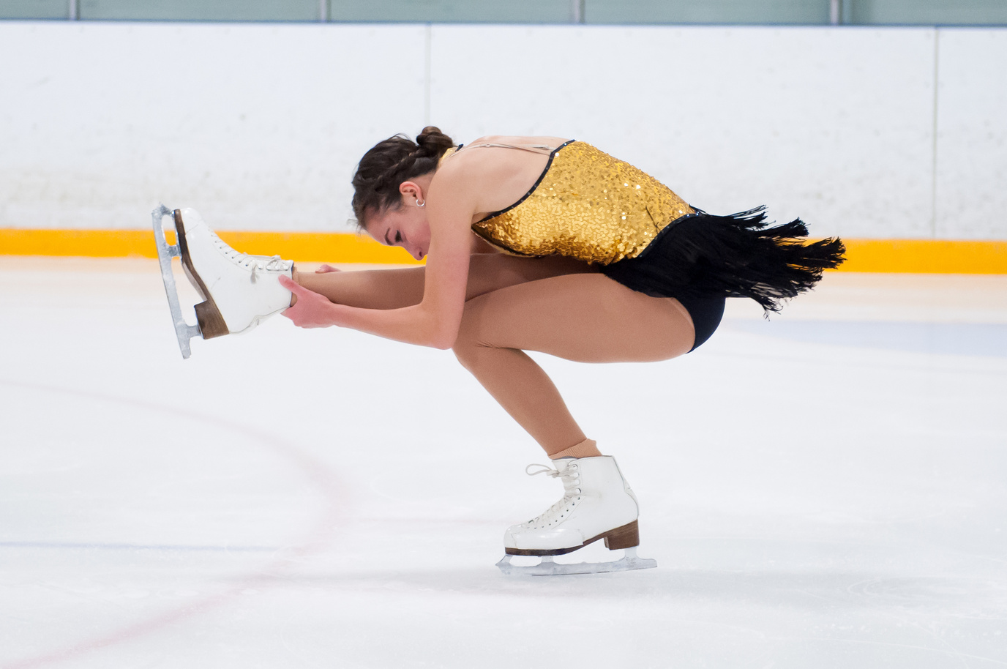


2.2 LEVERS
thepeclassroom.com

Slide 20
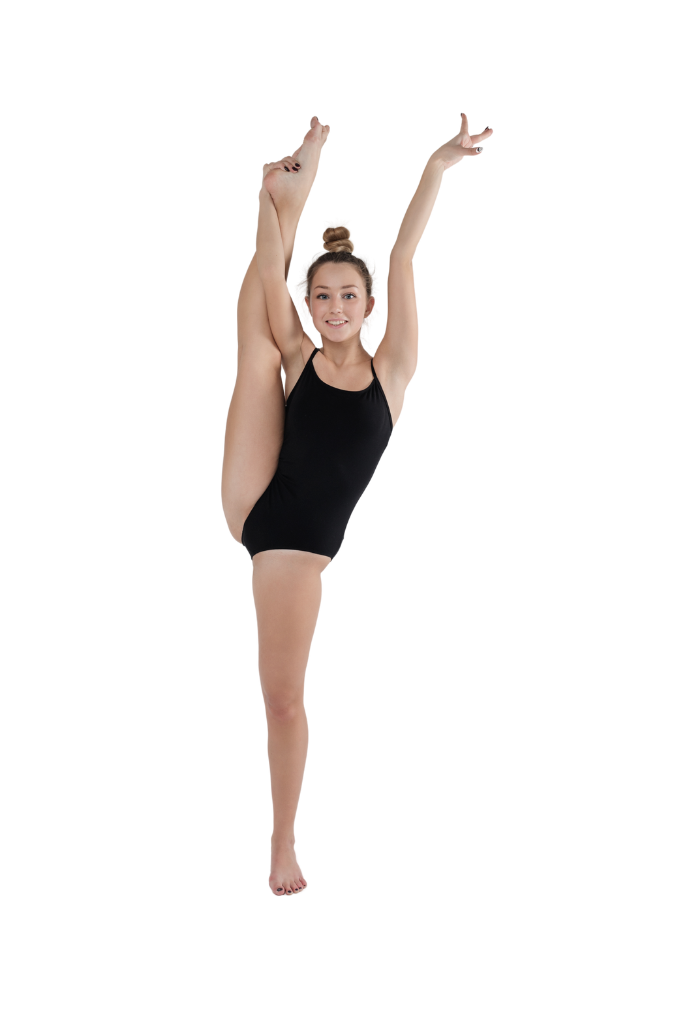
LEVER SYSTEMS
Lever Systems allow movement to take place in our body.
Every lever has 3 components. Use the words below to fill in the gaps.
force axis move
lever rotates force
Fulcrum – The ______ around which the lever _______
Load – The _______ of the thing that you want to _______
Effort – The _______ that is applied by the user of the ________ system
Booklet
Page 9

Slide 21
LEVER SYSTEMS
Fulcrum – The axis around which the lever rotates
Load – The force of the thing that you want to move
Effort – The force that is applied by the user of the lever system
How can joints within the body be referred to as levers?
Which part of the joint generates the force required for movement?
Booklet
Page 9

Slide 22
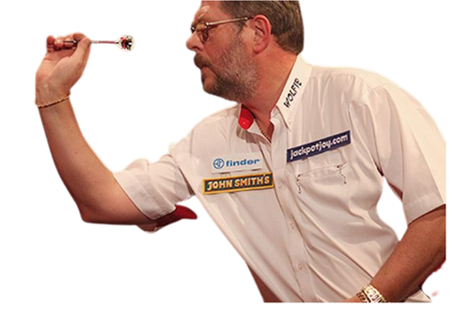
LEVER SYSTEMS
Think about a darts player throwing a dart. What is the….
Fulcrum: ___________________
Load: ______________________
Effort: _______________________
Booklet
Page 10

Slide 23
LEVER SYSTEMS
Think about a darts player throwing a dart. What is the….
Fulcrum: Elbow
Load: Dart
Effort: Tricep
Booklet
Page 10

Slide 24
DIFFERENT CLASSES OF LEVER SYSTEMS
Lever Systems can be classed as 1st class, 2nd class or 3rd class. The class of a Lever System depends on what can be found in the middle.
1st Class = Fulcrum in the Middle
1.2.3.
F.L.E
2nd Class = Load in the Middle
3rd Class = Effort in the Middle
Booklet
Page 10

Slide 25
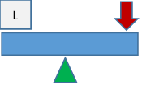
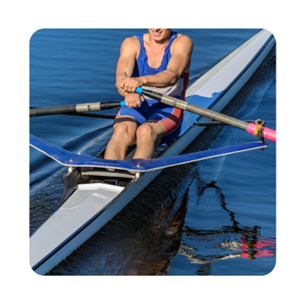
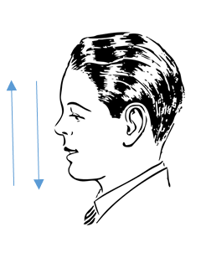
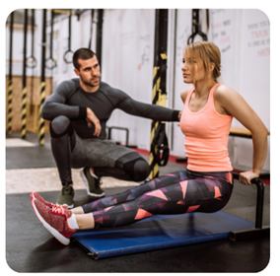
FIRST CLASS LEVER SYSTEMS
Rowing
Load - Water
Fulcrum - Top of Oar
Effort - Biceps
Nodding your Head
Load - Weight of the head through the chin
Fulcrum - The joint at the top of the neck
Effort - The muscles at the bottom of the neck
Tricep Dip
Load - Body weight through the hands
Fulcrum - Elbow
Effort - Triceps
Fulcrum in the Middle
Booklet
Page 11

Slide 26
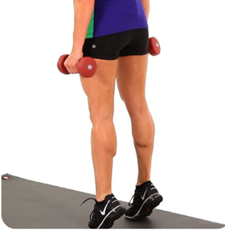
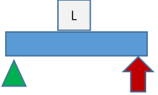
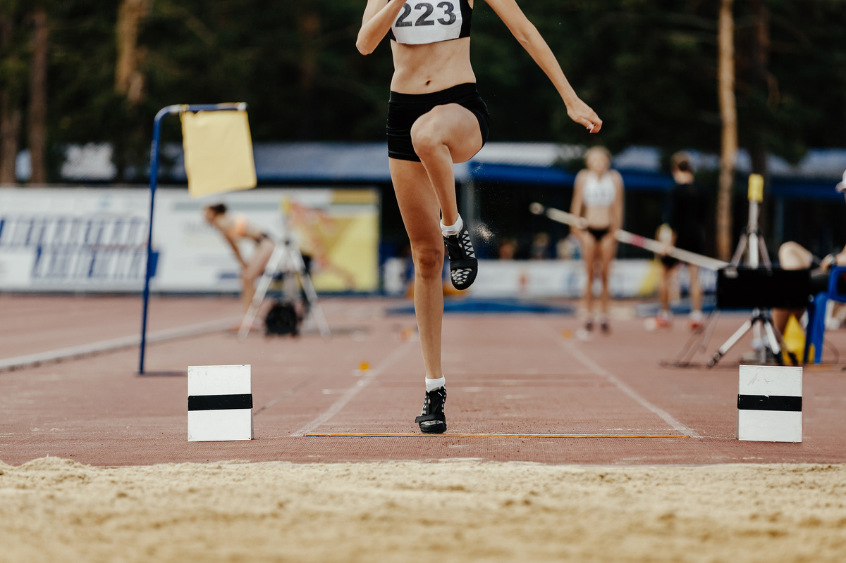
SECOND CLASS LEVER SYSTEMS
Calf Raise
Fulcrum - Balls of the Feet
Load - Bodyweight through the centre of the foot
Effort - Gastrocnemius
Load in the Middle
Taking off during the long jump requires the same lever system as a calf raise
Booklet
Page 21

Slide 27
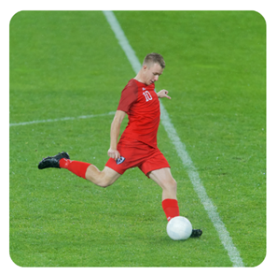
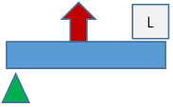
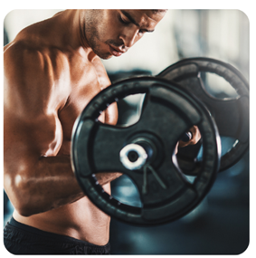
THIRD CLASS LEVER SYSTEMS
Kicking a Ball
Fulcrum - Knee
Effort - Quadriceps
Load - Ball
Bicep Curl
Fulcrum - Elbow
Effort - Biceps
Load - Dumbbell/Barbell
Effort in the Middle
Booklet
Page 13

Slide 28
MECHANICAL ADVANTAGE/DISADVANTAGE
Lever Systems can be seen to have a mechanical advantage or a mechanical disadvantage.
Mechanical Advantage = Effort Arm ÷ Load Arm.
Mechanical Advantage
Mechanical Disadvantage
When a large load can be lifted with relatively little effort.
When it takes a lot of effort to lift a relatively small load.
Booklet
Page 14

Slide 29



MECHANICAL ADVANTAGE/DISADVANTAGE
A Second Class Lever System will always have a mechanical advantage due to the effort arm being longer than the load arm.
Load arm
Effort arm
Load arm- sits between the load and the fulcrum
Effort arm- sits between the effort and the fulcrum
Booklet
Page 14

Slide 30
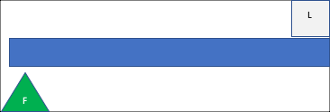
MECHANICAL ADVANTAGE/DISADVANTAGE
A Third Class Lever System will always have a mechanical disadvantage due to the load arm being longer than the effort arm.
Effort arm
Load arm
Load arm- sits between the load and the fulcrum
Effort arm- sits between the effort and the fulcrum
Booklet
Page 15

Slide 31
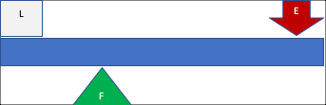
MECHANICAL ADVANTAGE/DISADVANTAGE
A First Class Lever System may have a mechanical advantage or a mechanical disadvantage depending on the length of the effort arm in relation to the resistance arm.
Effort arm
Load arm
In this example the effort arm is longer than the load arm, producing a mechanical advantage.
Booklet
Page 16
Remember: Mechanical Advantage = Effort Arm ÷ Resistance Arm

Slide 32
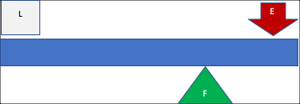
MECHANICAL ADVANTAGE/DISADVANTAGE
However, in this First Class Lever example the load arm is longer than the effort arm, producing a mechanical disadvantage.
Load arm
Effort arm
Load arm- sits between the load and the fulcrum
Effort arm- sits between the effort and the fulcrum
Booklet
Page 16
Remember: Mechanical Advantage = Effort Arm ÷ Resistance Arm

Slide 33
MECHANICAL ADVANTAGE/DISADVANTAGE
Class of Lever System
Advantage
Disadvantage
1st Class
Mechanical Advantage - A large load can be lifted with relatively little effort
Slower Movement
Mechanical Advantage - A large load can be lifted with relatively little effort
2nd Class
Slower Movement
Mechanical Disadvantage - large effort is needed to lift a relatively small load
3rd Class
Fast Movement

Slide 34
QUESTIONS
Using Newton’s First Law, as well as your knowledge of the neuromuscular system, analyse how a long jumper is able to begin their movement for a run up (2)
A volleyball player has been told that they are unstable whilst playing a set shot. Explain two ways that they can increase their stability whilst playing this shot (2)
A bicep curl is an example of which type of lever system? (1)
Give one advantage and one disadvantage of the lever system used when performing a bicep curl (2)

